Slide 1
Jardin’s Principle

Slide 2
Understanding
Simplistic
Simple
Complicated

Slide 3
Understanding
Observations
Simplistic
Profound
Obvious
Simple
Sophisticated
Complicated

Slide 4
Jardin’s Principle
Wine-tasting
LAW
Relationships
Business
Brexit
Music
Communication
Maths

Slide 5
Jardin’s Principle: Complications
1
‘Simplistic-obvious’
or
‘Simple-profound’?

Slide 6
Quiz:
Guru or Gardener?
Water is needed by all living things
Edward de Bono (thinking guru)
b) Remember to sharpen the saw
Stephen Covey (business guru)
c) When planning a pavement, think about the drainage
Eric (the bloke who did my garden)

Slide 7
Jardin’s Principle: Complications
2
‘Complicated-Sophisticated’
believe they’re top level

Slide 8
She Loves You’ - The Beatles
“…with its duple metre, almost hypnotic beat, pentatonic melody, 32-bar song form and tonic-mediant tonal relationship, its text concerns adolescent love and has a quasi-ritualistic ‘yeah, yeah, yeah’ refrain.”
Grove Dictionary of Music

Slide 9
Jardin’s Principle: Complications
3
You are probably wrong
about the level you’re at

Slide 10
Jardin’s Principle: Complications
4
It’s hard to get to LEVEL 3
without going through
LEVELS 1 and 2 first.

Slide 11
Jardin’s Principle: Complications
5
Without profound understanding, we tend to
over-simplify
or
over-complicate

Slide 12
Jardin’s Principle: Complications
6
Jardin’s Principle
is self-referential

Slide 13
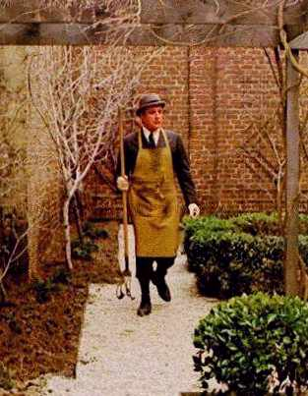
Jardin’s Principle
Simplistic
Complicated
Simple

Slide 14
Stigler’s Law
No scientific discovery is named after the person who first discovered it.

Slide 15
Jardin’s Principle
www.RobEastaway.com/blog/jardin-principle

Slide 16
