Slide 1
DeuxNuts
Maths of the Mk3 trick thread

Slide 2
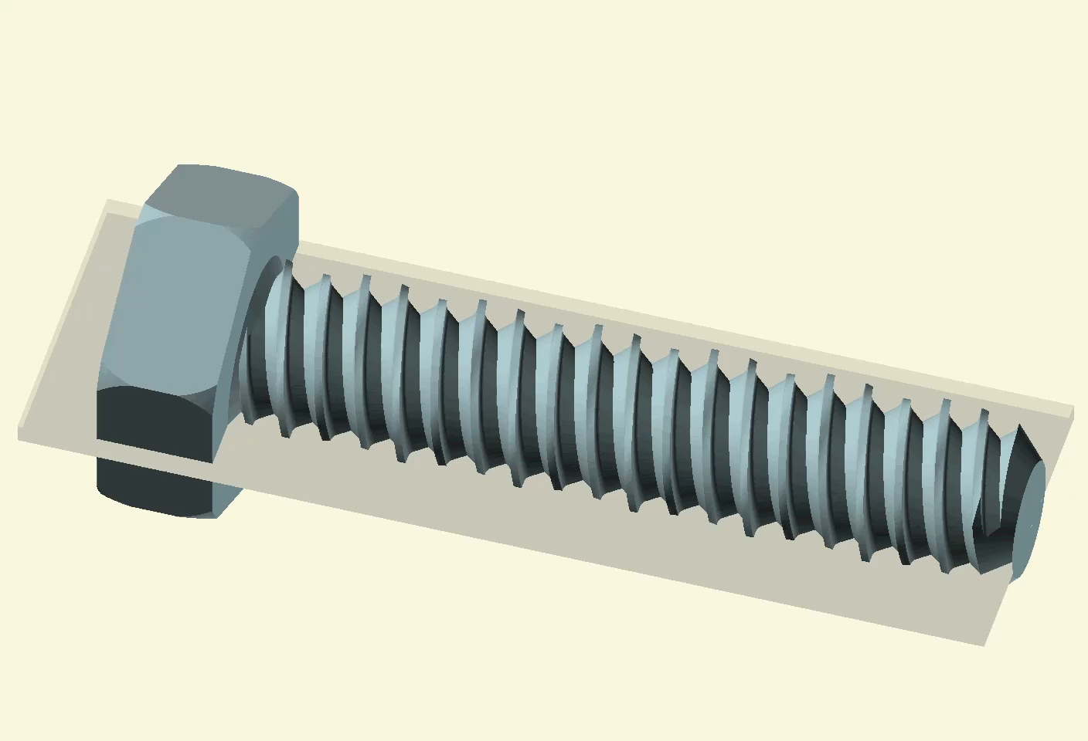
All slides view a slice through bolt
(But no bolts were harmed)

Slide 3
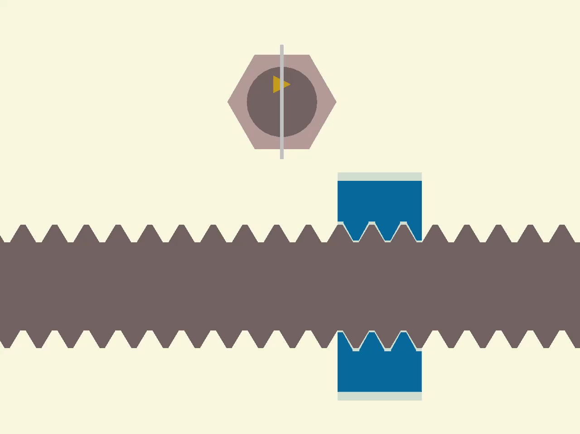
Start with ordinary nut and bolt threads

Slide 4
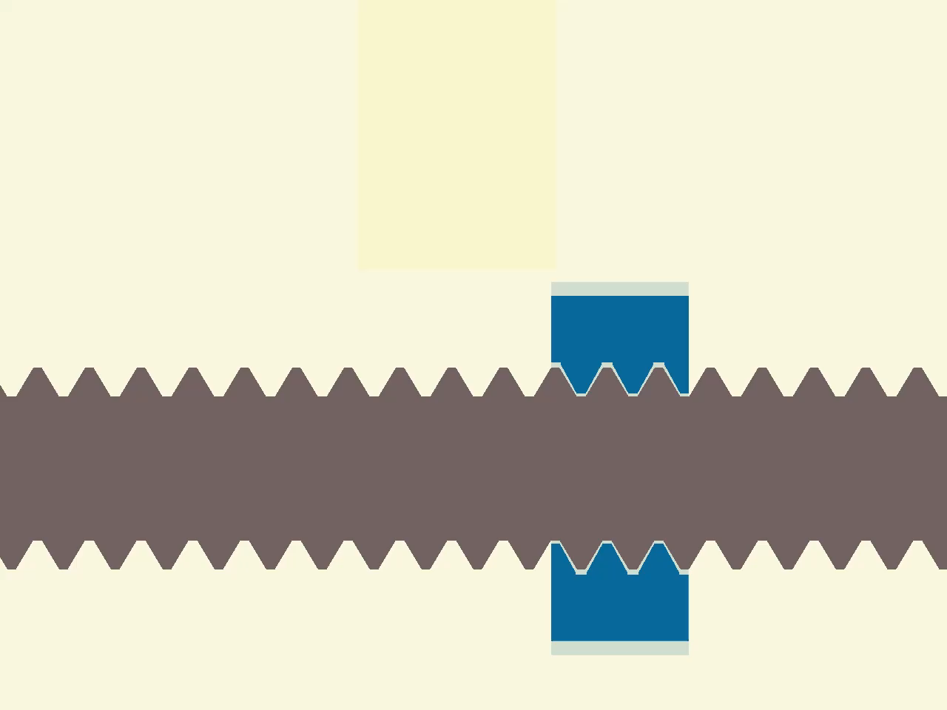
Cut notches into blue ‘normal’ nut

Slide 5
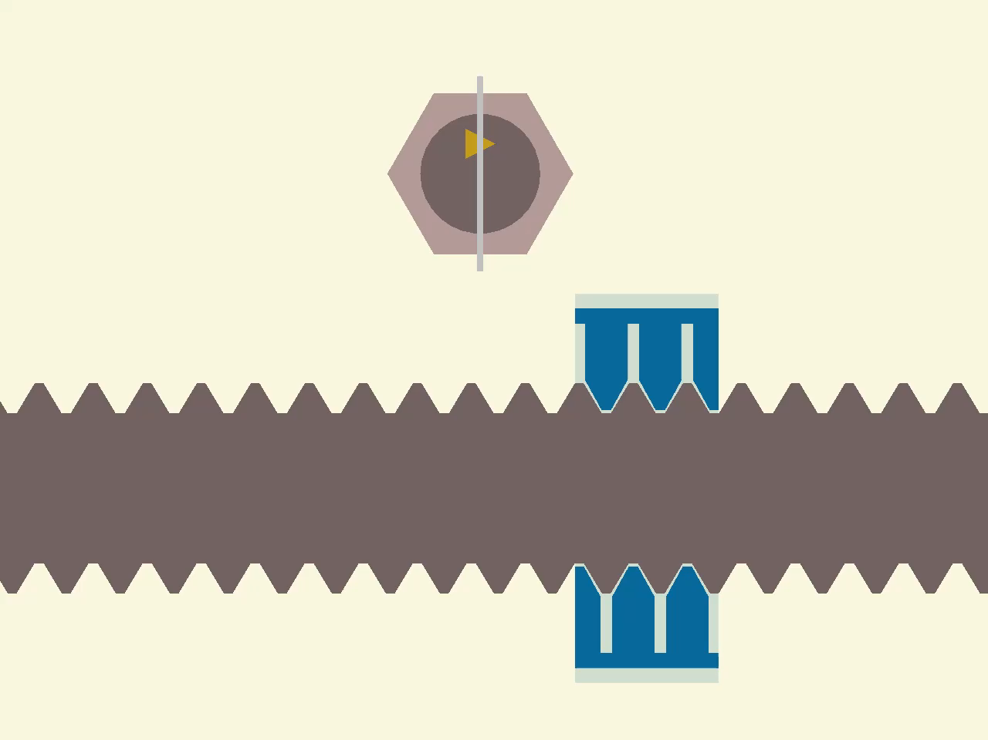
Notched nut still works normally

Slide 6

Extend ridges atop threads

Slide 7
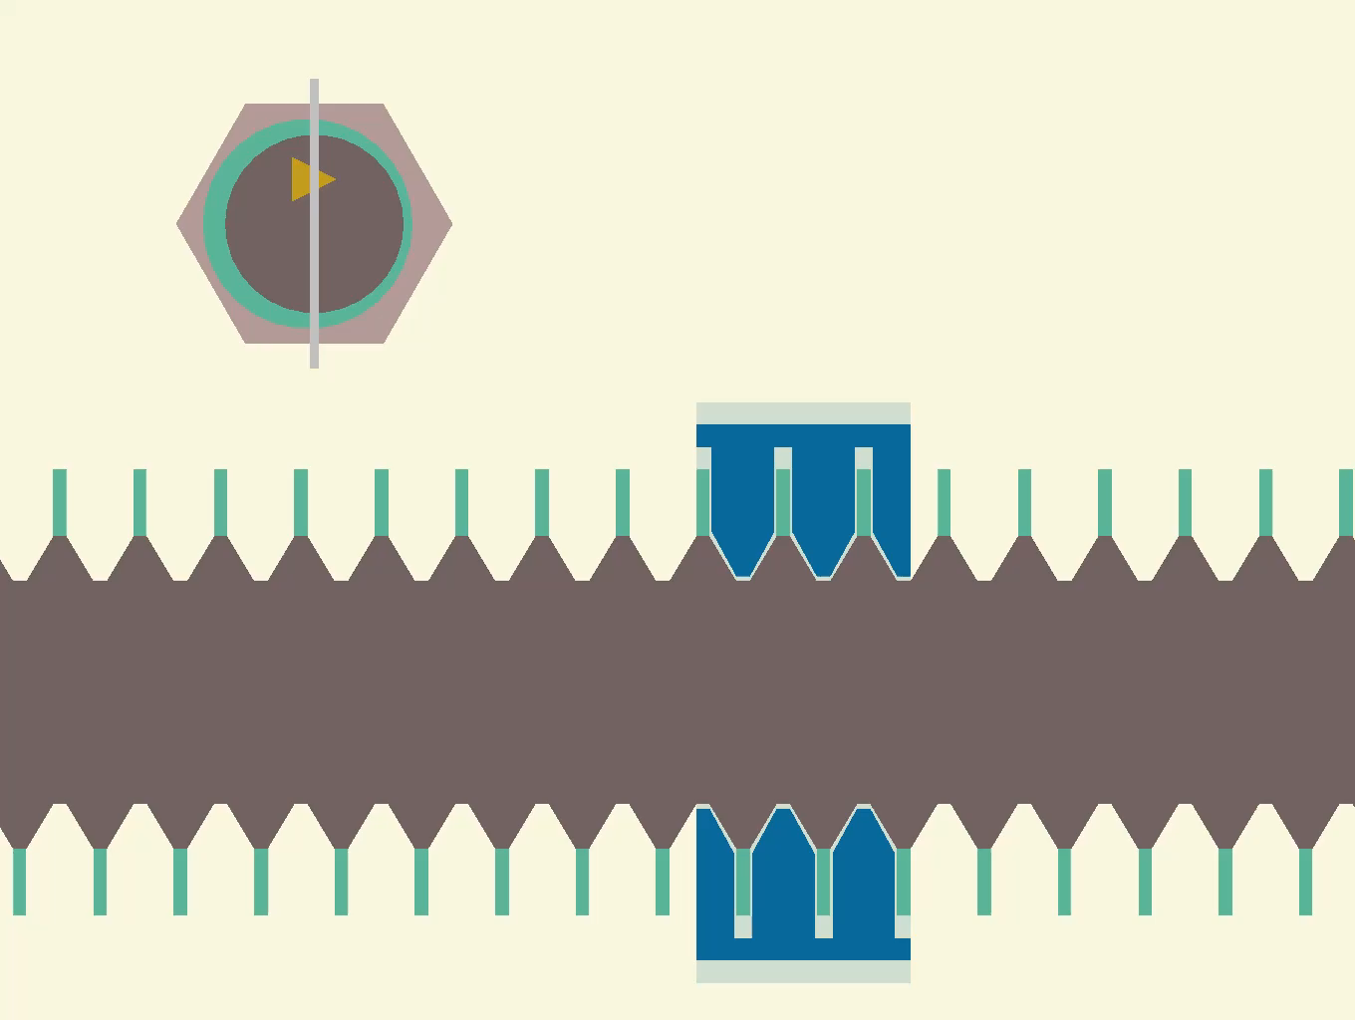
Ridges of all heights pass through notched nut

Slide 8
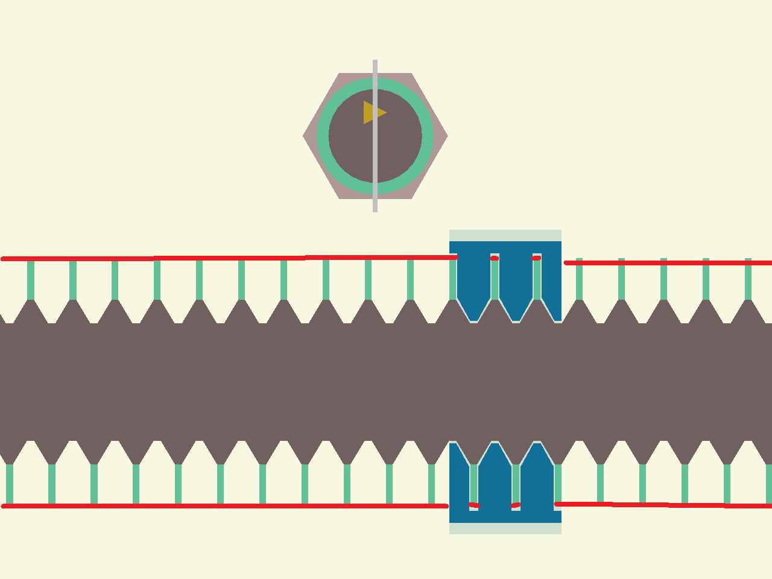
So, why keep all ridges at the same heights?

Slide 9
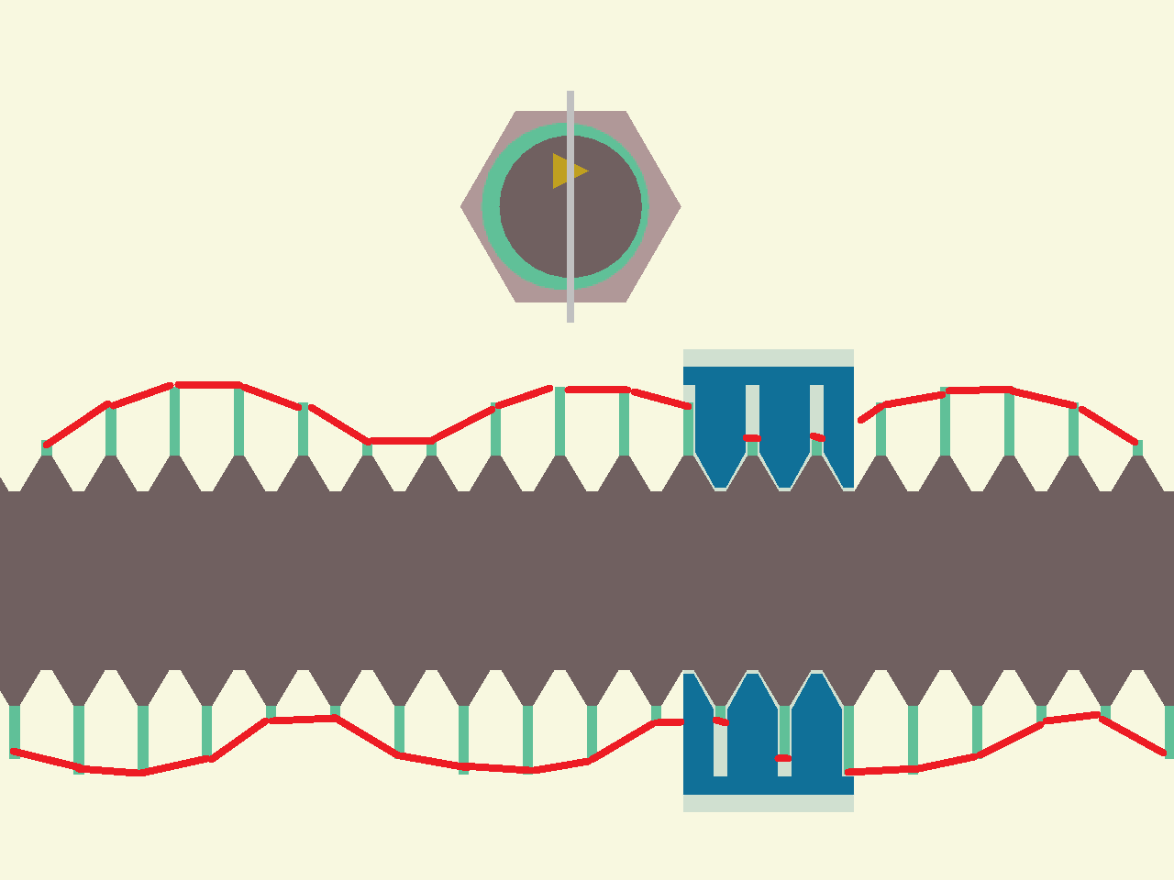
Modulate ridge heights by sin –⅓Θ

Slide 10
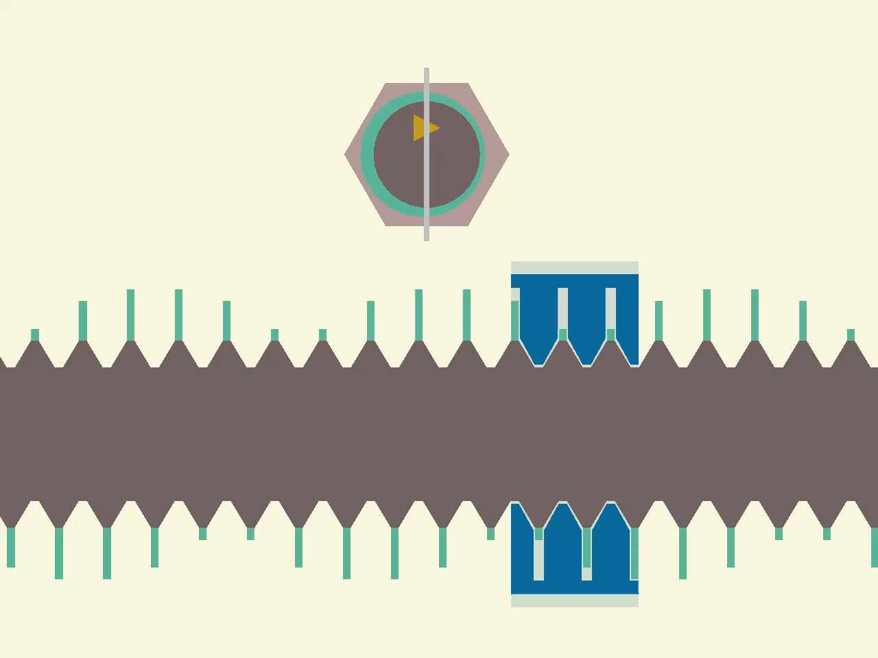
Ridges modulate waves in reverse direction

Slide 11
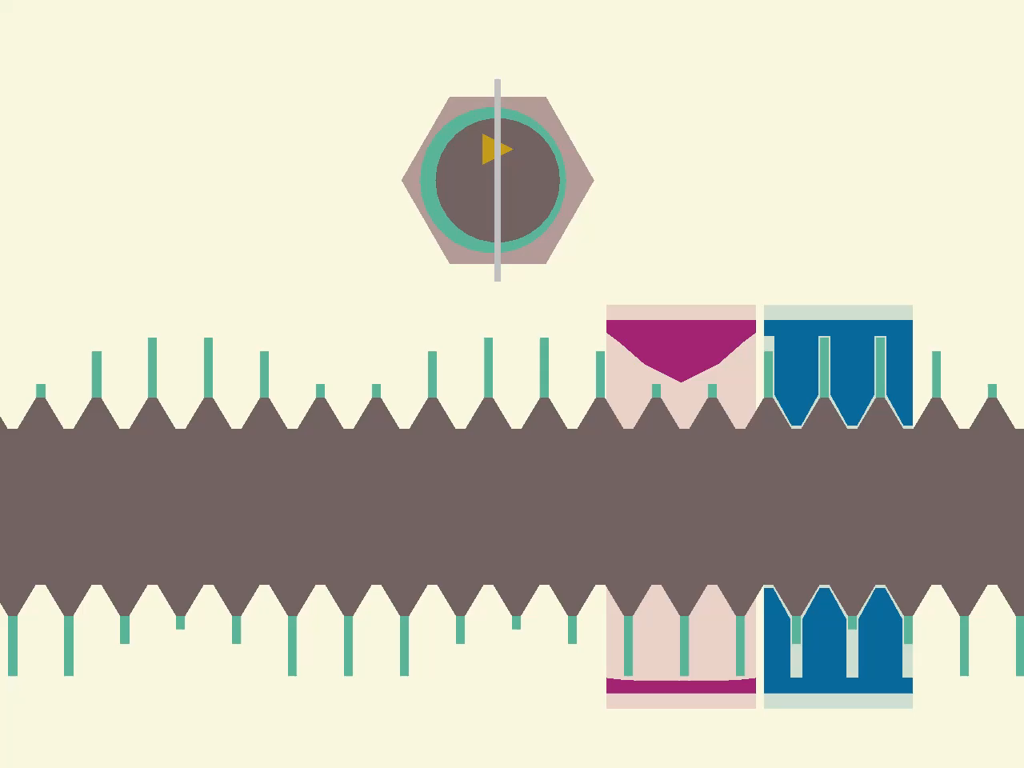
Build red nut that rides waves atop ridges

Slide 12
Red nut rides waves moving left,
Blue nut follows threads moving right

