Slide 1
An Unappreciated Result and a Folding Puzzle
Martin Harris, Online MathsJam Conference 2020

Slide 2
The Unappreciated Result
P + Q + R = 180°
P + Q = 180° - R
tan( P + Q ) = tan( 180° - R )
tan(P) + tan(Q) = -tan(R)
1 - tan(P).tan(Q)
tan(P) + tan(Q) = -tan(R) + tan(P).tan(Q).tan(R)
tan(P) + tan(Q) + tan(R) = tan(P).tan(Q).tan(R)

Slide 3
The Folding Puzzle (I)
Take a square of paper, and fold from the midpoint of the top to the bottom left corner. What is the ratio of the sides of the triangle below this line?
?
Hat tip to Martin Whitworth, who first showed me this on an online MathsJam

Slide 4
The Folding Puzzle (II)
Now fold the bottom right corner up to meet the other corner. How far up the right hand side is the point where the fold hits?
?

Slide 5
Back to the Formula
tan(P) + tan(Q) + tan(R) = tan(P).tan(Q).tan(R)
IF R = 45°, tan(R) = 1, and the formula can be rearranged to express tan(Q) in terms of tan(P):
tan(P) + tan(Q) + 1 = tan(P).tan(Q)
tan(P) + 1 = [tan(P) – 1] .tan(Q)
tan(Q) = tan(P) + 1 tan(P) – 1

Slide 6
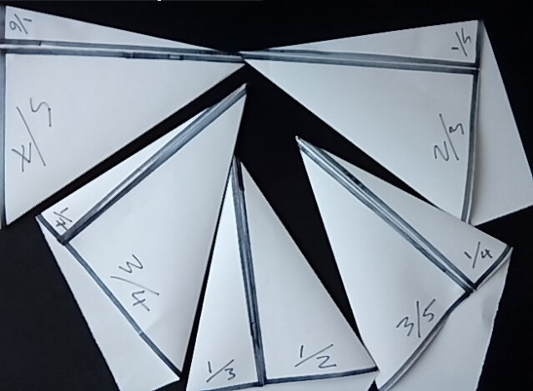
Other Examples
?

Slide 7
End
@MarHarStar
tan(Q) for your time :)

