Slide 1
A method for solving quadratic equations
Martin Whitworth
@MB_Whitworth

Slide 2

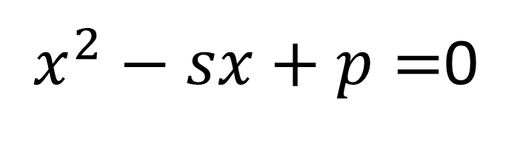

Consider a quadratic equation
y
$x^{2}−sx+p=$0
with roots a, b
(s,p)
(i.e. s is the sum of the roots and p is their product.)
Construct a circle with diameter (0,1), (s,p).
(0,1)
The x intercepts are the roots of the equation.
$$x=a$$
$$x=b$$
x

Slide 3


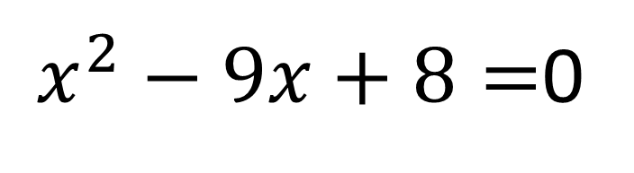

y
$x^{2}−sx+p=$0
$x^{2}−9x+8=$0
$$\begin{matrix}s=9 \\ p=8\end{matrix}$$
(s,p)
(9,8)
Roots are x=1, x=8
(0,1)
$$x=1$$
$$x=8$$
x

Slide 4
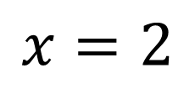
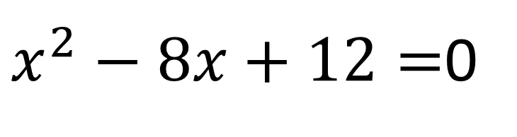

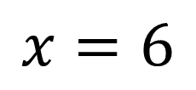
Another example
y
(8,12)
$x^{2}−8x+12=$0
$$\begin{matrix}s=8 \\ p=12\end{matrix}$$
Roots are x=2, x=6
(0,1)
x
$$x=2$$
$$x=6$$
x

Slide 5
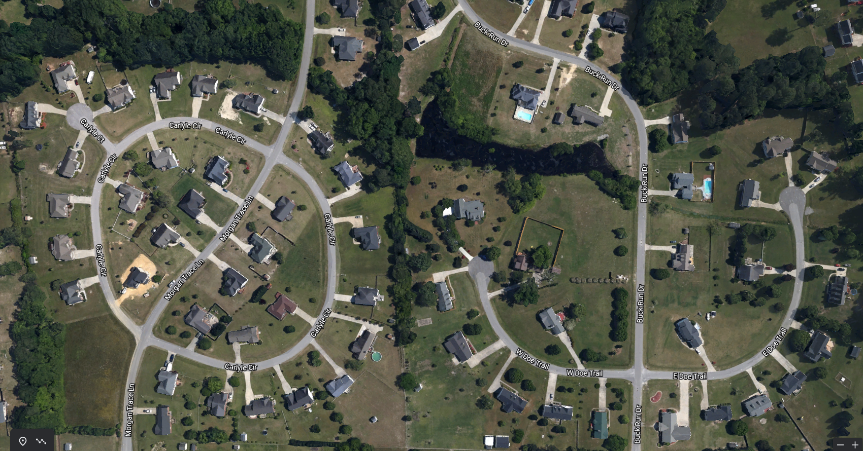
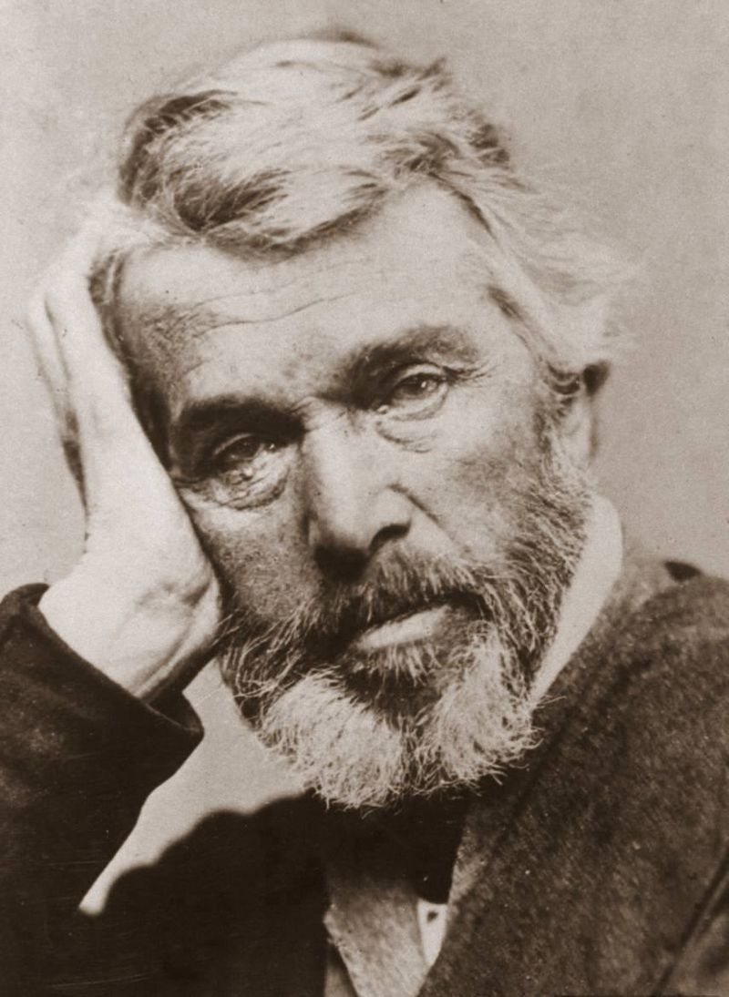
y
Carlyle Circle
Thomas Carlyle, 1795-1881
Scottish historian, writer, mathematician
His 1837 history of The French Revolution was the inspiration for Dickens’ A Tale of Two Cities
Coined the term “the dismal science” for economics
x
x
Carlyle Circle, Goldsboro, NC 27530, USA

Slide 6
Why does it work?
Circle with diameter (a,b),(c,d)
(x,y)
(x-c,y-d)
Vectors (x-a, y-b) and (x-c,y-d) meet at a right angle.
(x-a,y-b)
(c,d)
So their dot product is 0.
(a,b)
Formula for general point (x,y):
$$\left(x−a\right)\left(x−c\right)+\left(y−b\right)\left(y−d\right)=0$$

Slide 7
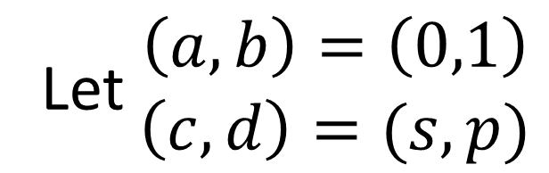
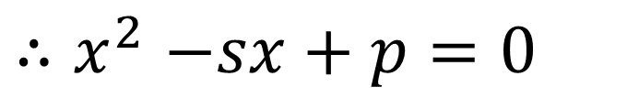
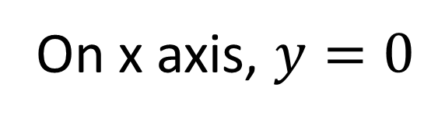
Applying it to the Carlyle circle
(x,y)
Let $\begin{matrix}\left(a,b\right)=\left(0,1\right) \\ \left(c,d\right)=(s,p)\end{matrix}$
(c,d)
=(s,p)
$$∴x\left(x−s\right)+\left(y−1\right)\left(y−p\right)=0$$
On x axis, $y=0$
(a,b)
$${∴x}^{2}−sx+p=0$$
=(0,1)
$$\left(x−a\right)\left(x−c\right)+\left(y−b\right)\left(y−d\right)=0$$
So the x intercepts are the roots of this equation

Slide 8
A geometrical proof
Given x intercepts A,B with x coordinates a,b
y
D
C
construct rectangle ABCD.
1
(s,p)
1
Given E with coordinates (0,1)
b
a
b
a
H
G
X
construct rectangle EFGH.
By symmetry, HX = b, XG = a, XC=1.
ab
ab
By the intersecting chord theorem,
BX × 1 = ab
E
F
1
b
So G has coordinates
s = HX+XG = b+a, p = BX = ab
a
A
B
x
So a circle with diameter EG, coordinates (0,1), (s,p) has x intercepts a,b.

Slide 9


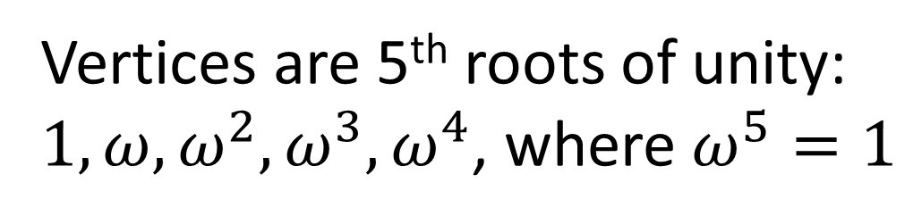
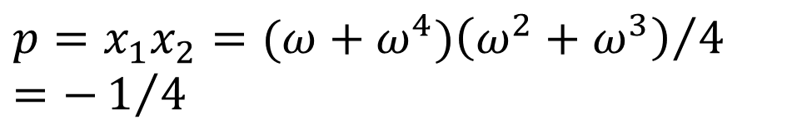

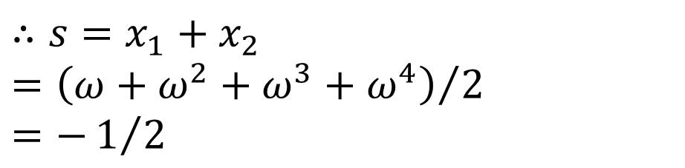

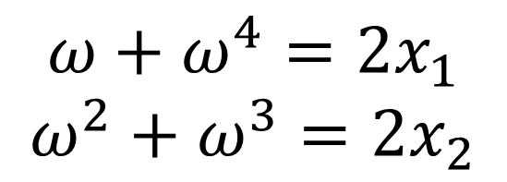


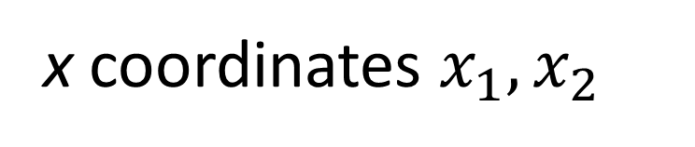


Let’s construct a regular pentagon in a circle
(0,1)
$$ω$$
Vertices are 5th roots of unity:
$1, ω, ω^{2},ω^{3},ω^{4}$, where $ω^{5}=1$
$$ω^{2}$$
x coordinates $x_{1},x_{2}$
$$ω+ω^{4}=2x_{1}$$
$$ω^{2}+ω^{3}=2x_{2}$$
1
$$x_{2}$$
$$x_{1}$$
$$x_{2}$$
$$x_{1}$$
$$∴s=x_{1}+x_{2}={\left(ω+ω^{2}+ω^{3}+ω^{4}\right)}/2$$
$$=−1/2$$
(s,p) = (-1/2, -1/4)
$$ω^{3}$$
$$p=x_{1}x_{2}={(ω+ω^{4})\left(ω^{2}+ω^{3}\right)}/4$$
$$=−1/4$$
$$ω^{4}$$
Notes:
More commonly, we construct 2x₁ and 2x₂ using (s,p) = (-1,-1) and then bisect to get x₁ and x₂, but what I’ve shown perhaps makes the principle clearer.

Slide 10
Construction of the regular heptadecagon (17-gon) is left as an exercise for the viewer.
But maybe the basis for some of the classic constructions will now be clearer.

