Slide 1

Disturbing Mandelbrot

Slide 2

Art first approach

Slide 3
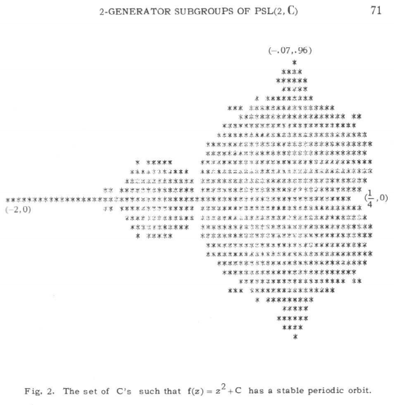

Algorithm
Complex plane
Favourite function $f(z)$
Take a point $c$, calculate $f(c)$ and add $c$.
Alternate: apply $f$ and add $c$.
If this sequence stays bounded: colour c.
Mandelbrot set: do that for squaring
(First ever published picture, 1978)

Slide 4


Any complex function will do (in theory)
$\sqrt{z}$ $→$ picture is the full plane
$z^{2.01}$ $→$ now we’re talking
Animation: Running the exponents from 1 to 5.
“multibrot”

Slide 5

Enter the dragon
Adding a linear term: $f(z)=z^{2}+tz$, for any real parameter $t$
animation, $t$ ranging from -4 to 4.
Project: Let’s make a 3d object and get it to the printer (-> Next year or tomorrow)

Slide 6
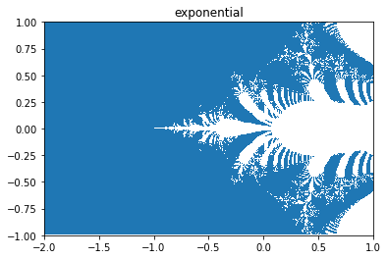


real fun $→$ complex fun
The python libraries come equipped with complex functions
$e^{z}= \sum{\frac{z^{n}}{n!}}$
$e^{iz}=\cos\left(z\right)+i sin⁡(z)$
Gamma function: extending !
1/Gamma
Wright Omega function
Zeta: Extending $\sum{\frac{1}{n^{x}}}$

Slide 7
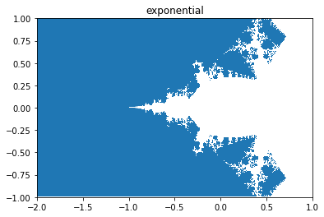
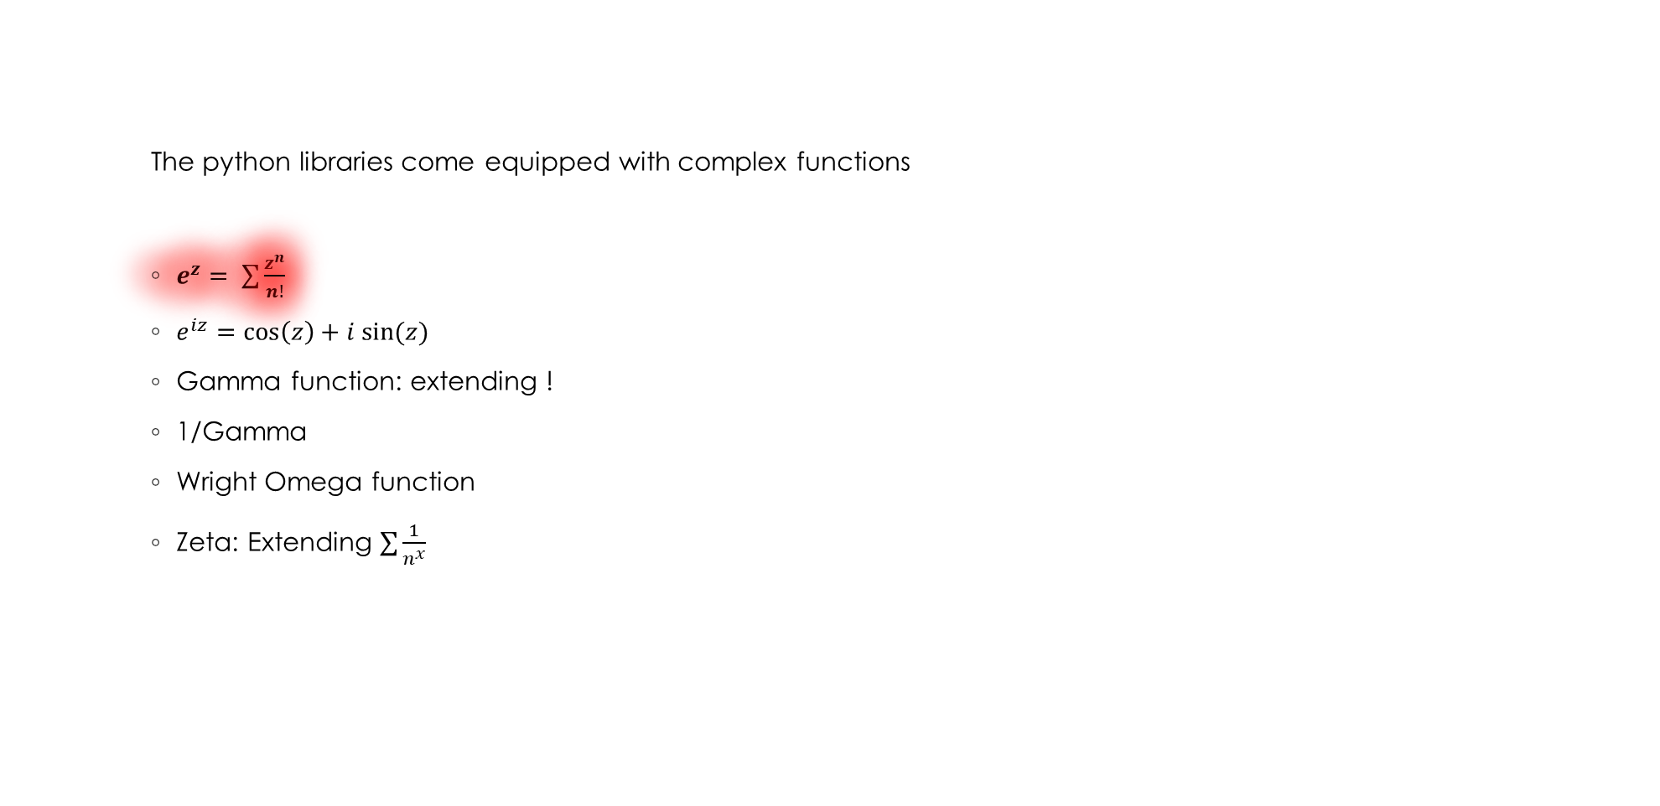
real fun $→$ complex fun
The python libraries come equipped with complex functions
$e^{z}= \sum{\frac{z^{n}}{n!}}$
$e^{iz}=\cos\left(z\right)+i sin⁡(z)$
Gamma function: extending !
1/Gamma
Wright Omega function
Zeta: Extending $\sum{\frac{1}{n^{x}}}$

Slide 8
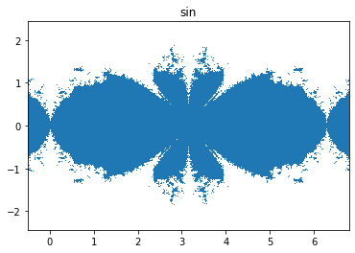

real fun $→$ complex fun
The python libraries come equipped with complex functions
$e^{z}= \sum{\frac{z^{n}}{n!}}$
$e^{iz}=\cos\left(z\right)+i sin⁡(z)$
Gamma function: extending !
1/Gamma
Wright Omega function
Zeta: Extending $\sum{\frac{1}{n^{x}}}$

Slide 9
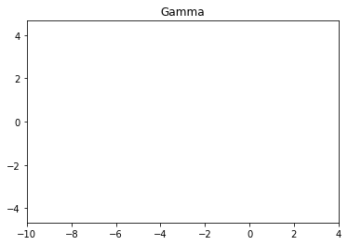
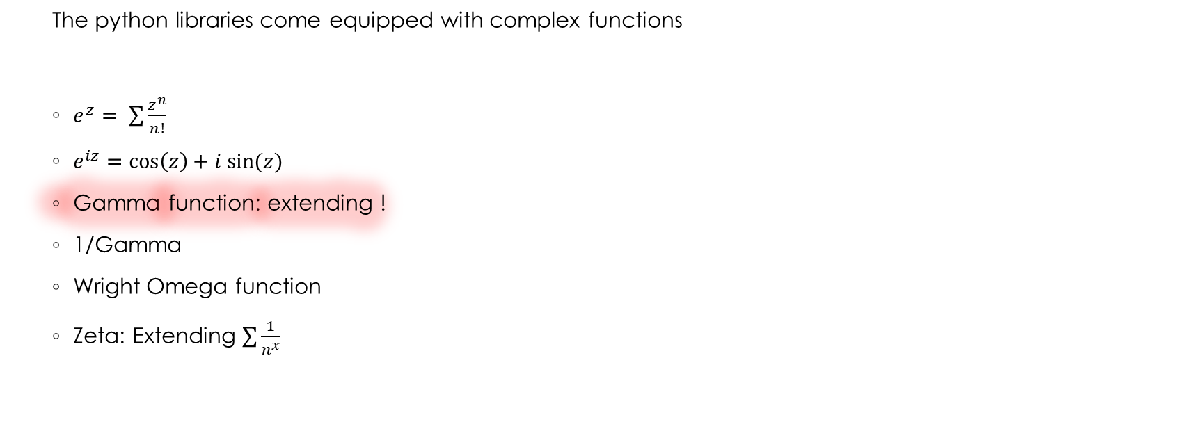
real fun $→$ complex fun
The python libraries come equipped with complex functions
$e^{z}= \sum{\frac{z^{n}}{n!}}$
$e^{iz}=\cos\left(z\right)+i sin⁡(z)$
Gamma function: extending !
1/Gamma
Wright Omega function
Zeta: Extending $\sum{\frac{1}{n^{x}}}$

Slide 10
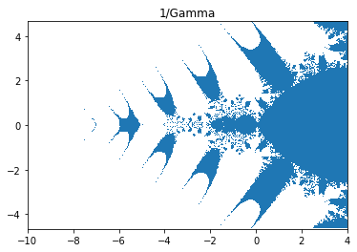
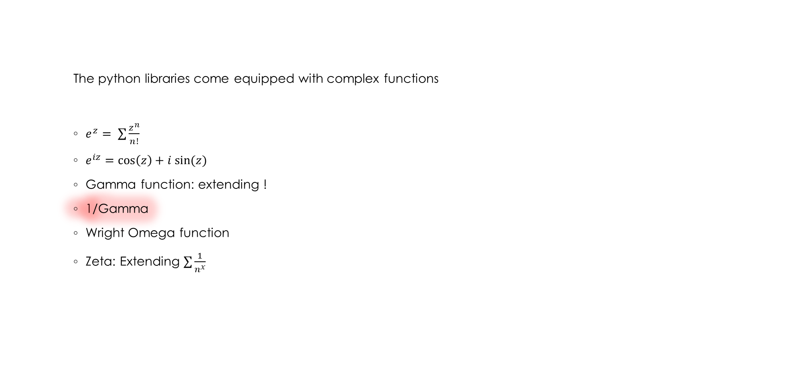
real fun $→$ complex fun
The python libraries come equipped with complex functions
$e^{z}= \sum{\frac{z^{n}}{n!}}$
$e^{iz}=\cos\left(z\right)+i sin⁡(z)$
Gamma function: extending !
1/Gamma
Wright Omega function
Zeta: Extending $\sum{\frac{1}{n^{x}}}$

Slide 11
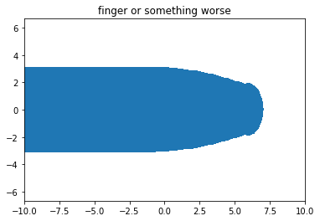
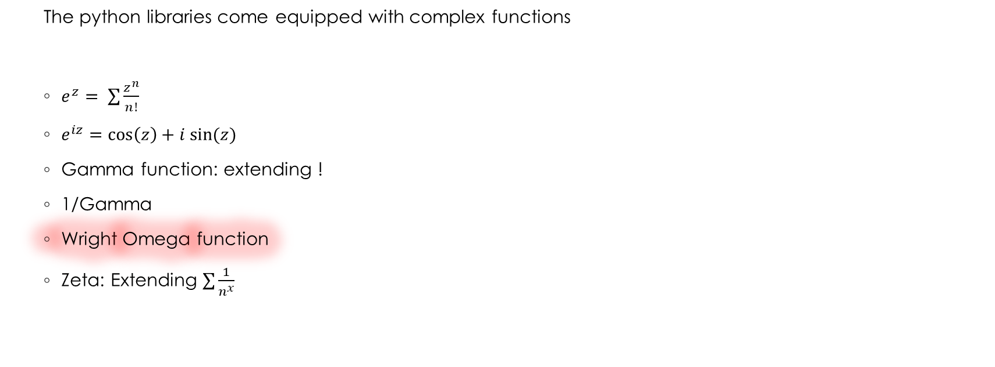
real fun $→$ complex fun
The python libraries come equipped with complex functions
$e^{z}= \sum{\frac{z^{n}}{n!}}$
$e^{iz}=\cos\left(z\right)+i sin⁡(z)$
Gamma function: extending !
1/Gamma
Wright Omega function
Zeta: Extending $\sum{\frac{1}{n^{x}}}$

Slide 12
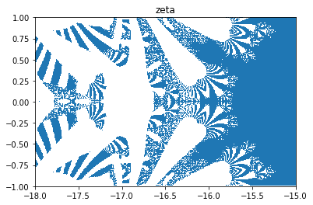

real fun $→$ complex fun
The python libraries come equipped with complex functions
$e^{z}= \sum{\frac{z^{n}}{n!}}$
$e^{iz}=\cos\left(z\right)+i sin⁡(z)$
Gamma function: extending !
1/Gamma
Wright Omega function
Zeta: Extending $\sum{\frac{1}{n^{x}}}$

Slide 13
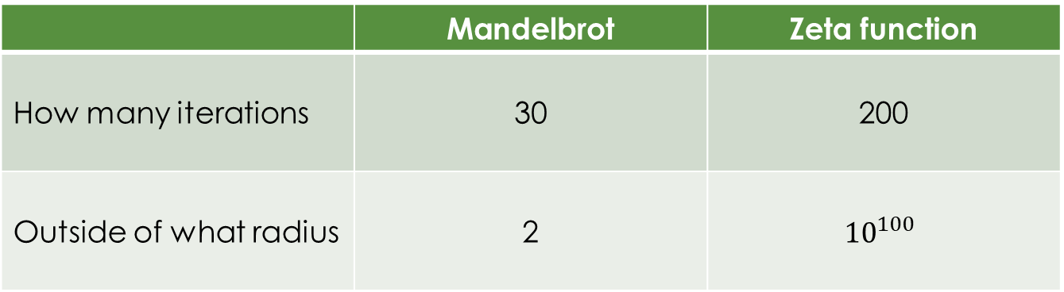
What counts as infinity
 | Mandelbrot | Zeta function
How many iterations | 30 | 200
Outside of what radius | 2 | $${10}^{100}$$

