Slide 1
Math is Hard,
Can we make it easier?
Big Maths Jams 2022
Sydney Weaver

Slide 2
Why I want to give this talk
I never received a higher education so certain fields of math are very hard for me
I want to make all parts of learning more accessible
Sometimes we don’t realize something is harder for others

Slide 3
Why math can be challenging
Let’s break down a couple reasons why.
Something familiar being used in an unfamiliar way
Difficult notation
There's an assumed prerequisite of knowledge so things are glossed over at times

Slide 4
Example of Something familiar being used in an unfamiliar way
7 x 5

Slide 5
Example of Something familiar being used in an unfamiliar way
7x 5
7 x 5

Slide 6
Watch out for false friends
Librairie vs library

Slide 7
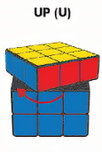
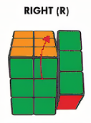
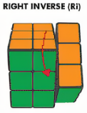
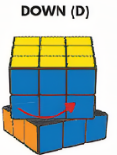
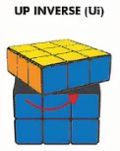
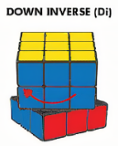
Let's look at the same info conveyed in many different ways

Slide 8
Let's look at the same info conveyed in many different ways
R U R' D
R U' R' D'

Slide 9
Let's look at the same info conveyed in many different ways
R U R' D
R U' R' D'

Slide 10
The same information conveyed in different ways
[R U R’, D]

