Slide 1
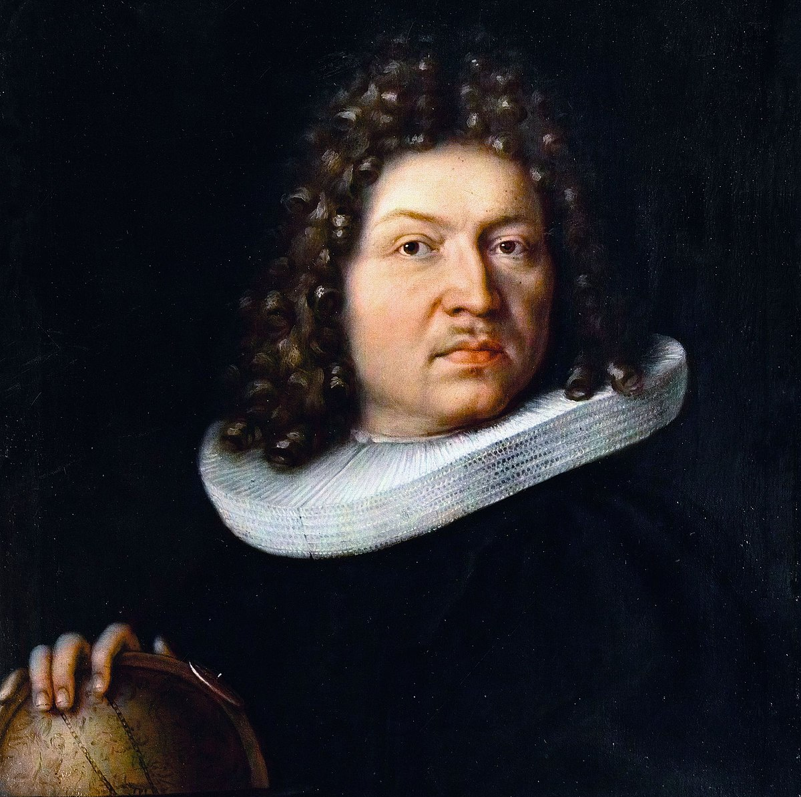

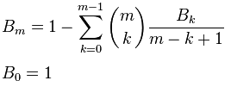
Bernoulli Numbers Seki
Jacob Bernoulli
1655 - 1705
Takakazu Seki
1642 - 1708
T = 15s

Slide 2
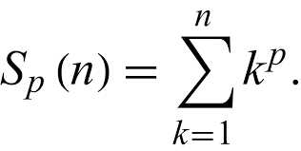
S_{p} : 1^{p} + 2^{p} + 3^{p} + 4^{p} + 5^{p} + 6^{p} + 7^{p} + 8^{p} + 9^{p} + … + n^{p} = ?
p = 0 : 1 + 1 + 1 + 1 + 1 + 1 + 1 + 1 + 1 … + 1 = 1 n
One is Everything
T = 40s

Slide 3
p = 1 : 1 + 2 + 3 + 4 + 5 + 6 + 7 + 8 + 9 … + n
p = 2 : 1 + 4 + 9 + 16 + 25 + 36 + 49 + 64 + 81 … + n²
p = 3 : 1 + 8 + 27 + 64 + 125 + 216 + 343 + 512 + 729 … + n³
p = 4 : 1 + 16 + 81 + 256 + 625 + 1296 + 2401 + 4096 + 6561 … + n⁴
… sum of integers , squares , cubes , fourth powers …
T = 60s

Slide 4
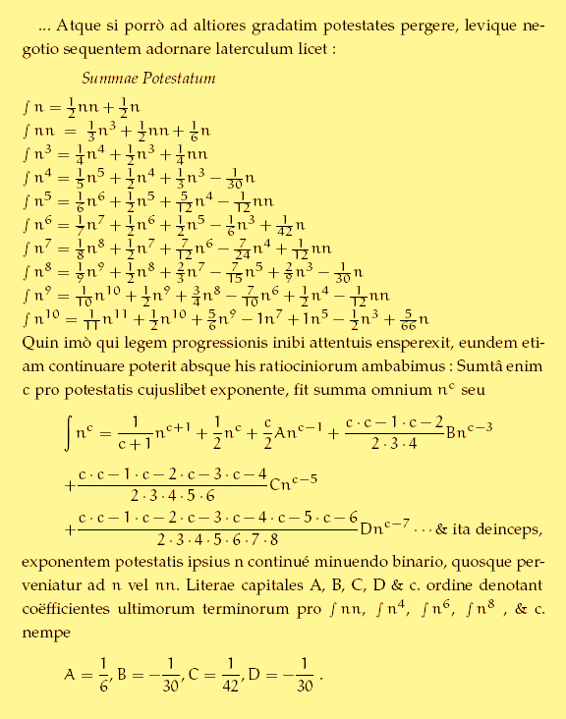
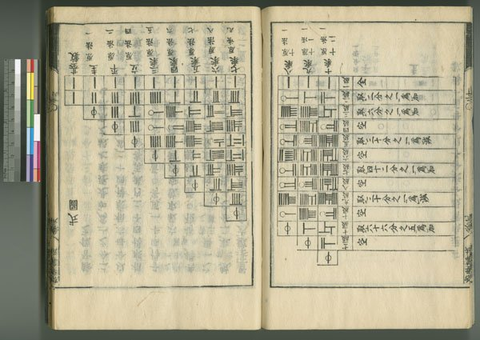
Bernoulli Numbers Seki
The ‘integral’ Symbol means summation in Bernoulli's notation
Jacob Bernoulli
Ars Conjectandi 1713
Takakazu Seki
Essentials of Mathematics 1712
T = 80s

Slide 5
Bernoulli Numbers Seki
Johan Faulhaber’s
(1580 – 1635)
Formula
He Knew the first 17 cases
Everything
1/2
1/6
Nothing
-1/30
Nothing
1/42
Nothing
-1/30
Pascals Triangle in Rod Numerals. Note the different symbol used for the 1’s on leading diagonal
Nothing
5/66
Nothing
Jacob Bernoulli
Ars Conjectandi 1713
Takakazu Seki
Essentials of Mathematics 1712
T = 100s

Slide 6
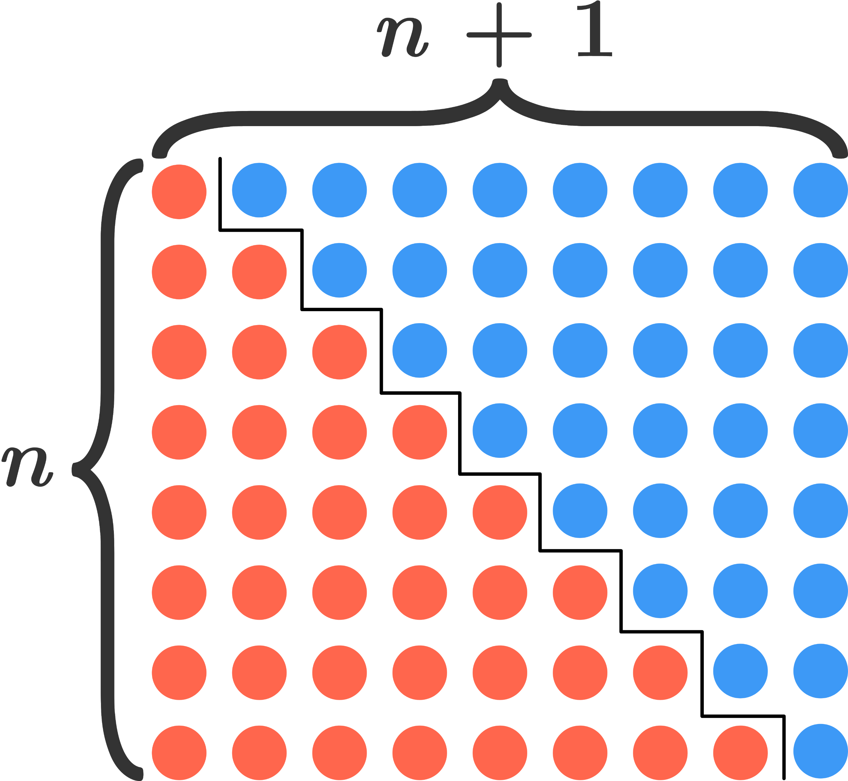
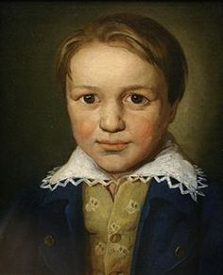
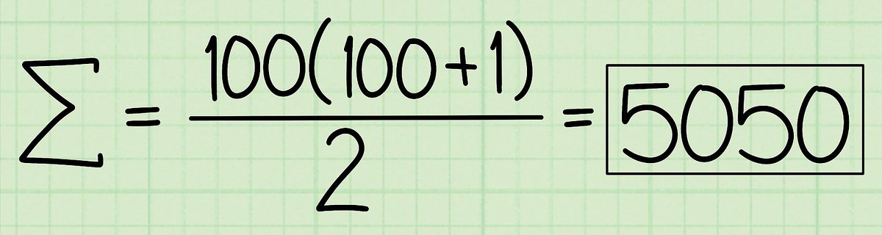
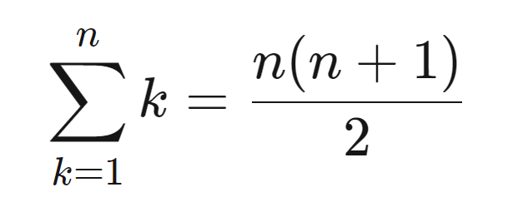
p = 1
= S₁(n) = ½ n² + ½ n
https://brilliant.org/wiki/sum-of-n-n2-or-n3/
T = 2m

Slide 7
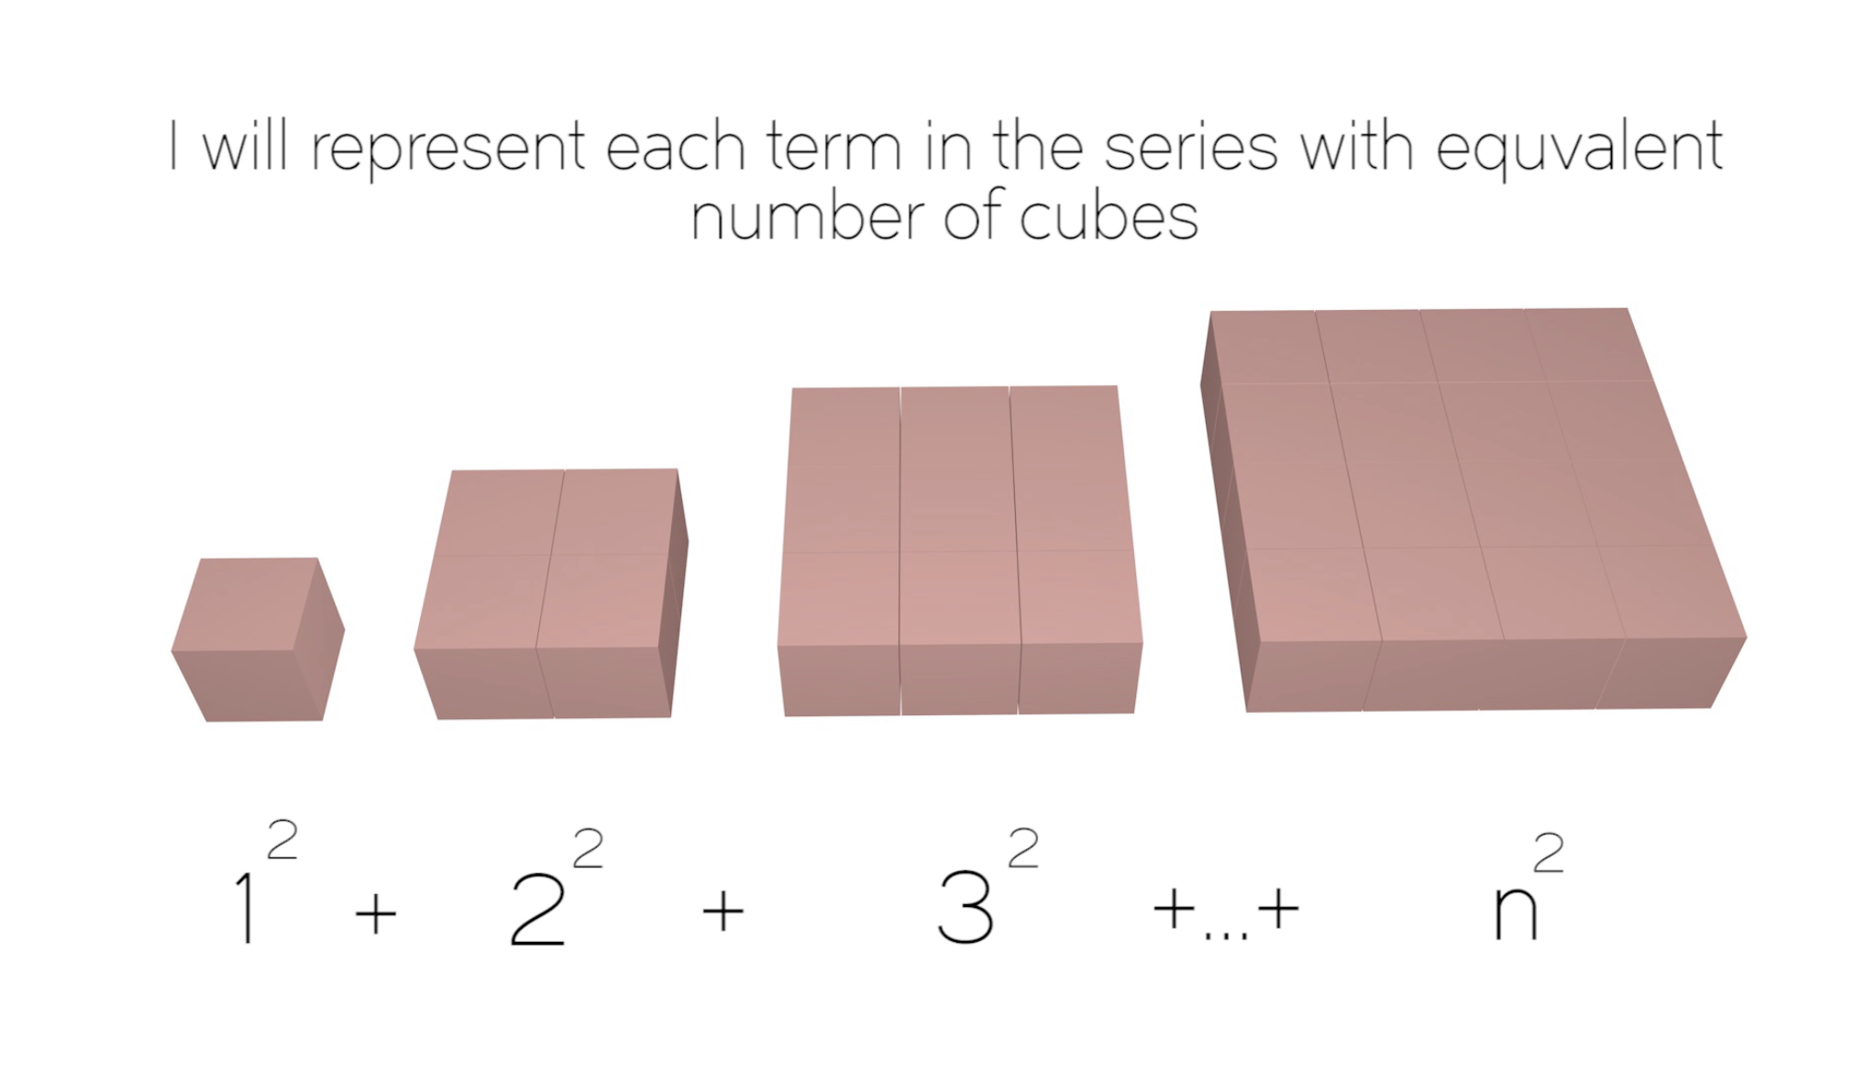
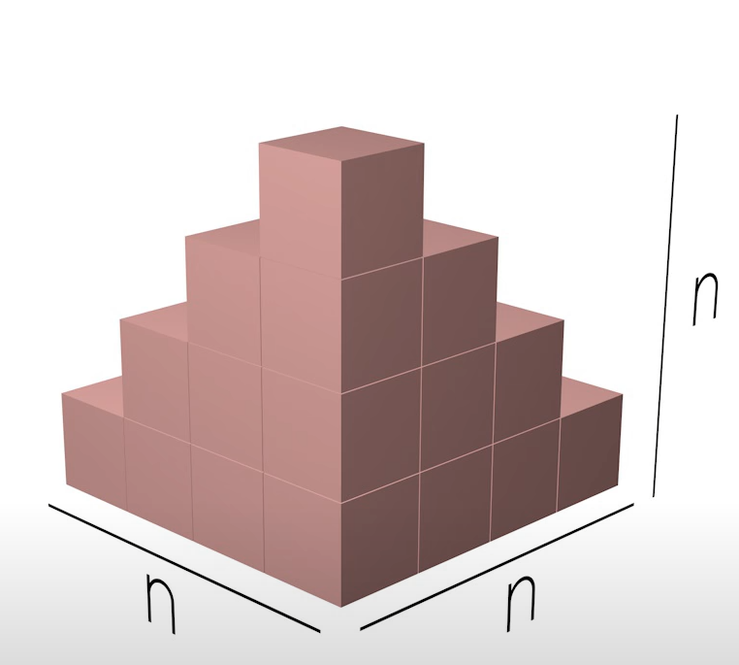
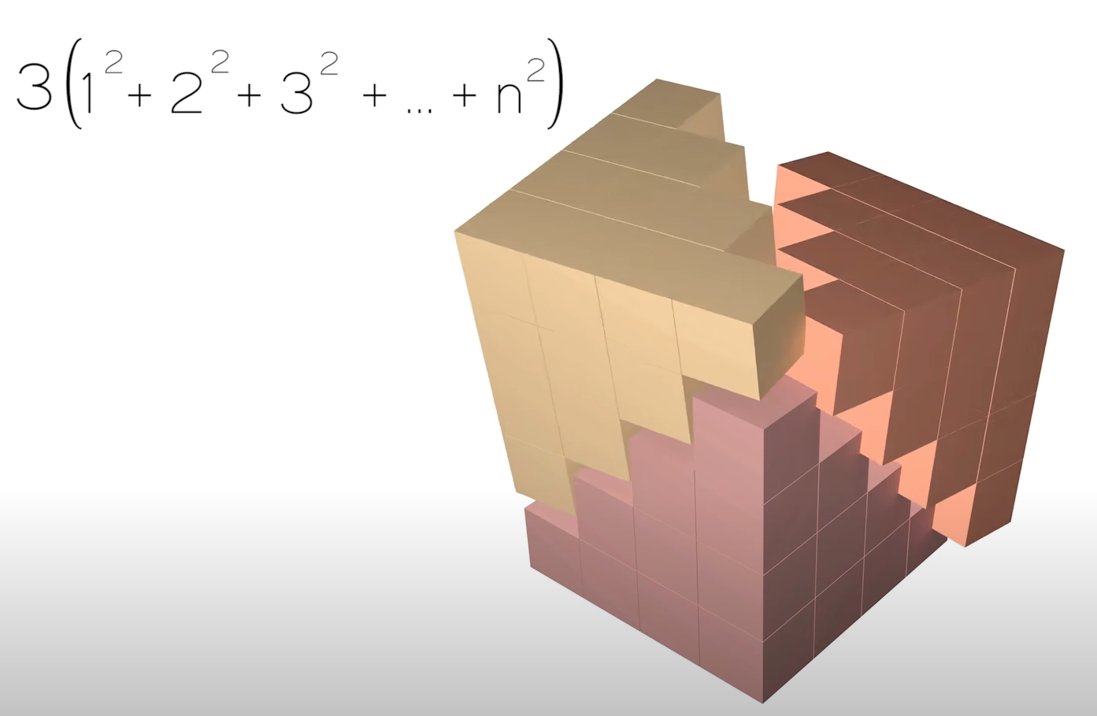
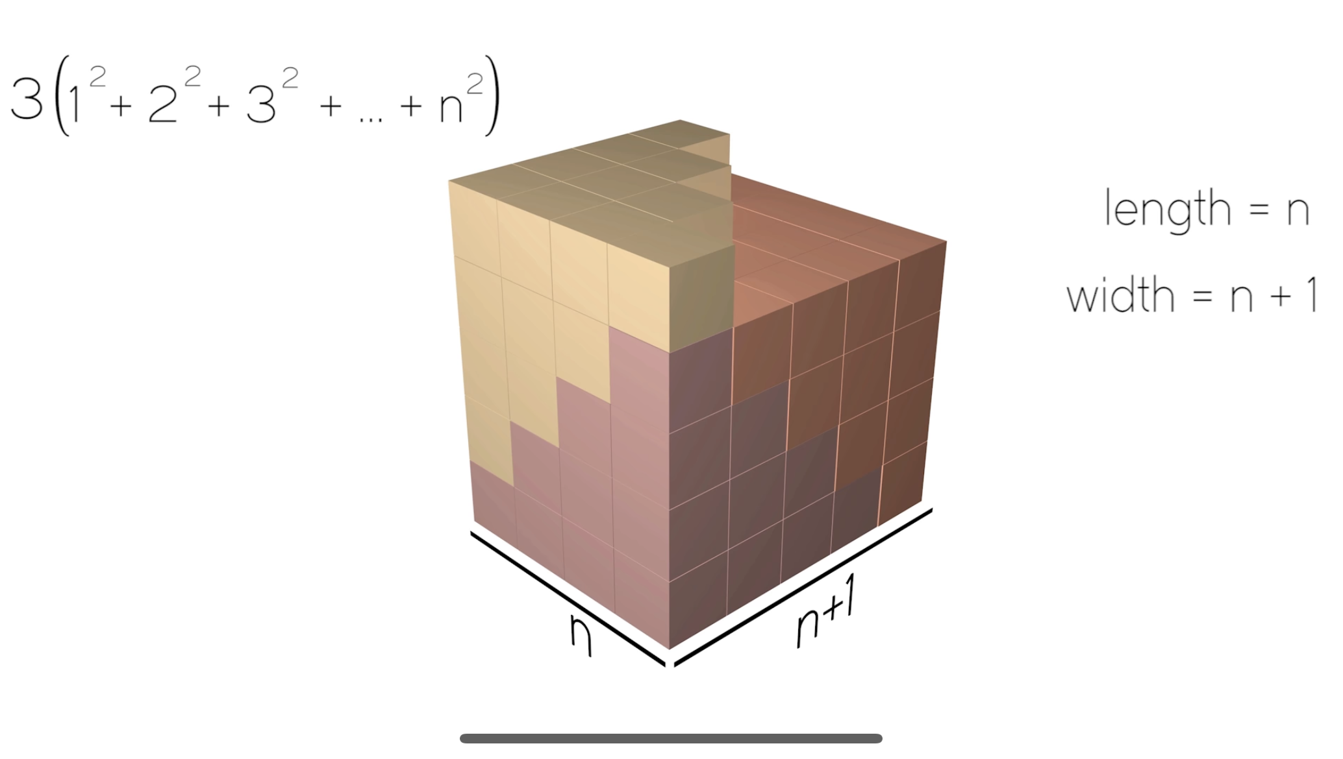
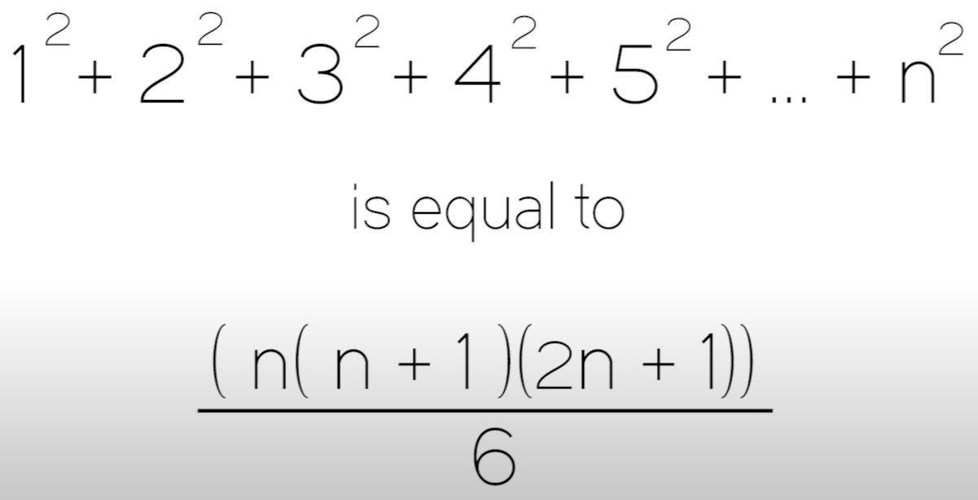
p = 2
n+1
n
= S₂(n) = ⅓ n³ + ½ n² + ⅙ n
https://www.youtube.com/watch?v=aXbT37IlyZQ
T = 2m30s

Slide 8
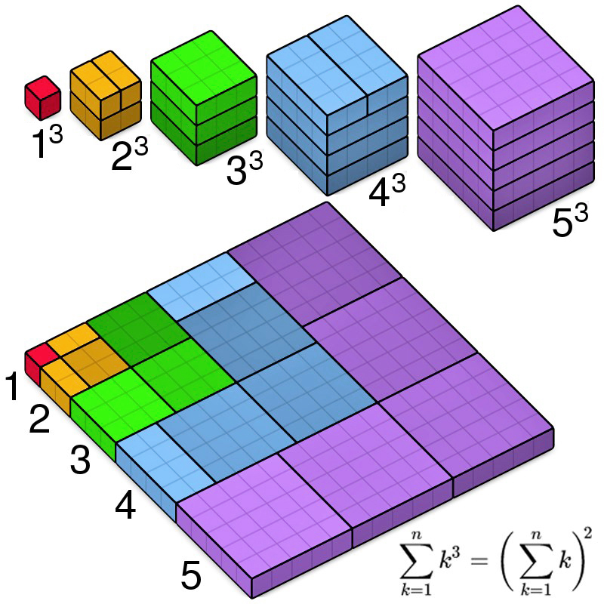
p = 3
= S₃(n)
= (S₁(n))²= ¼ n⁴ + ½ n³ + ¼ n² + 0n
T = 2m50s

Slide 9
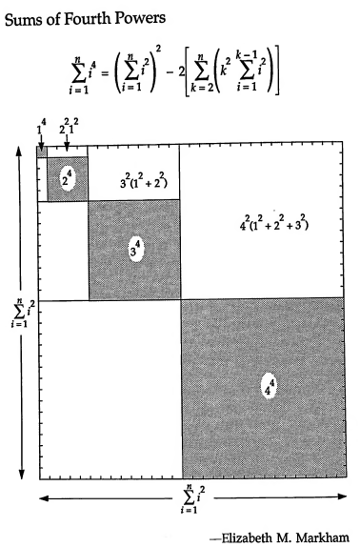
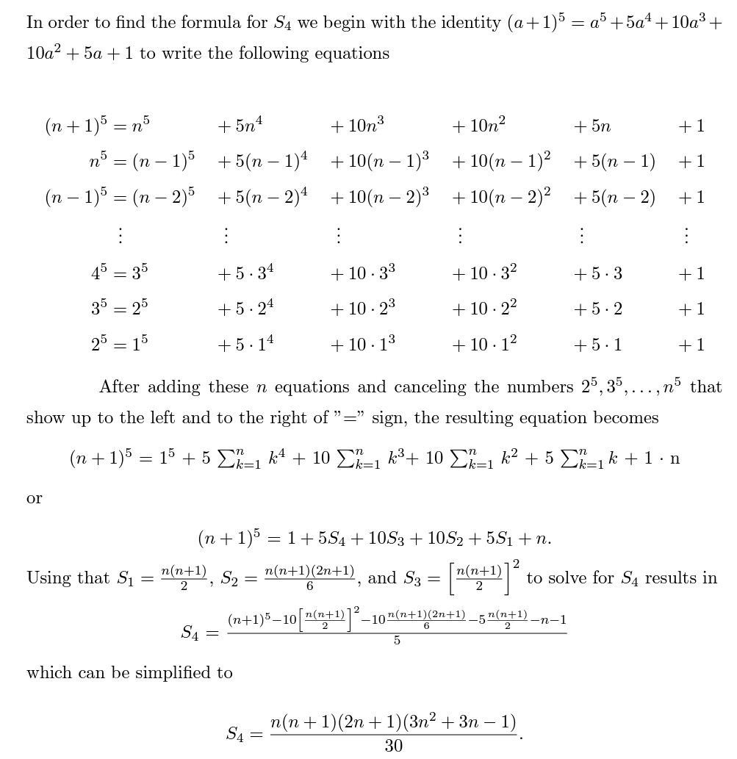

p = 4
= (S₄(n) =
-1/30
T = 3m30s

Slide 10
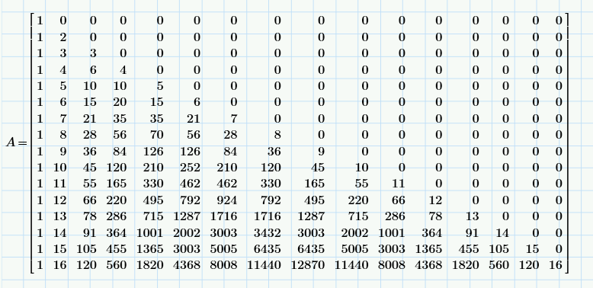
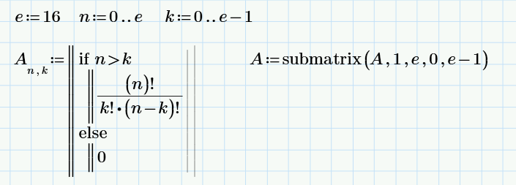
T = 4m

Slide 11
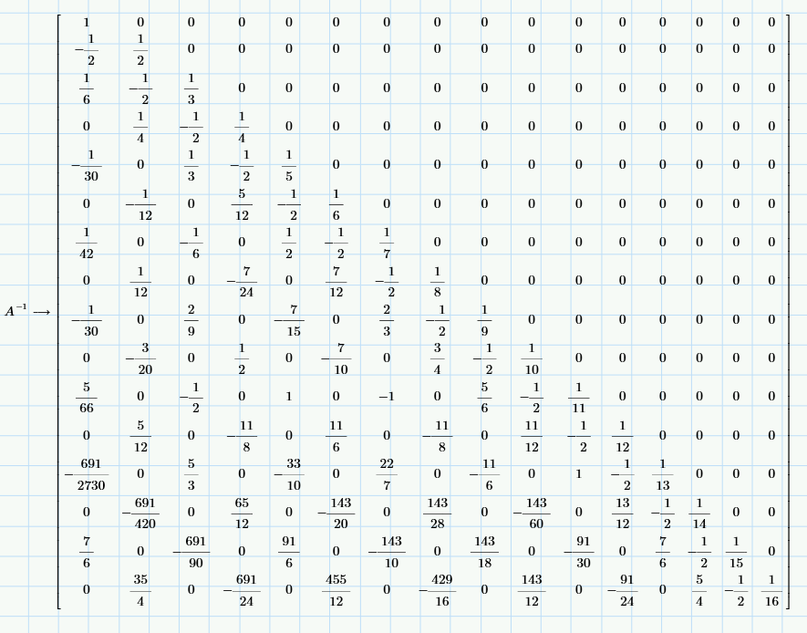
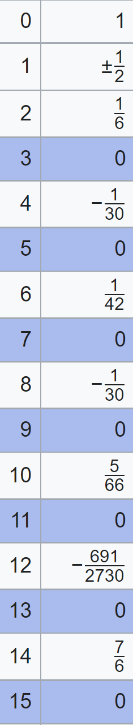
T = 4m20s

Slide 12
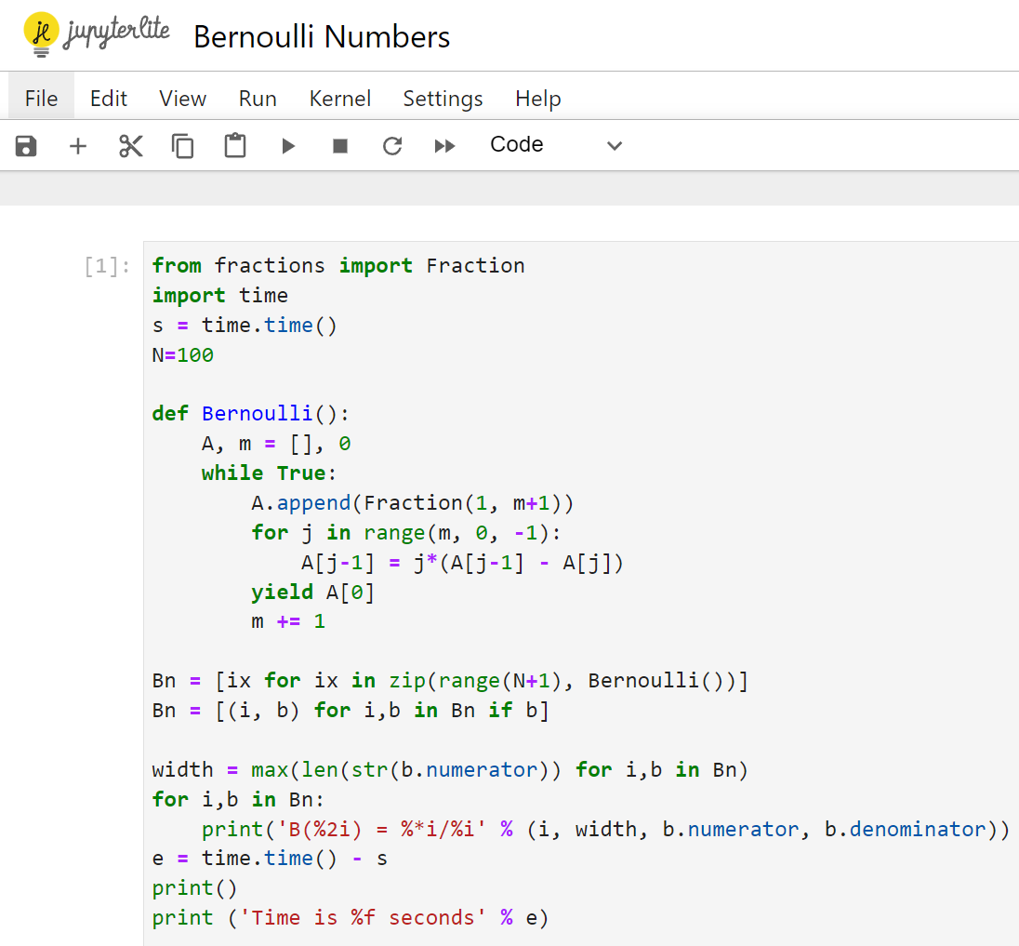
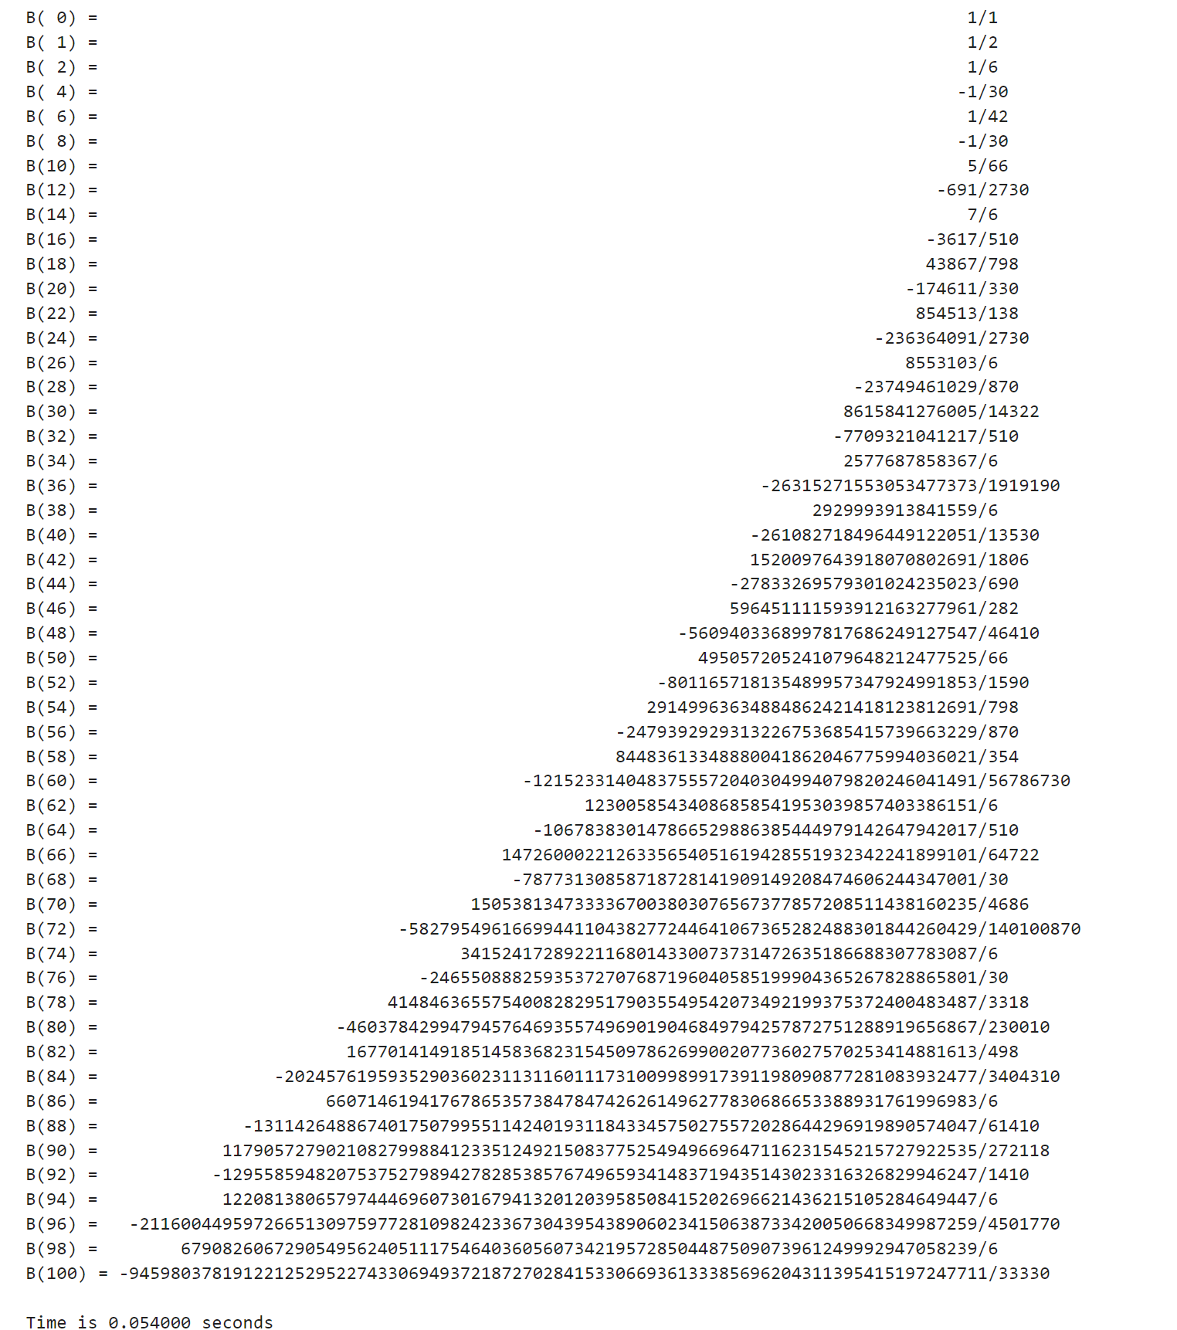
https://rosettacode.org/wiki/Bernoulli_numbers
T = 4m40s

Slide 13
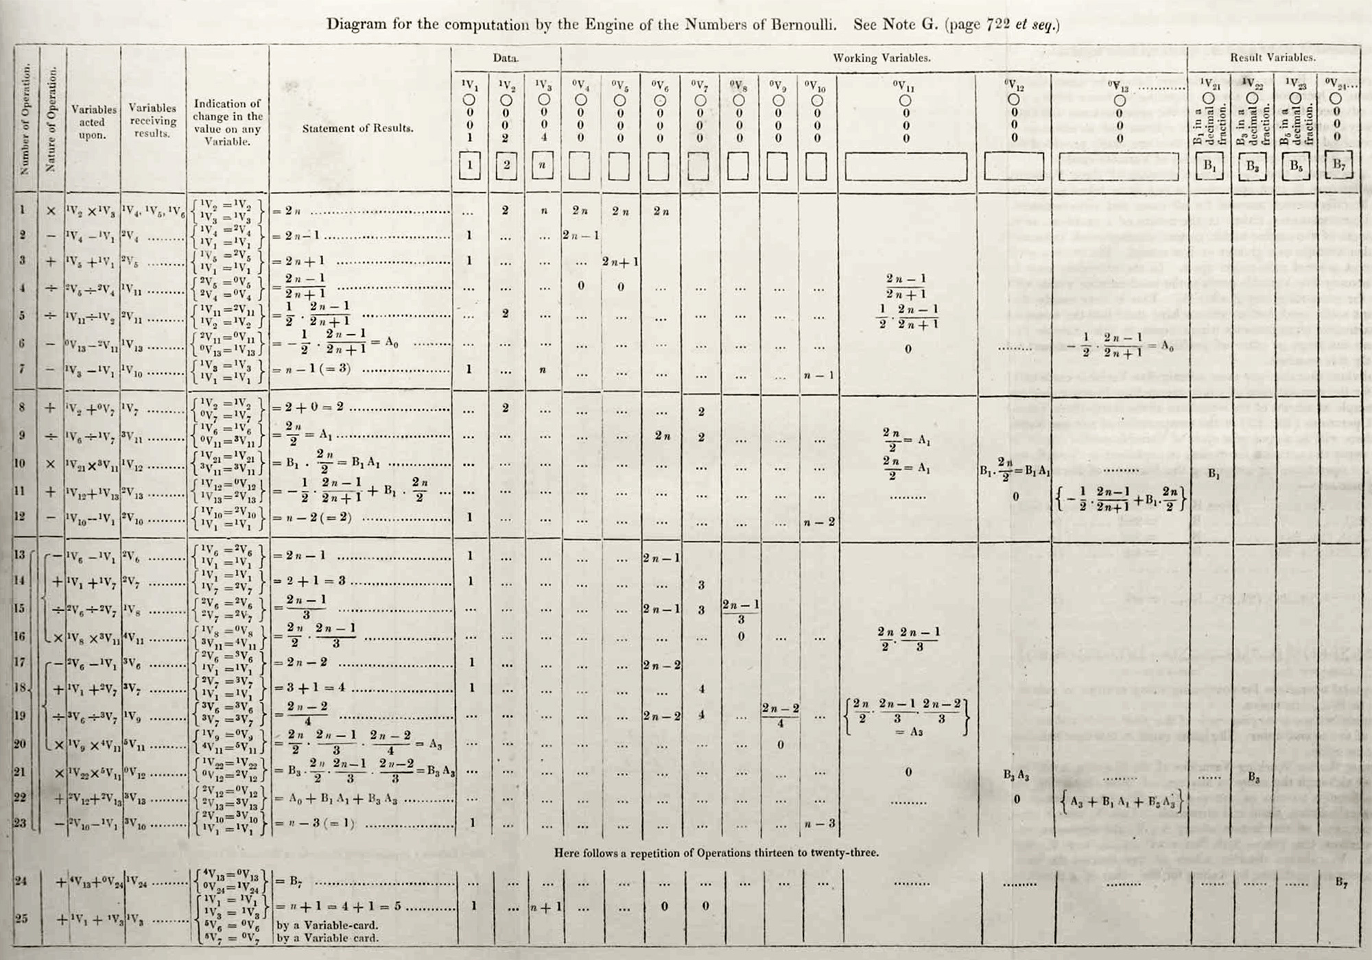
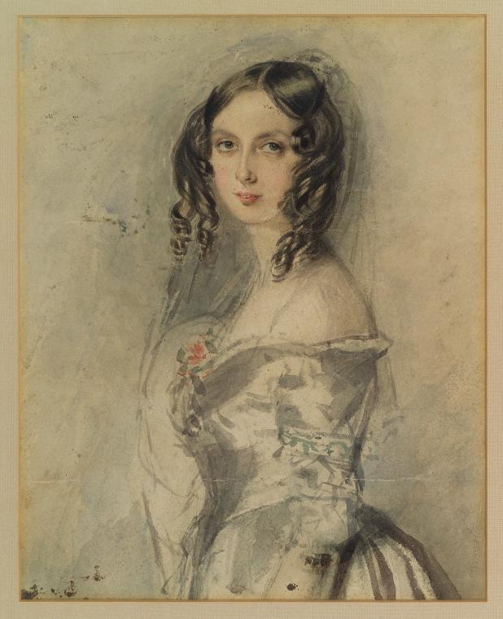
Bug or
Typesetting error ?
Should read V₄ / V₅
Ada Lovelace Note G
Program to find ‘B₇’ (- 1/30)
https://enigmaticcode.wordpress.com/tag/bernoulli-numbers/
https://twobithistory.org/2018/08/18/ada-lovelace-note-g.html
https://writings.stephenwolfram.com/2015/12/untangling-the-tale-of-ada-lovelace/
T = 5m

Slide 14
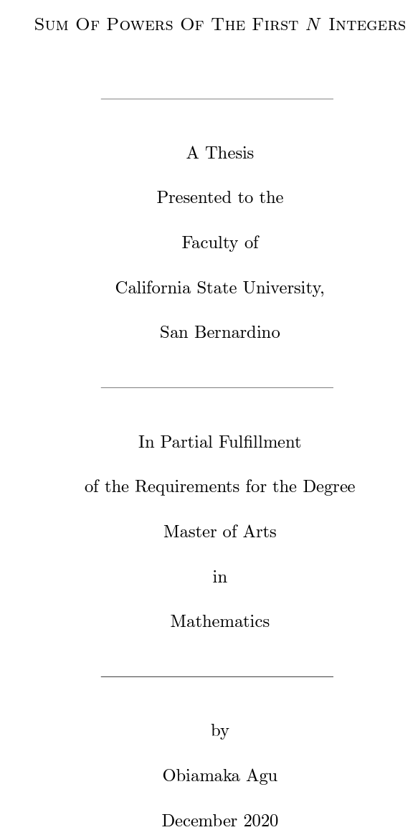
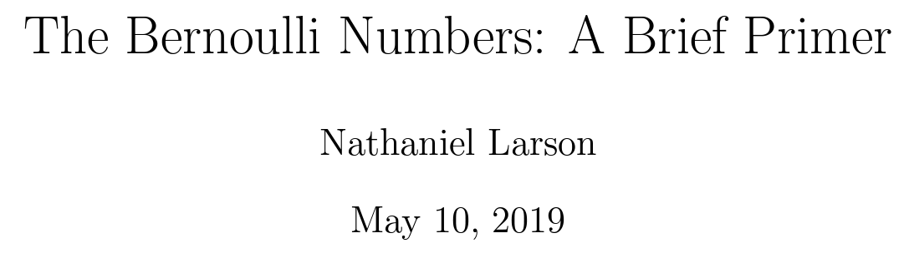
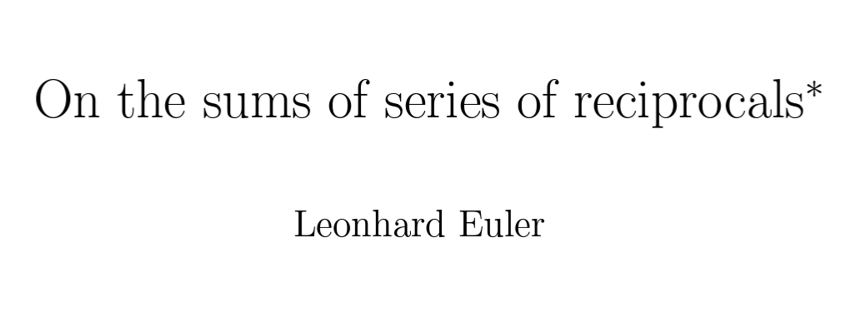
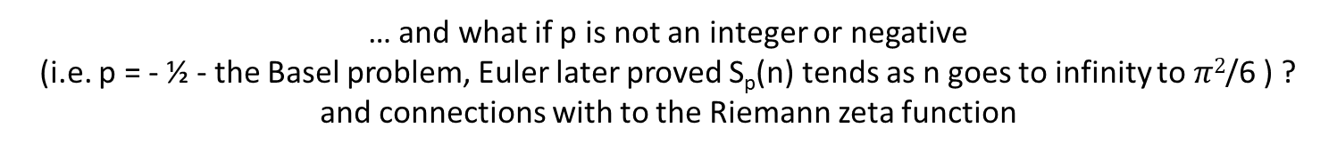
Further Reading
https://www.whitman.edu/documents/Academics/Mathematics/2019/Larson-Balof.pdf https://scholarworks.lib.csusb.edu/etd/1132/ https://arxiv.org/abs/math/0506415
… and what if p is not an integer or negative
(i.e. p = - ½ - the Basel problem, Euler later proved S_{p}(n) tends as n goes to infinity to $π2$/6 ) ?
and connections with to the Riemann zeta function
references

