Slide 1

Size isn’t Everything!
Colin Graham MathsJam Gathering
19th November 2022

Slide 2
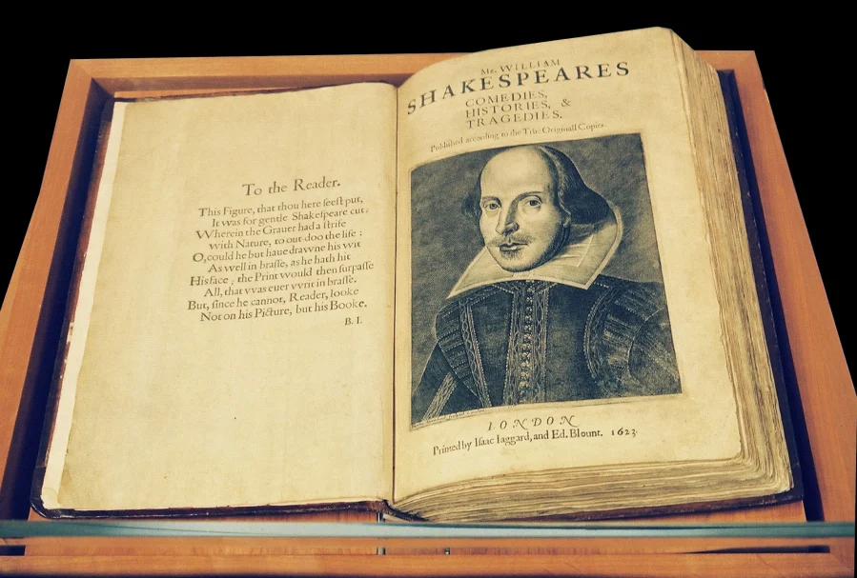
Aspect Ratios
Quarto - 9½ inches wide and 12 inches high
Folio - 12 inches wide and 19 inches high

Slide 3
Aspect Ratios
Quarto - 9½ inches wide and 12 inches high
Folio - 12 inches wide and 19 inches high
Folding in half:
½ Quarto becomes 9 ½ by 6
½ Folio becomes 12 by 9 ½

Slide 4
Aspect Ratios
Quarto - 9½ inches wide and 12 inches high
Folio - 12 inches wide and 19 inches high
Folding in half:
½ Quarto becomes 9 ½ by 6
½ Folio becomes 12 by 9 ½

Slide 5
Aspect Ratios
Quarto - 9½ inches wide and 12 inches high 19:24
Folio - 12 inches wide and 19 inches high 12:19
Folding in half:
½ Quarto becomes 9 ½ by 6
½ Folio becomes 12 by 9 ½

Slide 6
Aspect Ratios
Quarto - 9½ inches wide and 12 inches high 19:24
Folio - 12 inches wide and 19 inches high 12:19
Folding in half:
½ Quarto becomes 9 ½ by 6 19:12
½ Folio becomes 12 by 9 ½ 24:19

Slide 7
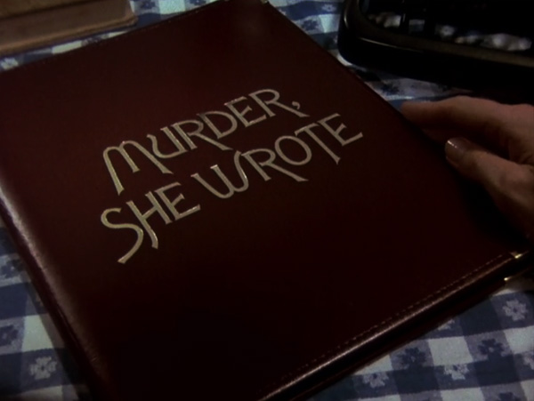
Aspect Ratios
4
3

Slide 8
Aspect Ratios
Margins on 16:9
12:9

Slide 9
Aspect Ratios
Cut-offs on 16:9
16:12

Slide 10
Aspect Ratios
Distortion on 16:9

Slide 11

Aspect Ratios
Lichtenberg suggested using an aspect ratio of 1:$\sqrt{2}$

Slide 12

Aspect Ratios
Lichtenberg suggested using an aspect ratio of 1:$\sqrt{2}$
Porstmann said A0 should be 1m²:
$\sqrt[4]{2}$ m by $\frac{1}{\sqrt[4]{2}}$ m

Slide 13

Aspect Ratios
Lichtenberg suggested using an aspect ratio of 1:$\sqrt{2}$
Porstmann said A0 should be 1m²:
$\sqrt[4]{2}$ m by $\frac{1}{\sqrt[4]{2}}$ m
A0 is 1,189 mm × 841 mm (46.8 in × 33.1 in)

Slide 14
Geometric Means and Envelopes
A0 > B1 > A1

Slide 15

Geometric Means and Envelopes
A0 > B1 > A1
A0 = 1 m² and A1 = ½ m². For the area of B1 to maintain the same aspect ratio, then:
$$\sqrt{1m^{2}⋅\frac{1}{2}m^{2}}=\sqrt{\frac{1}{2}m^{4}}= \frac{\sqrt{2}}{2}m^{2}$$

Slide 16

Geometric Means and Envelopes
A0 > B1 > A1
A0 = 1 m² and A1 = ½ m². For the area of B1 to maintain the same aspect ratio, then:
$$\sqrt{1m^{2}⋅\frac{1}{2}m^{2}}=\sqrt{\frac{1}{2}m^{4}}= \frac{\sqrt{2}}{2}m^{2}$$
Exactly one side of B-size has a length of $\frac{1}{2^{n}}m ∀ n ε ℕ$ $⟹B0 is 1m wide$

Slide 17

Geometric Means and Envelopes
A0 > B1 > A1
A0 = 1 m² and A1 = ½ m². For the area of B1 to maintain the same aspect ratio, then:
$\sqrt{1m^{2}⋅\frac{1}{2}m^{2}}=\sqrt{\frac{1}{2}m^{4}}= \frac{\sqrt{2}}{2}m^{2}$
Exactly one side of B-size has a length of $\frac{1}{2^{n}}m ∀ n ε ℕ$ $⟹B0 is 1m wide$
B0 > C0 > A0, by the same geometric mean

Slide 18
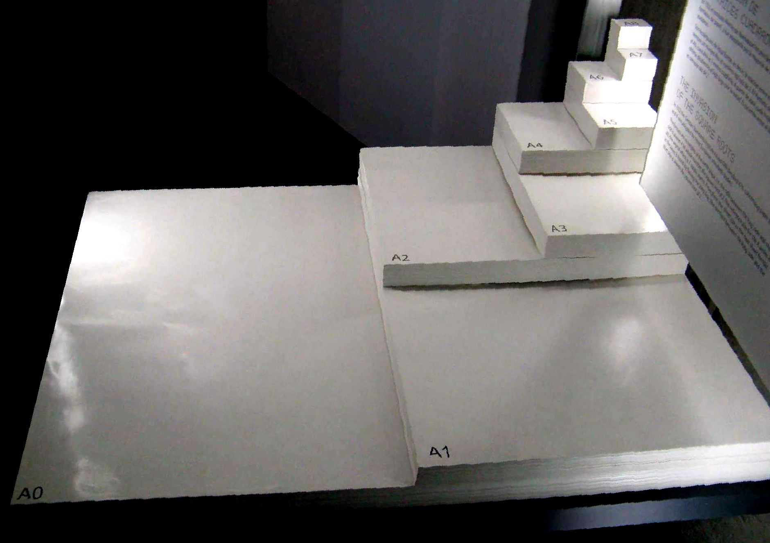
Invasion of the Square Root

Slide 19
Challenge
Using 2 sheets of the same A size, and their properties, can you show 2 ways to make a square, without a crease on the diagonal?

Slide 20

Challenge
Using 2 sheets of the same A size, and their properties, can you show 2 ways to make a square, without a crease on the diagonal?

Slide 21
A Little Bit of History
1786 Georg Christoph Lichtenberg - First preserved record of A4
1789 – 1799 The French were revolting - A2, A3, B3, B4 and B5
1790 France invited the British to help establish international metrics
1900s Dr Walter Porstmann formalized Lichtenberg’s suggestion
1922 Porstmann's system was introduced as DIN 476 in Germany
1971 The UK Paper and Board manufacturers adopted A, B and C sizes
1975 ISO 216 based on DIN 476 becomes the standard for paper sizes
1996 A3, A4, A5, B4, B5 are included in CSS as page sizes

