Slide 1
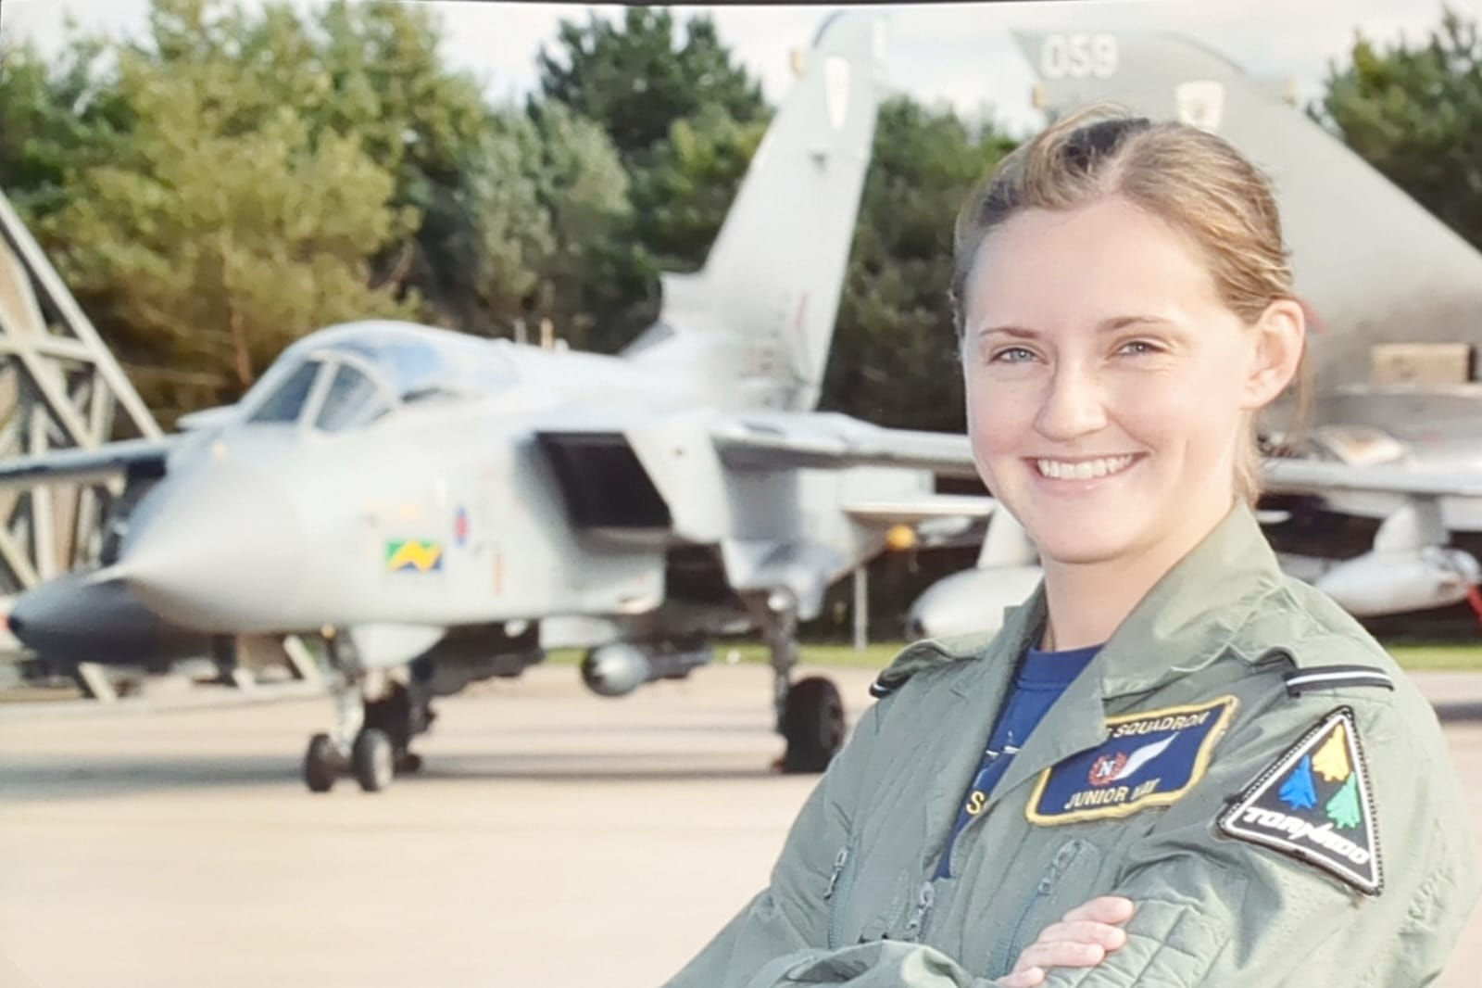
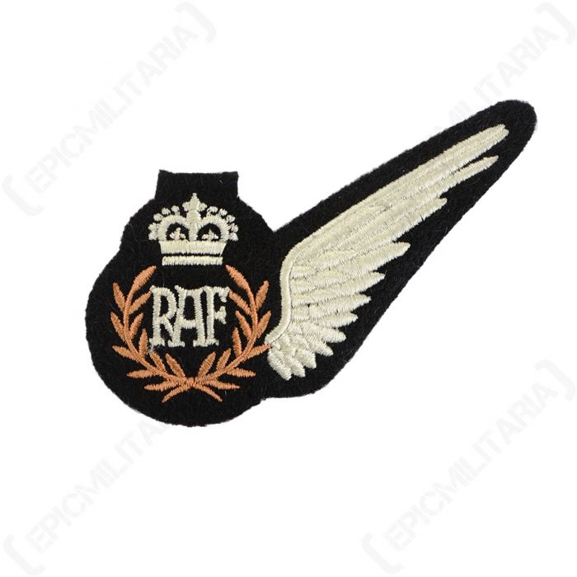

Jen Sparks – raf maths @shackers617

Slide 2
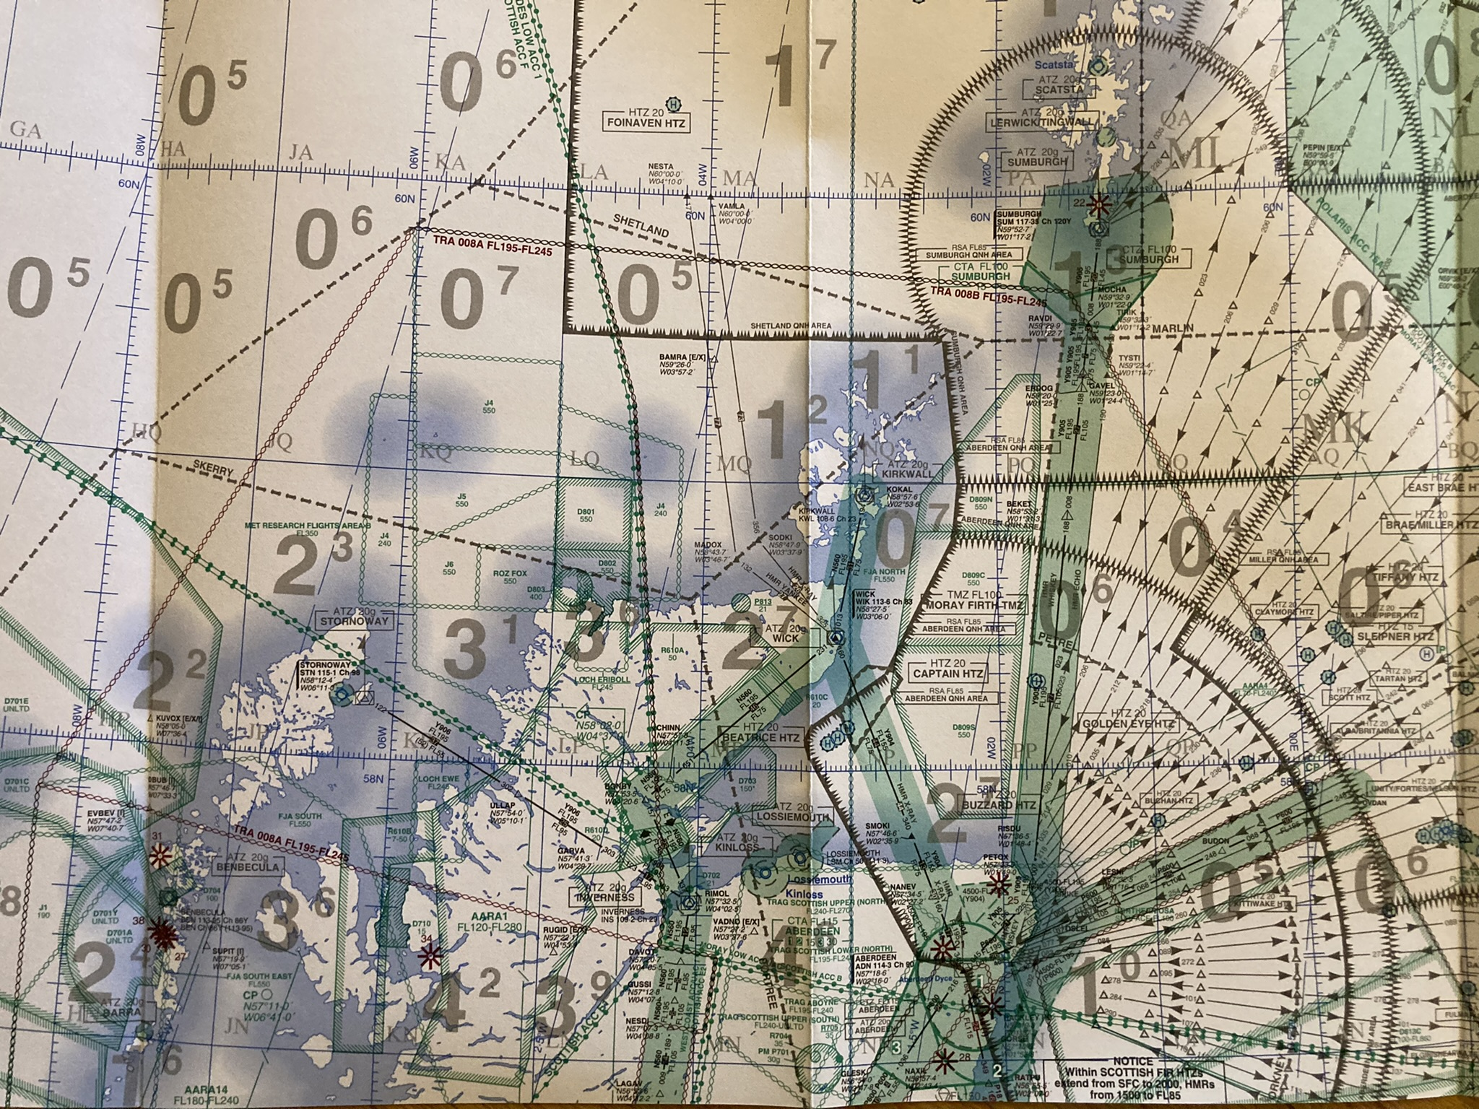
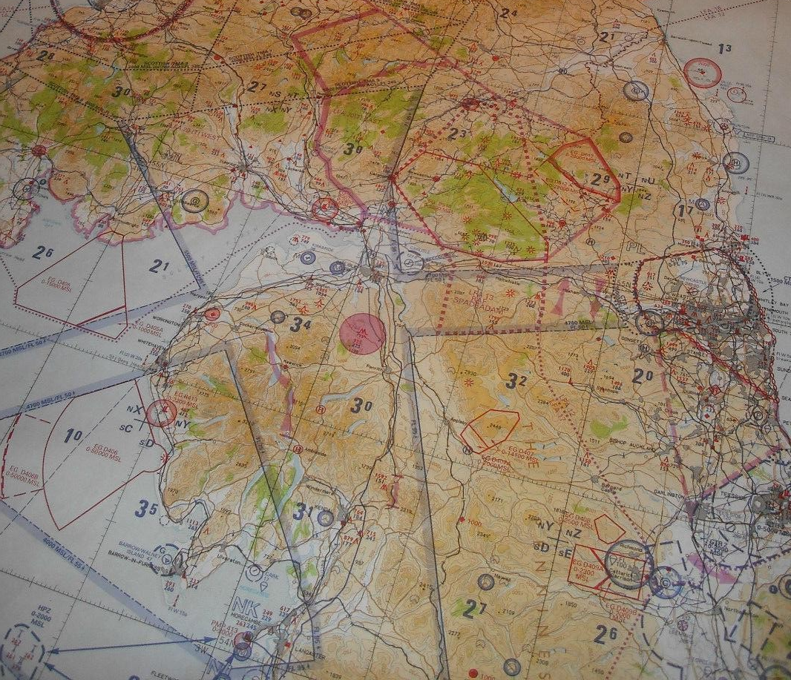
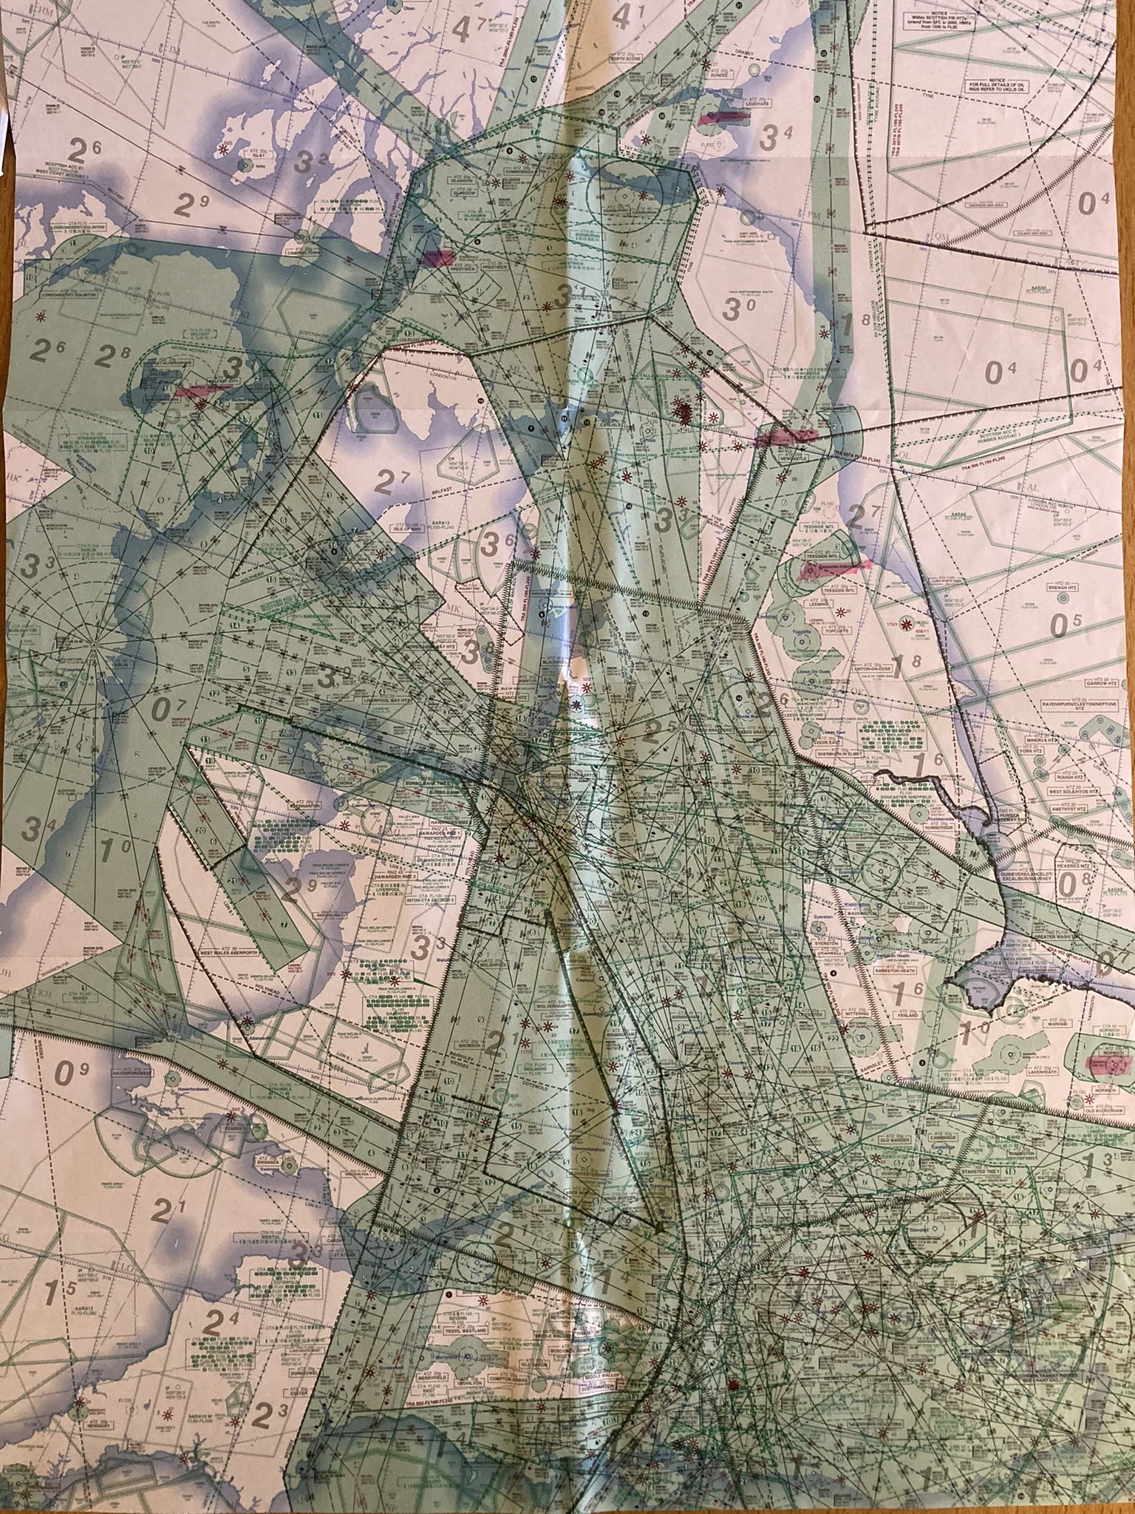
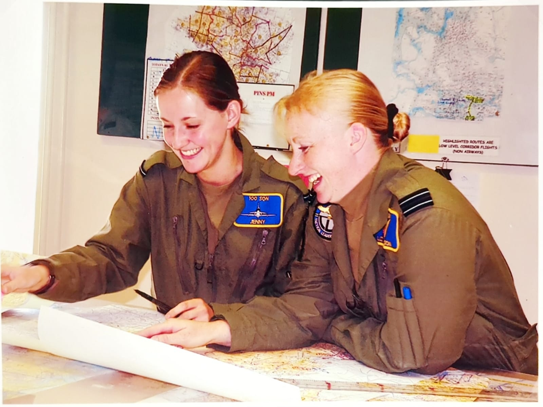
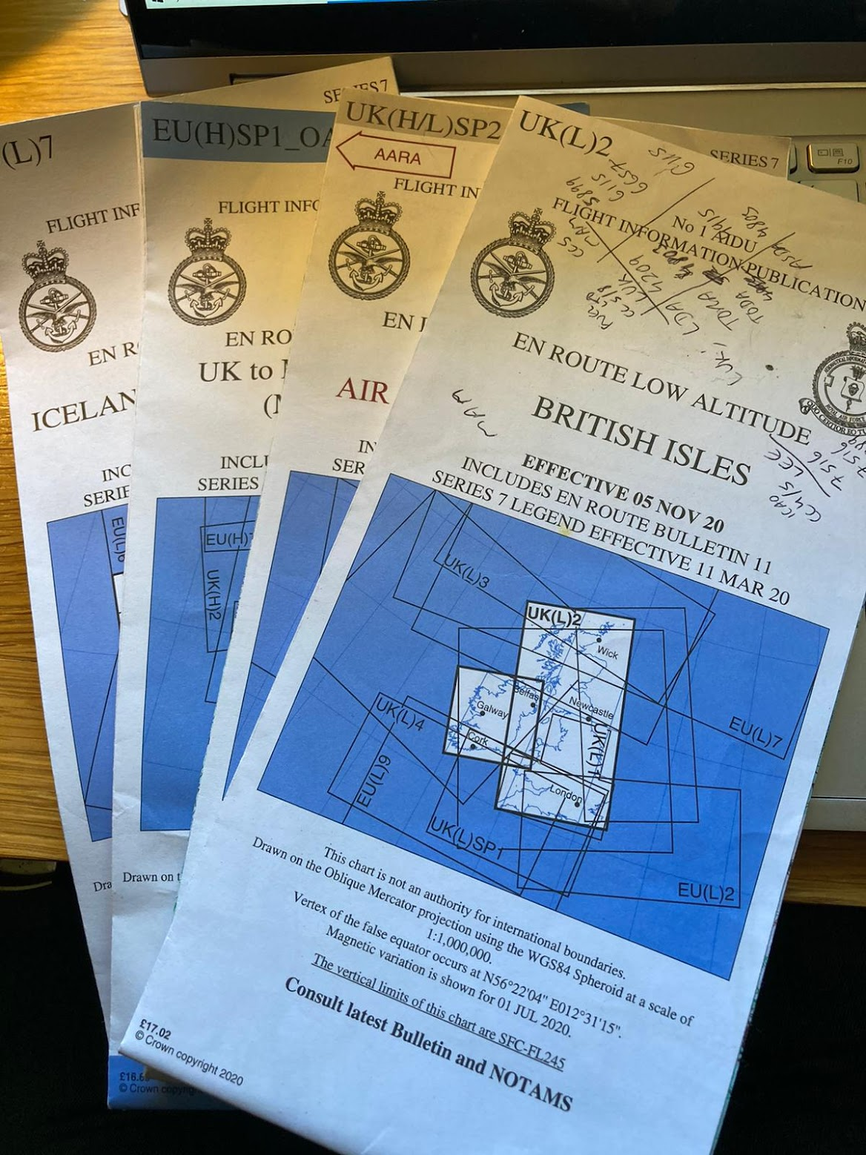

Slide 3
1 in 60 rule

Slide 4

Desired track
error
wind
actual track
$$θ$$

Slide 5

Desired track
1nm
?
$$60\sin\left(1°\right)=1.047144…$$
$≈$ 1nm
60nm
1°

Slide 6

Desired track
10nm
$$60\sin\left(10°\right)=10.41889$$
$≈10NM$
60nm
10°

Slide 7
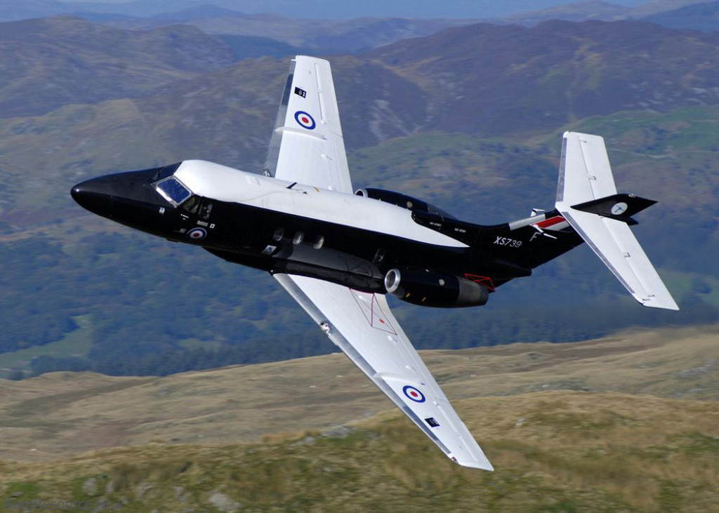
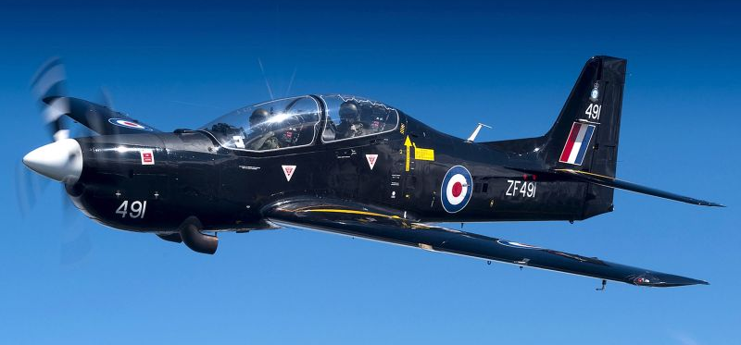
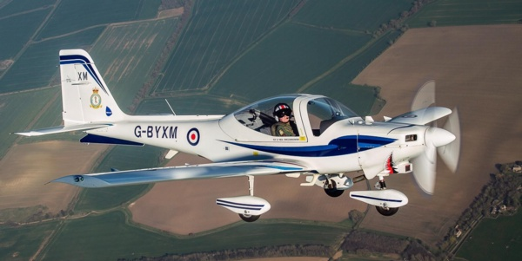
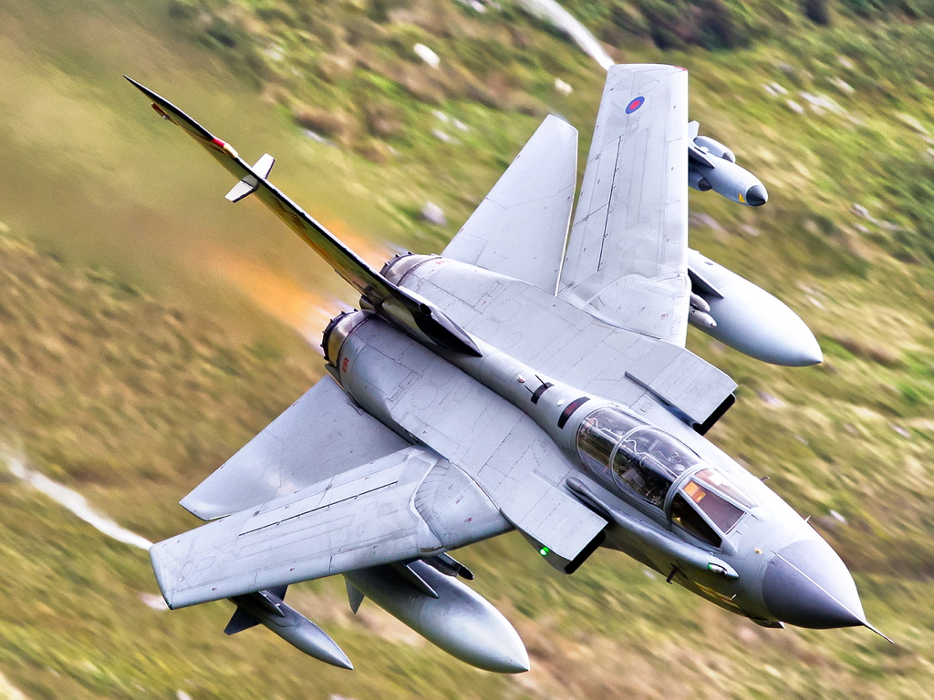
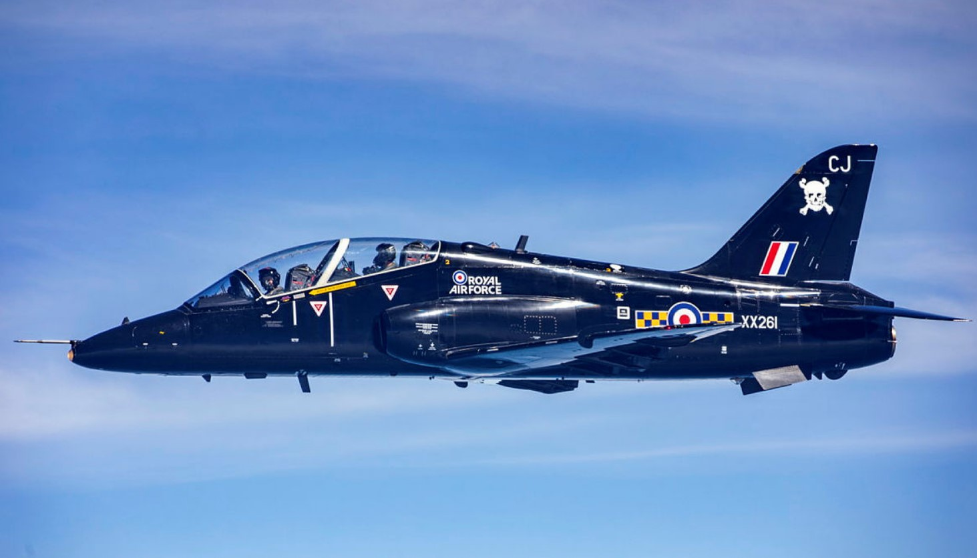

Slide 8
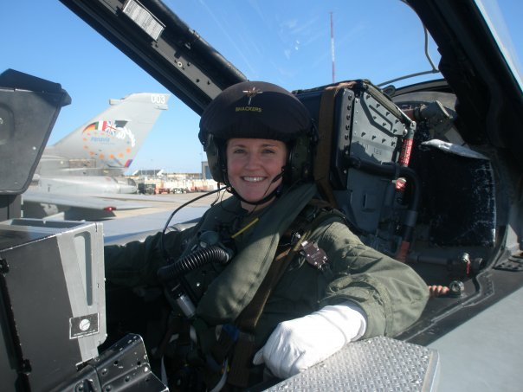
Jen Sparks – raf maths @shackers617

Slide 9
Intro –
RAF Navigator from age 18: 2003-2013
Open Uni degree: 2008 – 2015
Schools BTEC Instructor: 2014 – 2016
Maths PGCE/teacher: 2015 – present
Some of the maths I used...
Planning:
Bearings vs track (considering magnetic variation and planning for wind)
Measuring distances
Altitude planning – terrain avoidance and Safety Altitude
Calculating time airborne/working towards ‘time on target’ (TOT)
Cut-short opportunities if ‘late’
Fuel burn rates (vary depending on altitude)
Airborne:
Bearings/staying on track – 1 in 60 rule
Effects of wind (drift) – could be very different to what was planned/forecast!
Speed Distance Time calculations to achieve TOT (+/- 10 seconds)
Rates of ascent/descent – distance needed to climb or descend to desired altitude
Understanding the 3d picture – Flying in formation with other aircraft and avoiding collision
Fuel burn rates – regular checks/mental calculations - do we have enough fuel to complete our sortie and return to base?
Emergency planning – where is our nearest diversion relative to current location?

