Slide 1
Skittles
Count the rainbow?

Slide 2
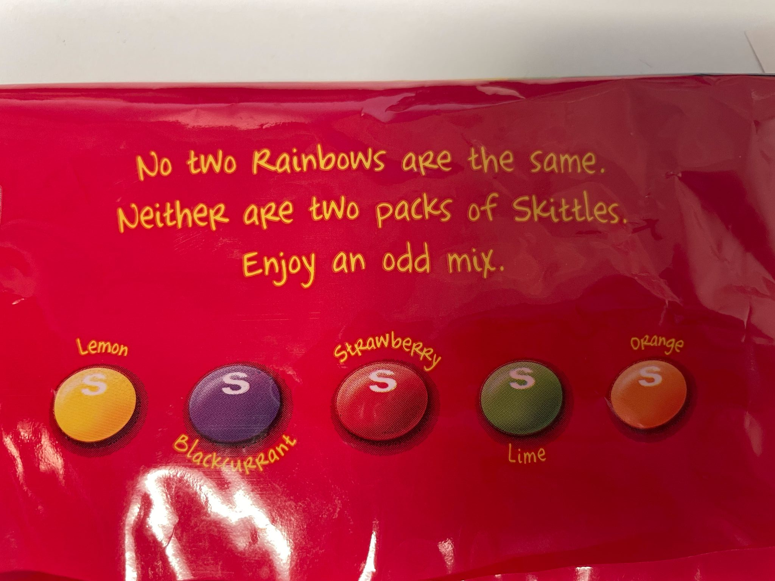

Slide 3
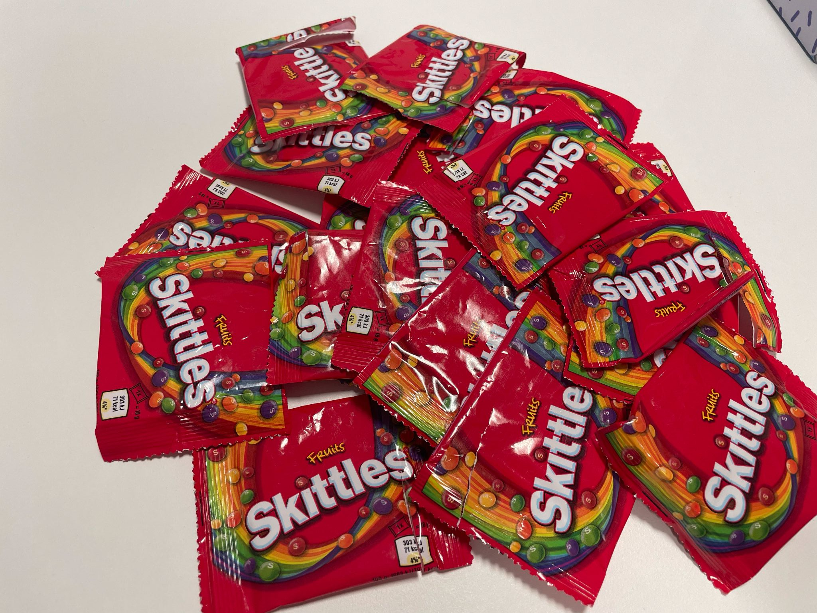

Slide 4
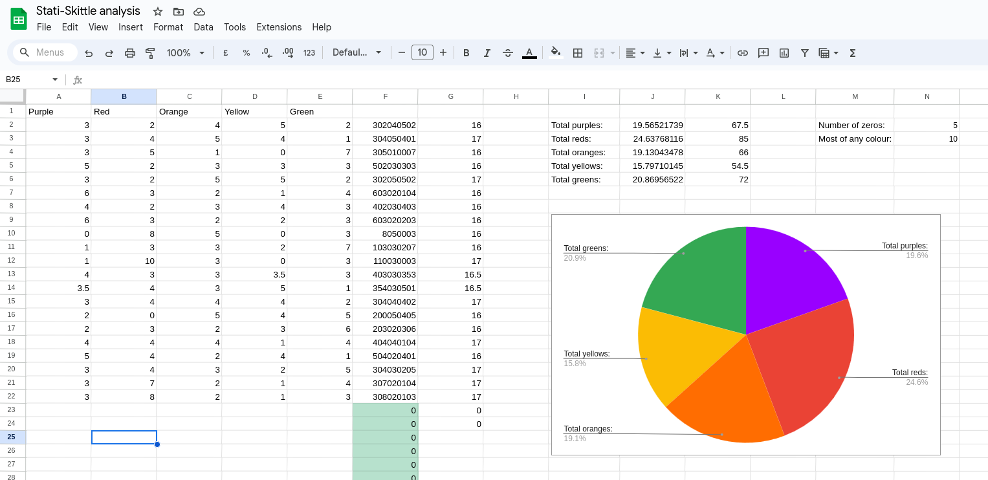

Slide 5
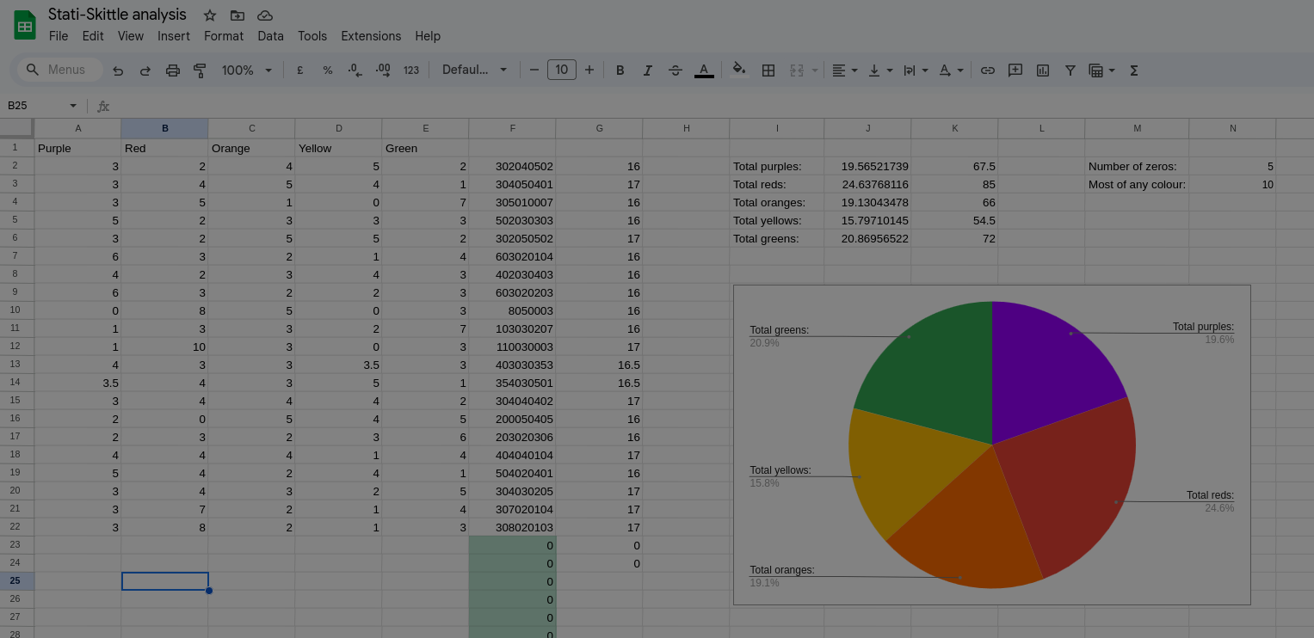


Slide 6
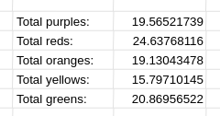

Slide 7


Slide 8
How many different packets of 16 Skittles are there?
Think of it as 20 Things: 16 Skittles and 4 Dividers

Slide 9
P
P
P
P
R
R
R
O
O
Y
Y
Y
Y
G
G
G

Slide 10


This is easy to count: there are
$$\left({20 \atop 4}\right)=4845$$
different packets with 16 skittles, so there are
$$\left({20 \atop 4}\right)+ \left({21 \atop 4}\right)=10830$$
total possible packets.

Slide 11
The birthday paradox
$$ℙ\left(no matches\right)= \frac{10830}{10830} ∗ \frac{10829}{10830} ∗ \frac{10828}{10830} ∗ …$$
We only need 123 bags to get this probability under a half!
(and with 180 packets, it’s around a quarter)

Slide 12
intentionally blank slide while we maybe do some live maths

Slide 13
What if we wanted to find ALL the different packets?
$$H ≈10830 ∗\left(\ln{10830}+0.5\right) ≈106 862$$
That’s more than a million Skittles and way more than we have time for ☹️

