Slide 1
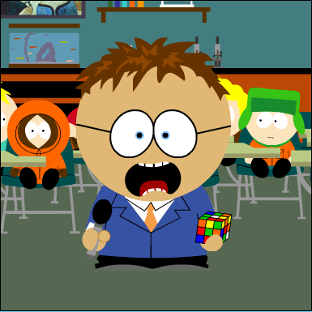

Know Your Place!
Colin Graham
MathsJam Gathering
11th November 2023

Slide 2
Some Rules
A bell may only move up one place, down one place or maintain its place
Every bell must ring in the row before any of them can ring again
There must be no repetition of a row before returning to the starting position (rounds)
An extent consists of n! changes and n! + 1 rows
1 2 3 4 5 6 – Row
X X X – Change
2 1 4 3 6 5

Slide 3
How it Works
A B C
1 2 3
2 1 3
Permutations
( A B )
Place Notation
3

Slide 4
How it Works
A B C
1 2 3
2 1 3
2 3 1
Permutations
( A B )
( B C )
Place Notation
3
1

Slide 5
How it Works
A B C
1 2 3
2 1 3
2 3 1
3 2 1
Permutations
( A B )
( B C )
( A B )
Place Notation
3
1
3

Slide 6
How it Works
A B C
1 2 3
2 1 3
2 3 1
3 2 1
3 1 2
1 3 2
1 2 3
Permutations
( A B )
( B C )
( A B )
( B C )
( A B )
( B C )
Place Notation
3
1
3
1
3
1

Slide 7
How it Works
A B C
1 2 3
2 1 3
2 3 1
3 2 1
3 1 2
1 3 2
1 2 3
Plain Hunt Singles
1 2 3
2 1 3
2 3 1
3 2 1
3 1 2
1 3 2
1 2 3
Permutations
( A B )
( B C )
( A B )
( B C )
( A B )
( B C )
Place Notation
3
1
3
1
3
1

Slide 8
Extensions
Plain Hunt Minimus
1 2 3 4
2 1 4 3
2 4 1 3
4 2 3 1
4 3 2 1
3 4 1 2
3 1 4 2
1 3 2 4
1 2 3 4
Permutations
(AB)(CD)
(BC)
(AB)(CD)
(BC)
(AB)(CD)
(BC)
(AB)(CD)
(BC)
Place Notation
X
14
X
14
X
14
X
14

Slide 9
Extensions
Plain Bob Minimus
1 2 3 4
2 1 4 3
2 4 1 3
4 2 3 1
4 3 2 1
3 4 1 2
3 1 4 2
1 3 2 4
1 3 2 4
Permutations
(AB)(CD)
(BC)
(AB)(CD)
(BC)
(AB)(CD)
(BC)
(AB)(CD)
(CD)
Place Notation
X
14
X
14
X
14
X
12

Slide 10
Extensions
Plain Bob Minimus
1 2 3 4
2 1 4 3
2 4 1 3
4 2 3 1
4 3 2 1
3 4 1 2
3 1 4 2
1 3 2 4
1 3 2 4
Permutations
(AB)(CD)
(BC)
(AB)(CD)
(BC)
(AB)(CD)
(BC)
(AB)(CD)
(CD)
Place Notation
X
14
X
14
X
14
X
12

Slide 11
Extensions
Plain Bob Minimus
1 2 3 4
2 1 4 3
2 4 1 3
4 2 3 1
4 3 2 1
3 4 1 2
3 1 4 2
1 3 2 4
1 3 2 4
Permutations
(AB)(CD)
(BC)
(AB)(CD)
(BC)
(AB)(CD)
(BC)
(AB)(CD)
(CD)
Place Notation
– 14 – 14 le 12

Slide 12
Extensions
Plain Bob Doubles – Lead Ends
1 3 5 2 4
1 5 4 3 2
1 4 2 5 3
1 2 3 4 5
40 Rows

Slide 13
Extensions
Plain Bob Doubles – Lead Ends
1 3 5 2 4
1 5 4 3 2
1 4 2 5 3
1 2 3 4 5
40 Rows
Bob
1 2 3 5 4
1 5 2 4 3

Slide 14
Extensions
Plain Bob Doubles – Lead Ends
1 3 5 2 4
1 5 4 3 2
1 4 2 5 3
1 2 3 4 5
40 Rows
Bob
1 2 3 5 4
1 5 2 4 3
Single
1 3 2 4 5
1 4 3 5 2

Slide 15
Time Scales
An extent on 7 bells would take about 3 hours

Slide 16
Time Scales
An extent on 7 bells would take about 3 hours
An extent on 8 bells would take about 1 day

Slide 17
Time Scales
An extent on 7 bells would take about 3 hours
An extent on 8 bells would take about 1 day
An extent on 19 bells would take about 7.7 billion years

Slide 18
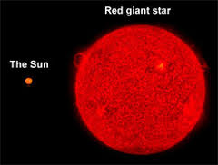
Time Scales
An extent on 7 bells would take about 3 hours
An extent on 8 bells would take about 1 day
An extent on 19 bells would take
In about 7.5 billion years

Slide 19
Time Scales
An extent on 7 bells would take about 3 hours
An extent on 8 bells would take about 1 day
An extent on 19 bells would take
In about 7.5 billion years
Bye bye Earth!

Slide 20

That’s All!
https://bit.ly/PlaceNotation

