Slide 1
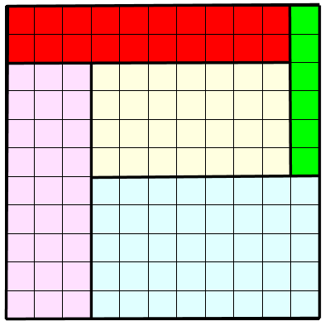
Rectangling Squares and Rectangles
MathsJam 2023
Donald Bell – donald@marchland.org

Slide 2
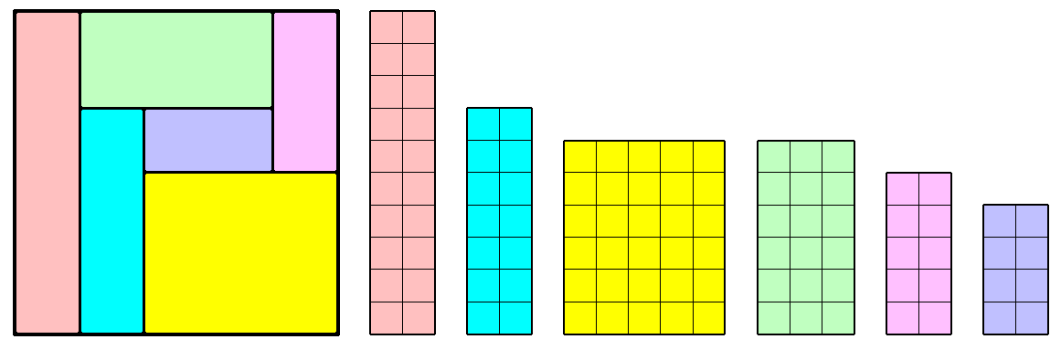
The First Problem:
A rectangle has two lengths of side, its height and its width
Can you divide a square into N rectangles so that all 2N of the lengths of sides are different?
In particular, can they be all the integers from 1 to 2N?
Not quite right, still some duplicate lengths of side

Slide 3
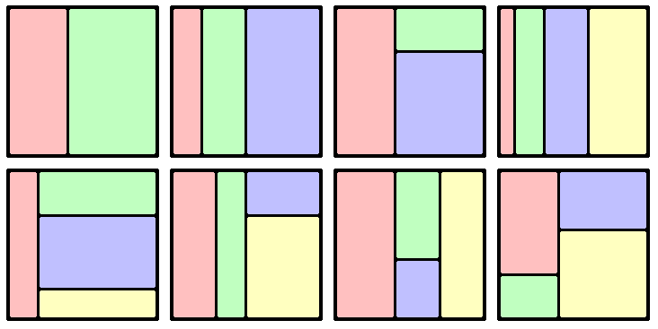
Dividing a square into N rectangles (1)
If a square is divided into only 2, 3 or 4 rectangles, then there will always be at least one repeat of a length of side

Slide 4
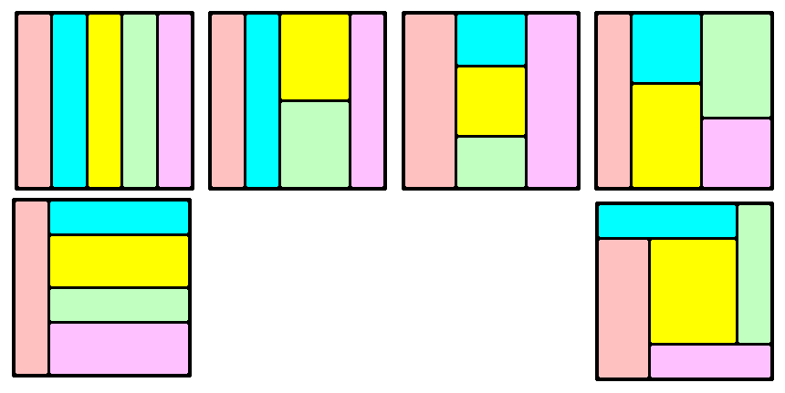
Dividing a square into N rectangles (2)
Nearly all of the ways of dividing a square into five rectangles have at least one repetition of a length of side
But this one might not!

Slide 5
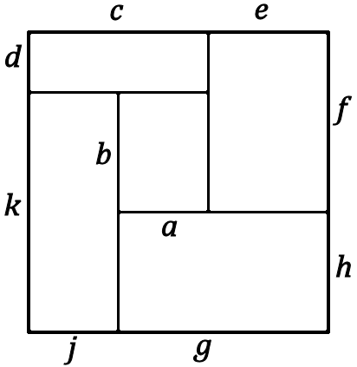
Searching for a solution
with no repeated length of side
Label the rectangles like this:
a⨯ b c⨯ d e⨯ f
g⨯ h j⨯ k
Then choose different values for
a, b, c, d, e
and all the rest will follow:
side = c + e f = b + d
g = a + e h = side – f
j = side – g k = side – d
A search program, looping through a range of values for a, b, c, d and e should then work. Easy to write in Python.

Slide 6
Rectangling the Square – finding a solution
If there is a solution, where the 10 different edge lengths are the integers 1 to 10, then the minimum square is 11⨯11.
To start with, divide the top edge into 10 and 1. In the Python search program, set c = 10 and
e = 1 and proceed from there.
But, long before Python, Bertie Smith and M. den Hertog found two solutions to the problem. This is one of them.
The rectangles are 1⨯6, 2⨯10, 3⨯9, 4⨯7 and 5⨯8.
So there are no repeated lengths.

Slide 7
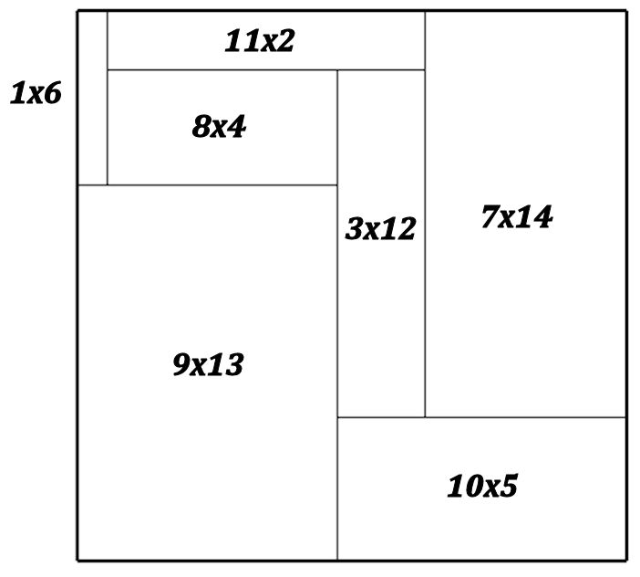
Rectangling a bigger square
There is no solution for N = 6.
So you can't divide a square into six rectangles whose sides are only the numbers 1 to 12.
But there are several solutions for N = 7. This square is divided into seven rectangles whose sides are 1 to 14

Slide 8
The Second Problem
Can you find a set of rectangles, again with no repeated length of side, that can be assembled into a rectangle in TWO different ways? (neither of them has to be a square).
This one turned out to be too difficult for me, so I put it on Mastodon. David Radcliffe found a whole family of solutions using five rectangles.
He showed that by giving values to just two parameters, a set of five rectangles can be produced that will form a rectangle in two different ways. There is still a need to check that all the edge lengths are different.
(his solution is used here by permission)

Slide 9
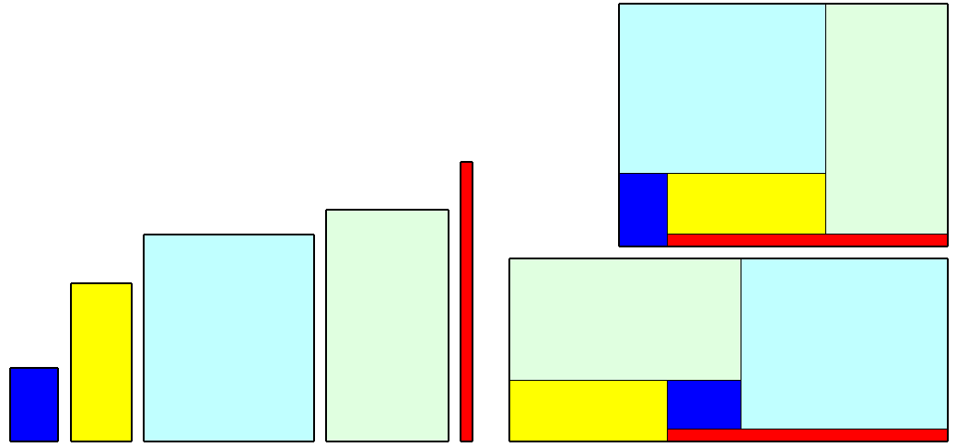
David Radcliffe's solution to the problem of two rectangled rectangles
The dimensions of these five rectangles are:
4 ⨯ 6, 5 ⨯ 13, 14 ⨯ 17, 10 ⨯ 19 and 1 ⨯ 23
The assembled rectangles are:
27 ⨯ 20 and 36 ⨯ 15
The general parametric solution, using a and b is: b⨯ (2a+b),
(a+b)⨯ (a+3b), (2a+3b)⨯ (a+4b), (2a+2b)⨯ (3a+4b), a⨯ (3a+5b)
If a = 1 and b = 4, for example, the numbers are all different.

Slide 10
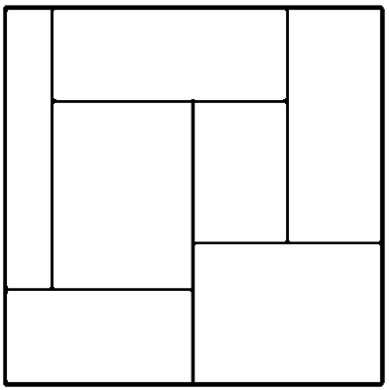
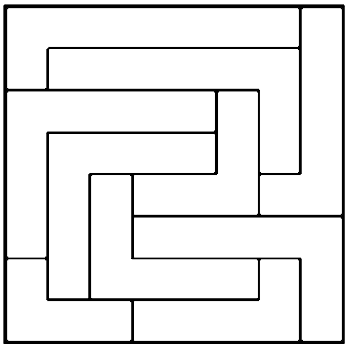
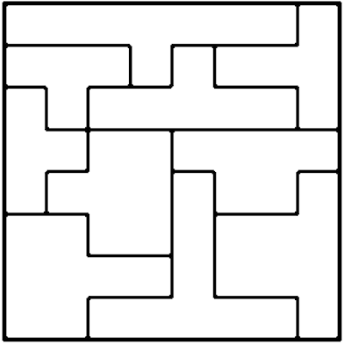
More Rectangled Squares and Rectangles
There are many opportunities for puzzles based on the dissection of squares into various sizes of rectangles, L-shapes or T-shapes.
See my Saturday Night Table.

