Slide 1

Gender in the Groove:
Are Half Our Tunes Topped by Dudes?
Hannah Gray
and
ChatGPT

Slide 2


Why?
Let’s play guess that tune …

Slide 3
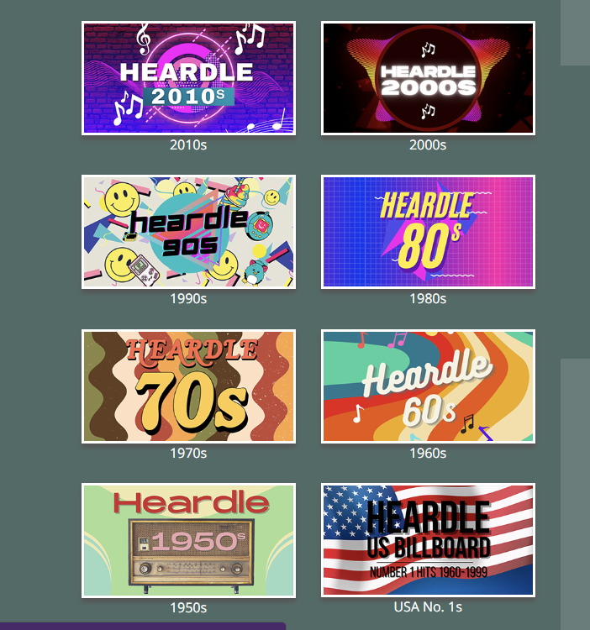
https://heardledecades.com/

Slide 4

“It’s a male…”
“Well, I’ve narrowed it down to 50%...”

Slide 5
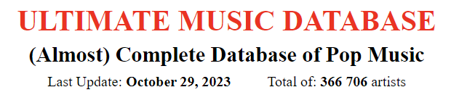
Extensive research…
ChatGPT was unhelpful…
“I don't have access to specific historical data like the UK Top 40 charts from a particular week in 1954. You may be able to find that information in historical records, archives, or through music chart databases that specialize in historical chart data.”
… so I searched internet forums …
http://www.umdmusic.com/

Slide 6
Random week from each year
1952 - 2023
Top 50 UK singles
Male/Female/Mixed/No Lyrics
A large spreadsheet and
hours later …

Slide 7
“It’s a male…”
“Well, I’ve narrowed it down to 50%...”

Slide 8
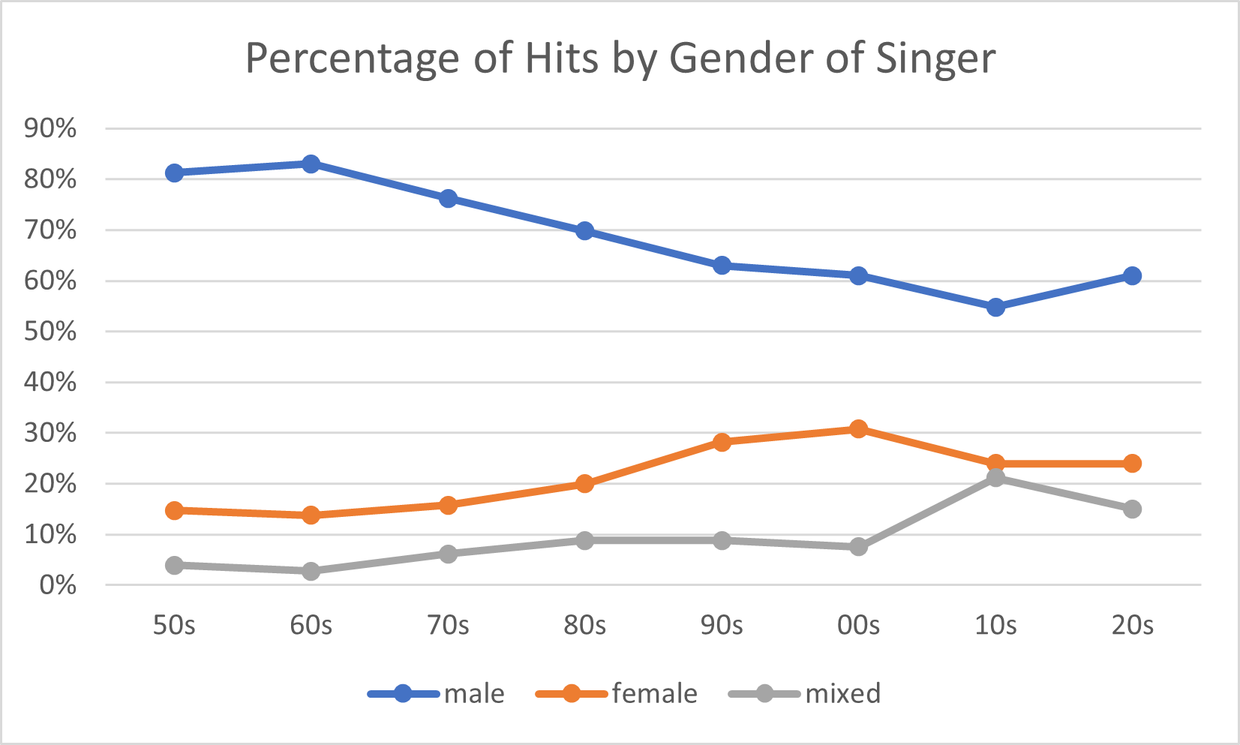

Slide 9
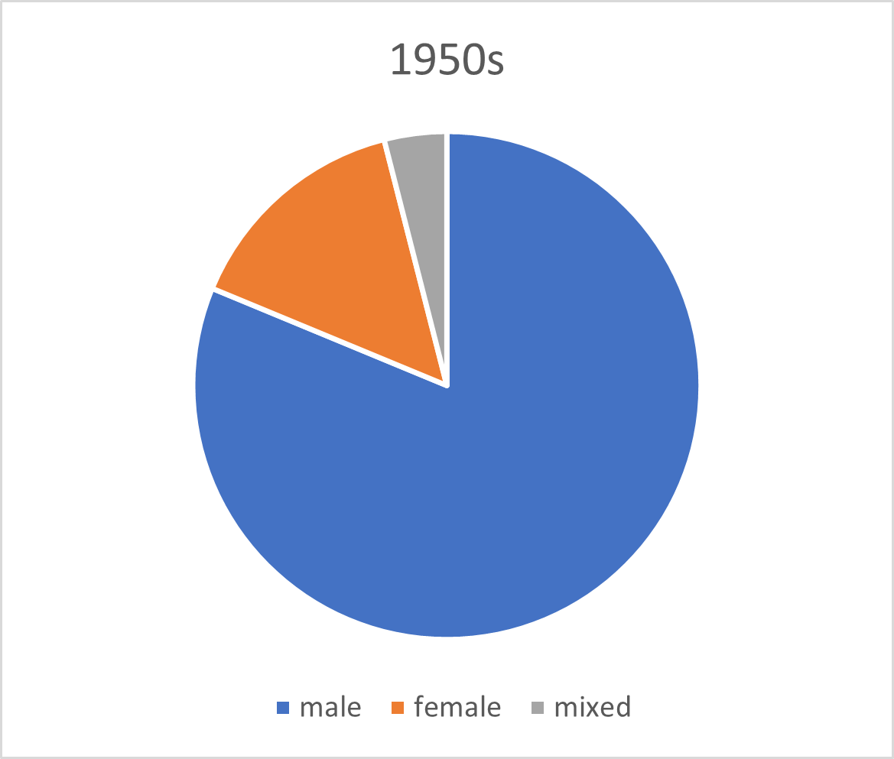
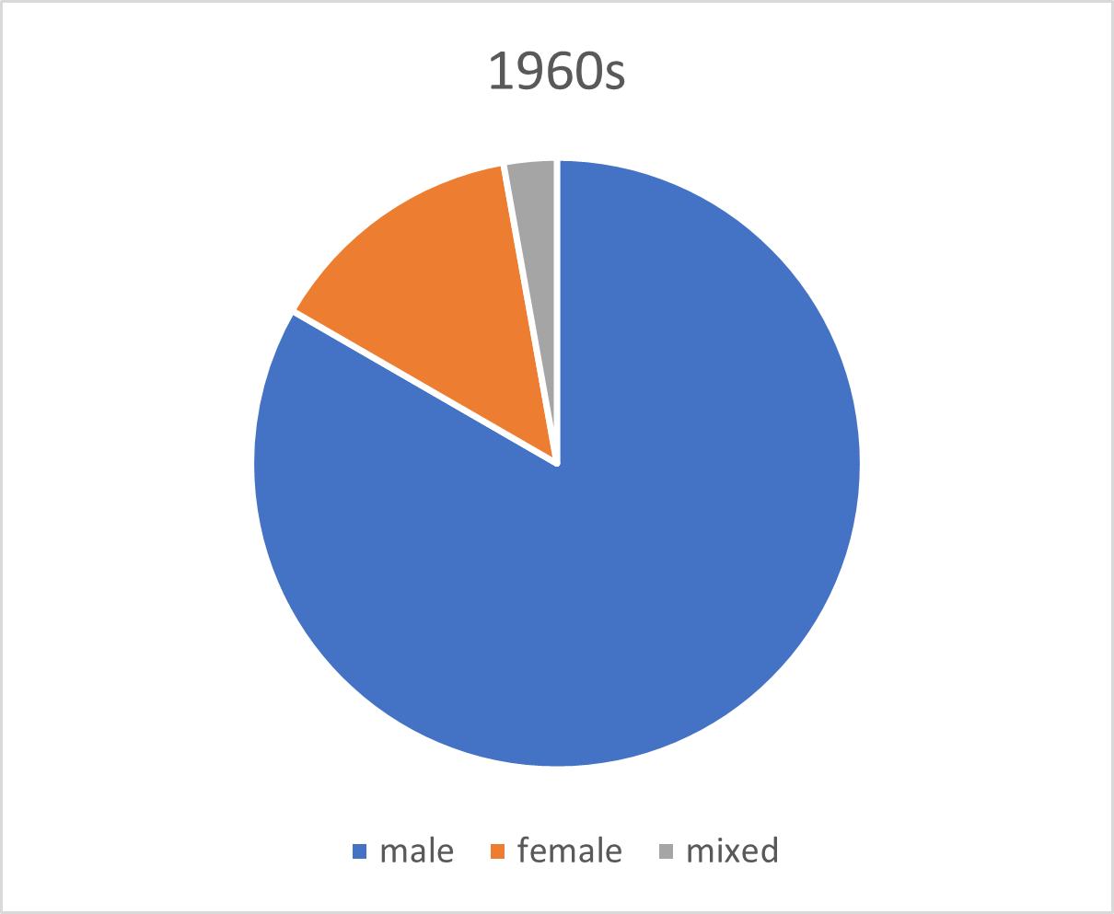
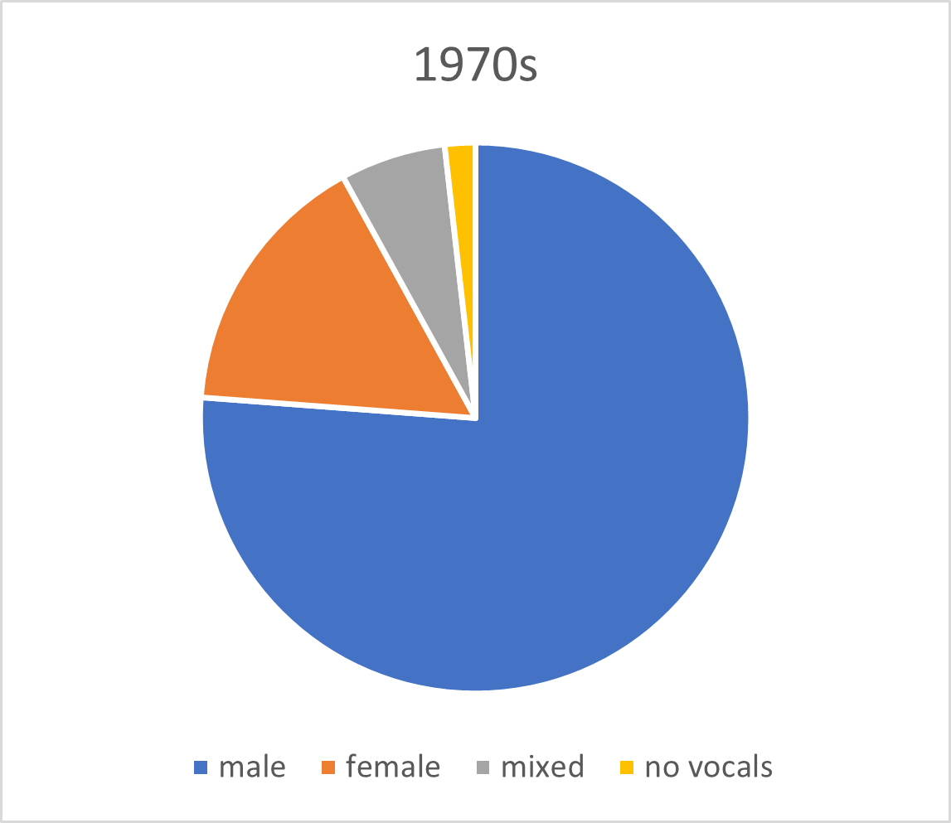
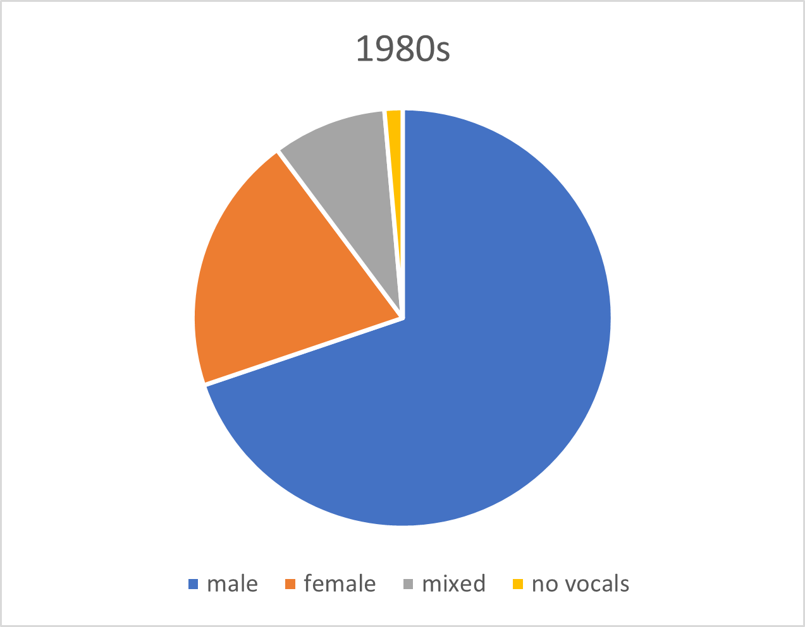

Slide 10
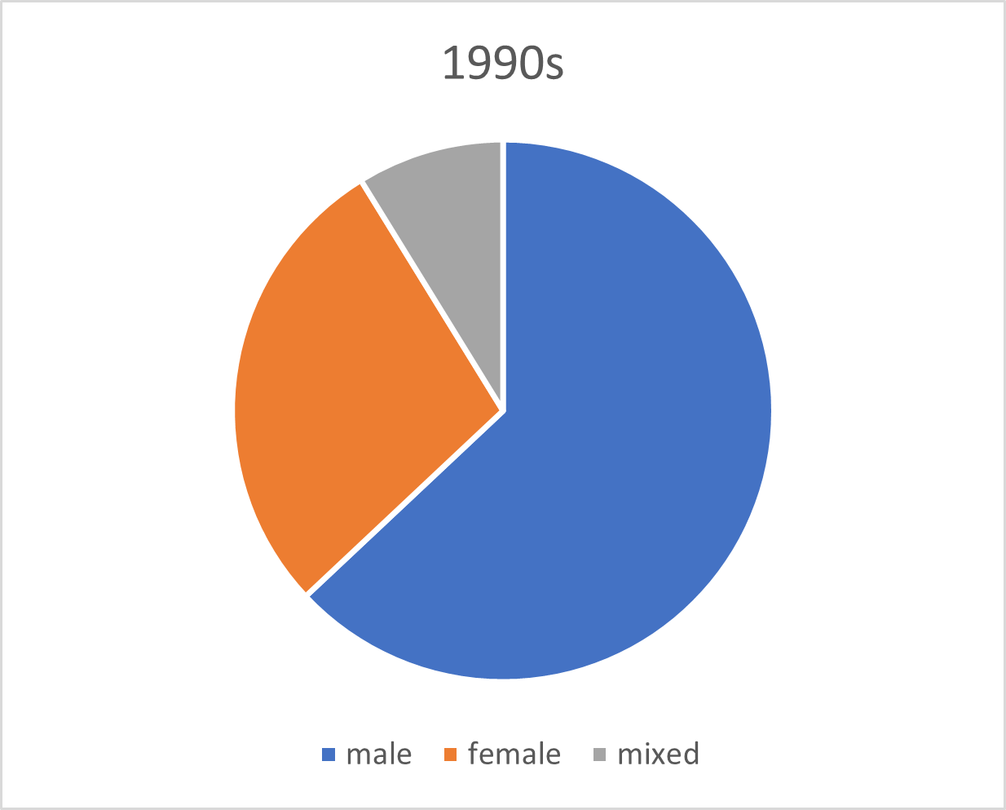

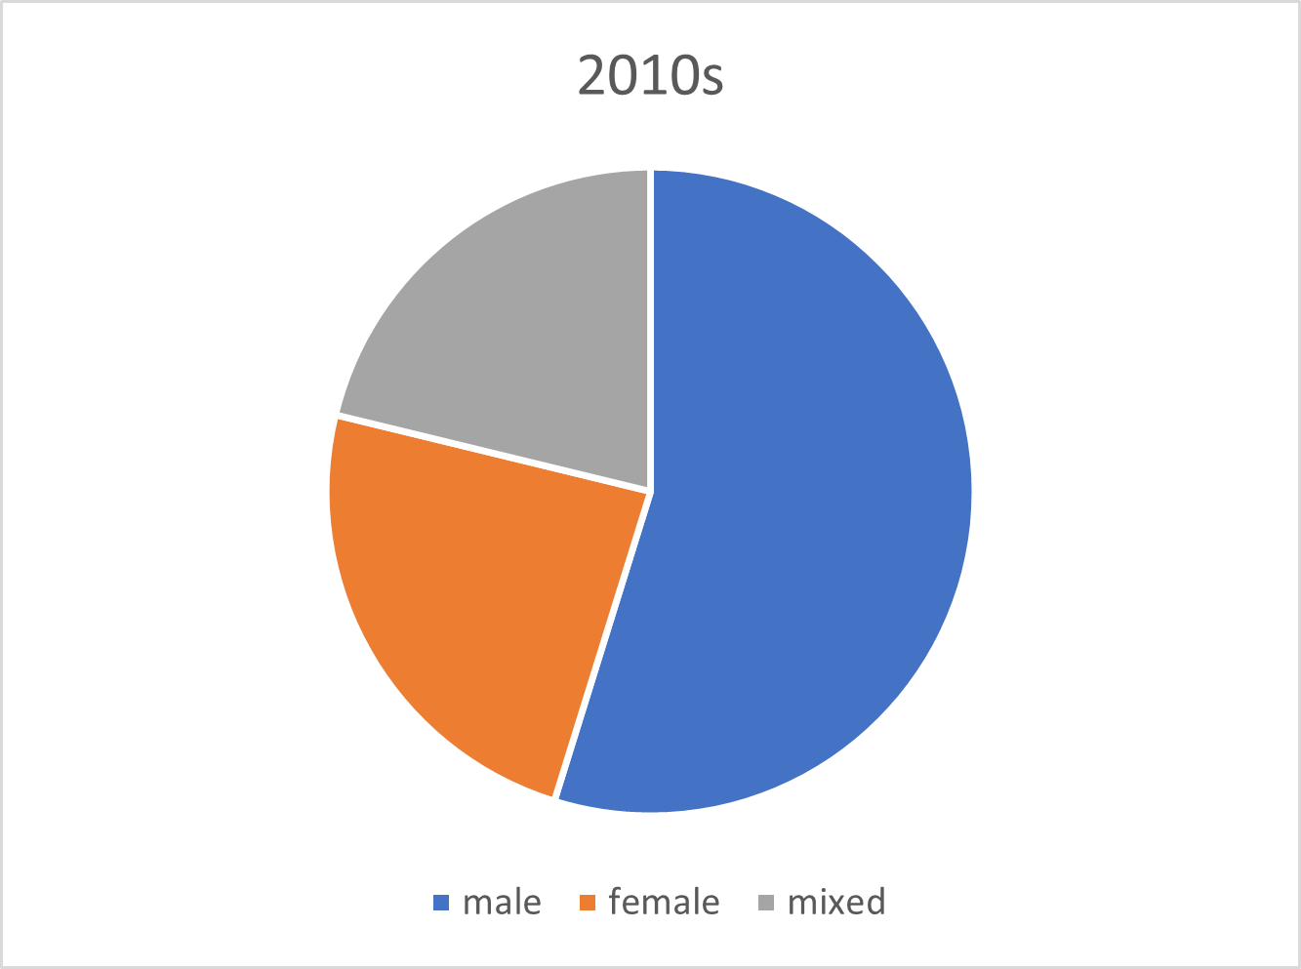
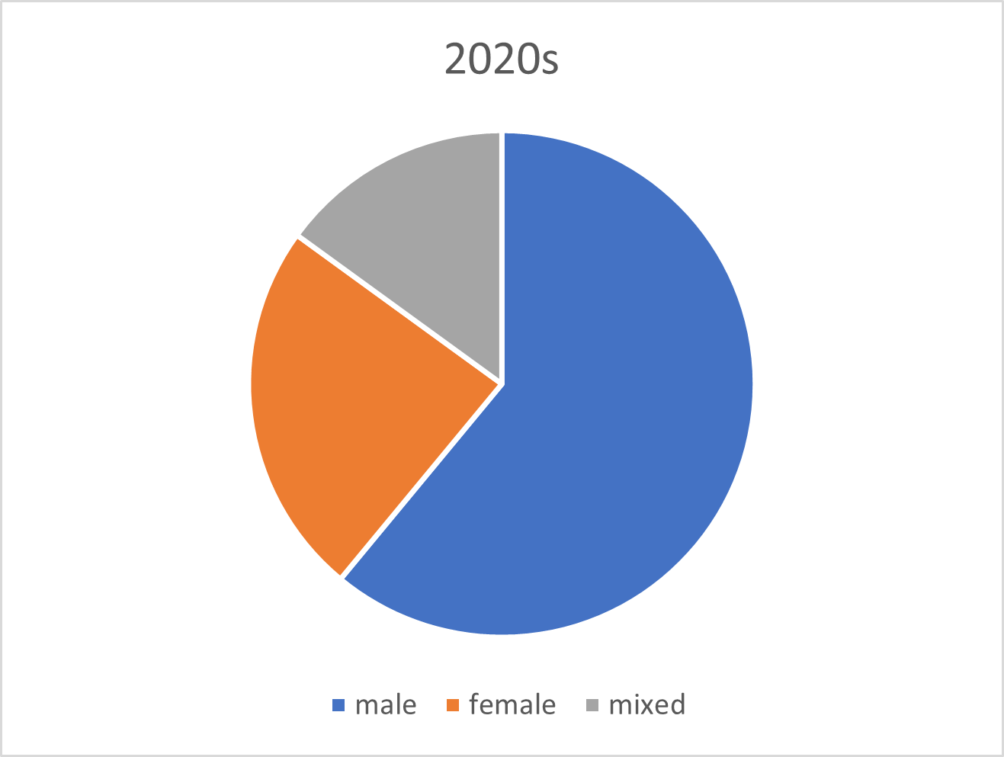
Hooray for Girl Power!
Notes:
Never thought I would thank the Spice Girls for anything!
A load of DJs and remixes and rappers.

Slide 11
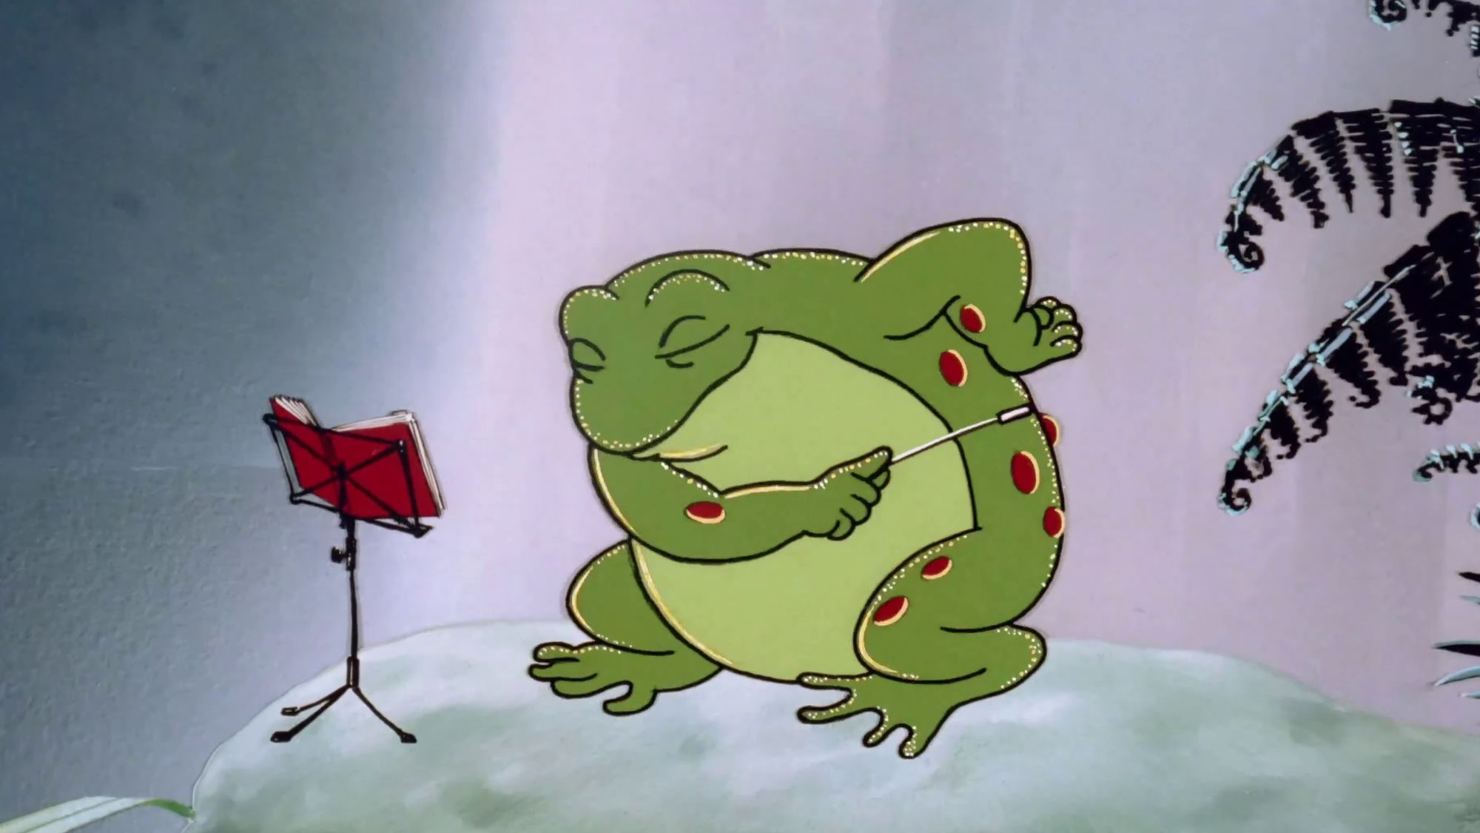
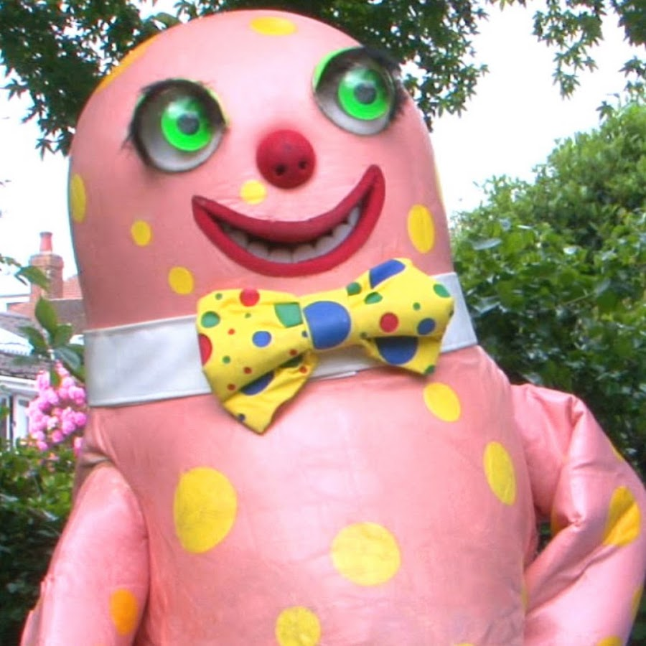
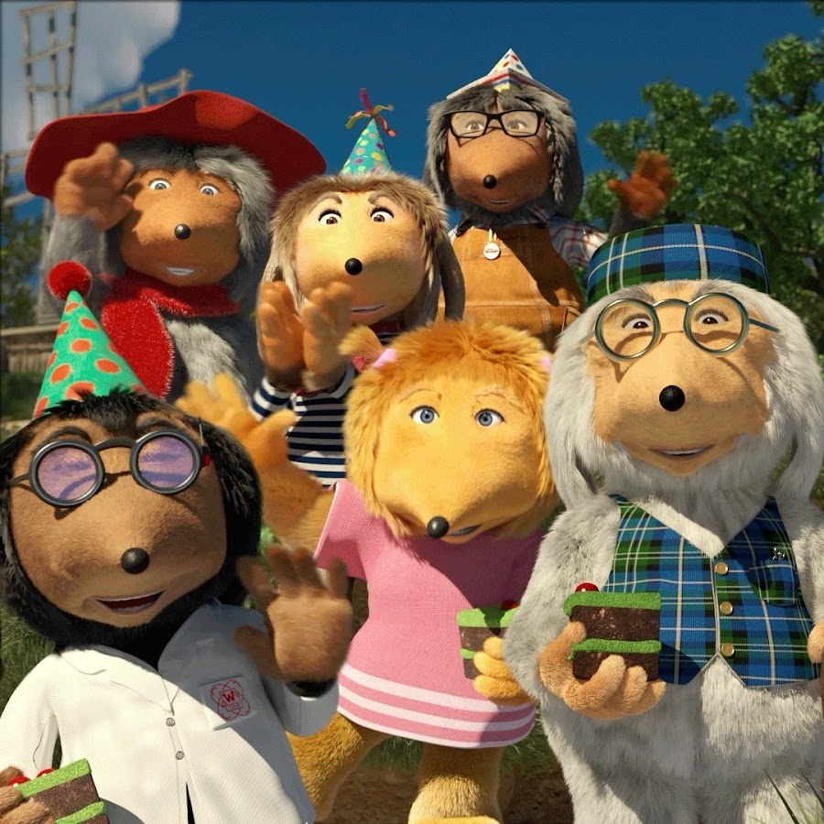
Problems
Notes:
Lots of data
No longer bi gender
Sometimes hard to classify
Artists hard to categorise

Slide 12
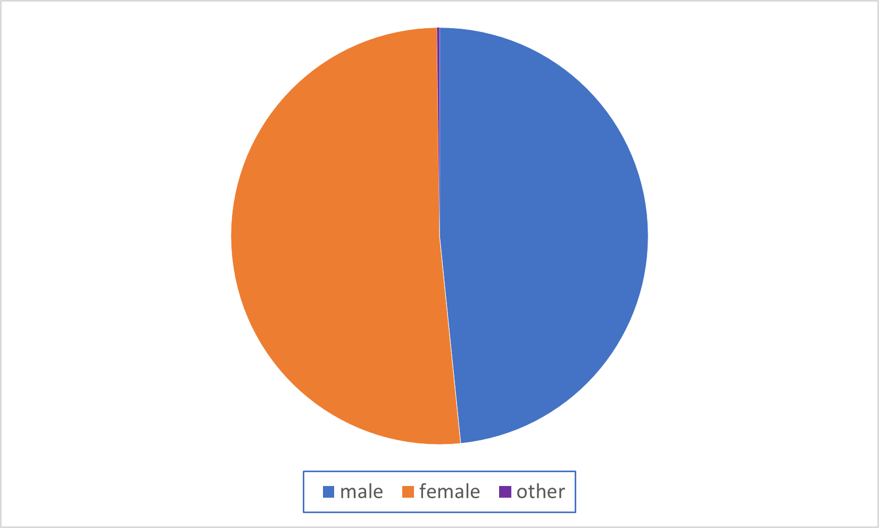
What should the charts look like?
UK Census Data 2021

Slide 13
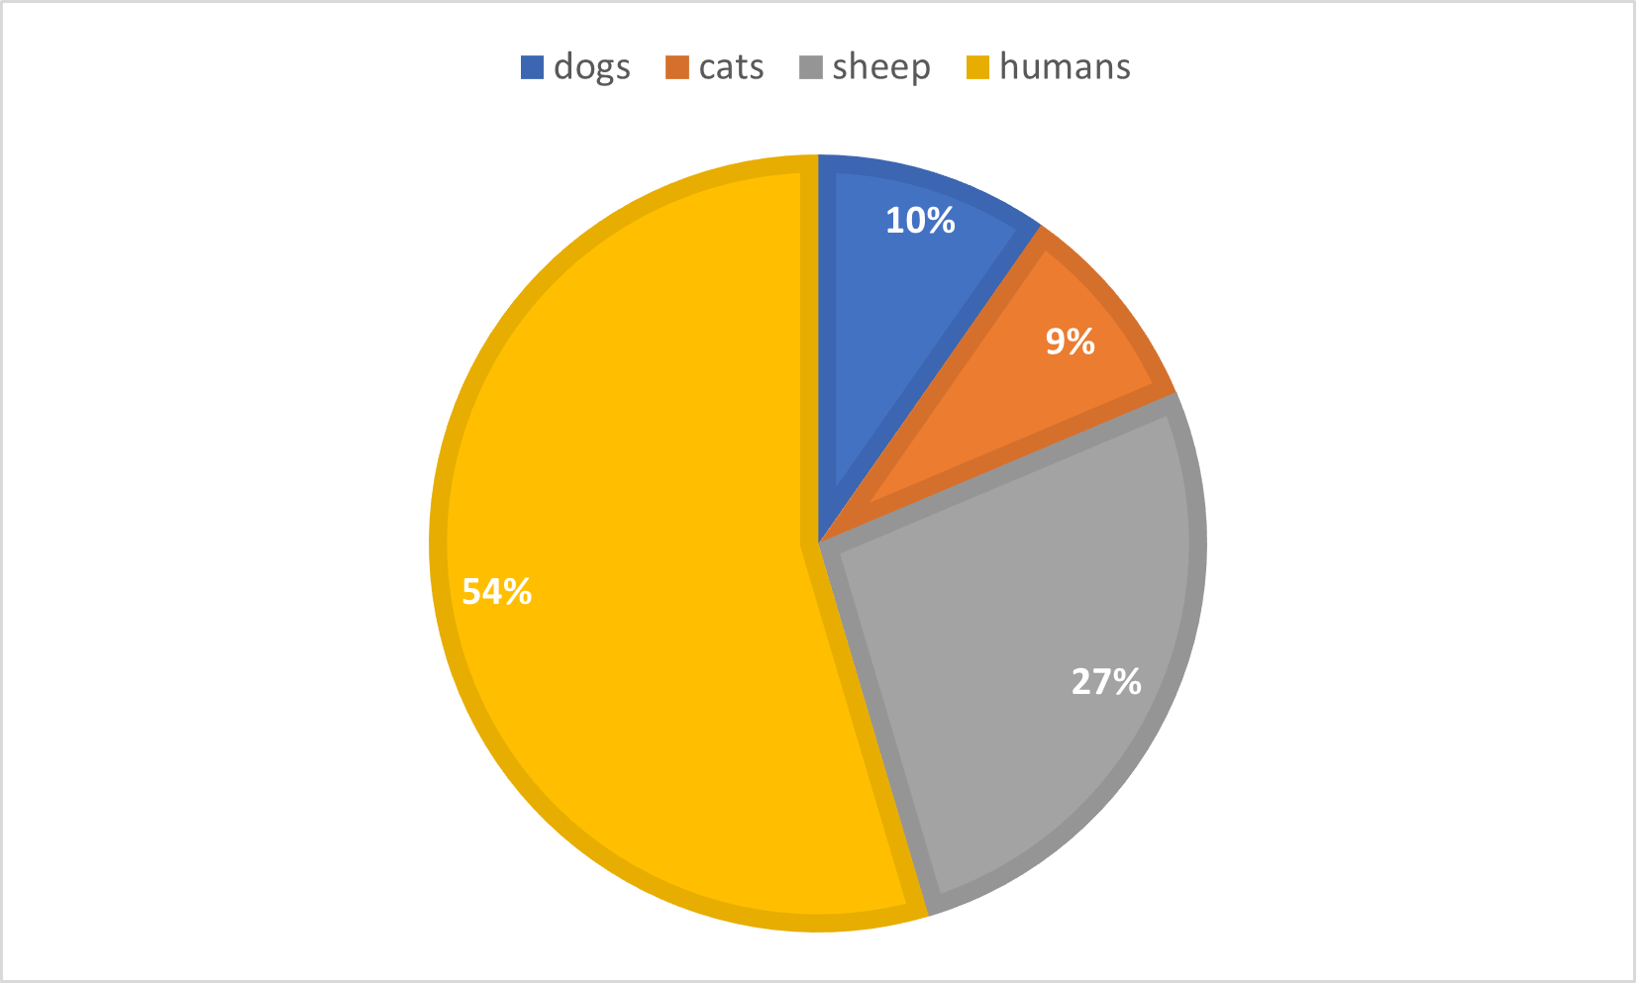

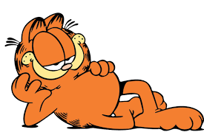
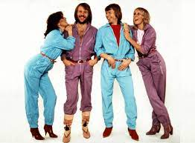
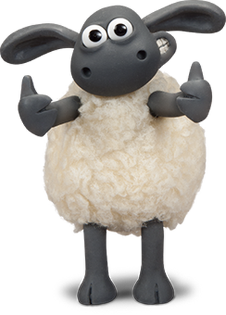
What should the charts look like?

Slide 14

The Future?
“It’s a computer …”

Slide 15
Conclusion
Male voices still dominate the charts
Heardle is a great way to pass car journeys.
Never write a mathsjam talk just to prove a point.
My Spotify list and google searches are going to be messed up for weeks.

