Slide 1
Diffy N-gons
What happens if we apply the rules and processes used for Diffy Squares to other polygons

Slide 2
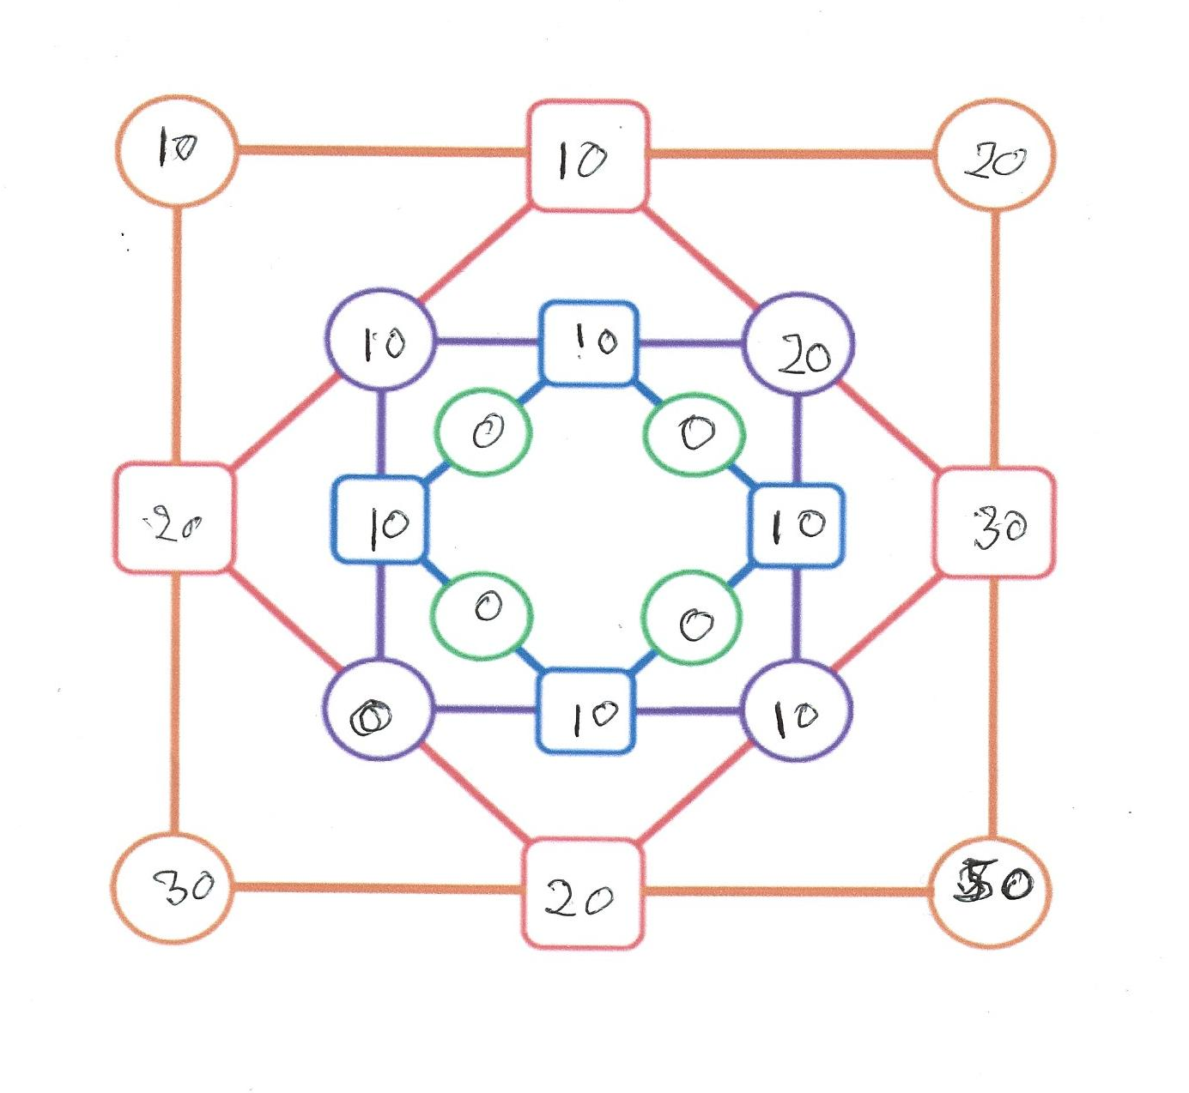

Slide 3
Some Properties of a Diffy Square
All Diffy Squares reduce to the zero Diffy in a finite number of steps
The number of steps required depends on the starting values
For given starting vales steps to the zero diffy is constant under addition and multiplication by a constant number and the symmetry of a square
A given a set of four distinct numbers can be up to 3 different number of steps depending on how they are arranged (19,3,45,103) needs 5 steps, (3,19,45,103) needs 7 steps and (3,103,19.45) needs only 4 steps to reach the 0 diffy. Property 3 means that in this case there are 8 arrangements for each number of steps 3X8 =24 the size of the permutation group of size 4

Slide 4
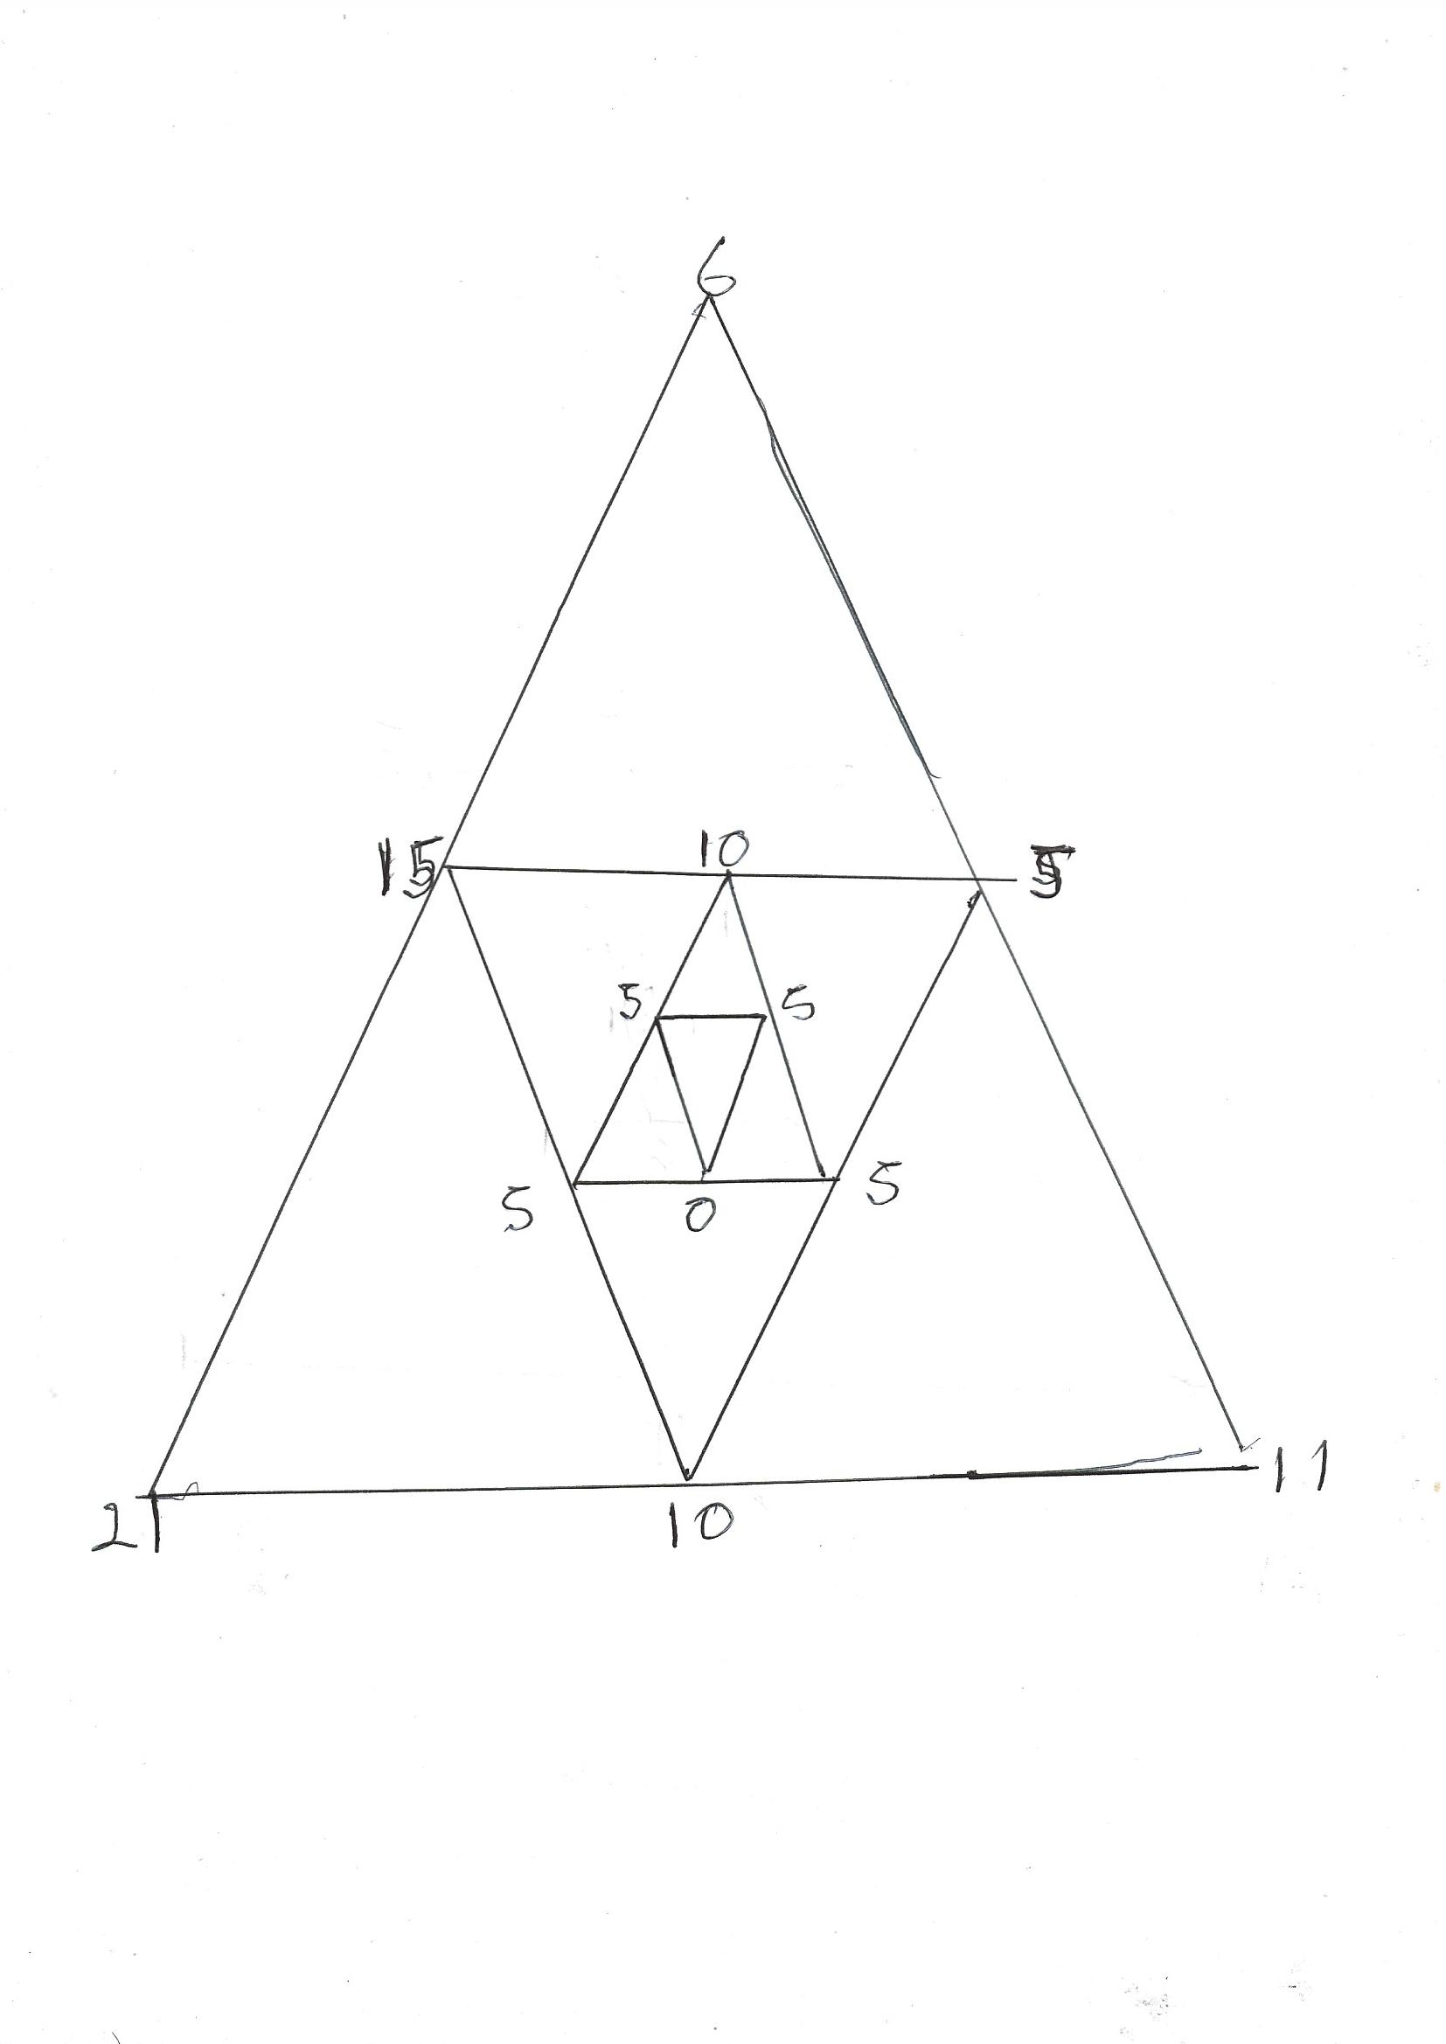

Slide 5
The Diffy Triangle
Three equal numbers is the only case that reduces to the zero Triangle This stating position I refer to as the Trivial Diffy.
All other starting positions reach a cycle point
The previous slide shows a starting position (6,11,21), it reaches (0,5.5) and then repeats for ever.
Changing the starting numbers can change the number of steps to the cycle Pont.

Slide 6
The Diffy 5-gon
NB at this point I stared using a spreadsheet so I could test lots of examples
The trivial diffy goes to the zero diffy in one step
All other values tested lead to a cycle step. The starting position (11,15,17.24.28) reaches a cycle point at step 12. (0,0,1,1,0) which repeats every 15th steps.
So is this a feature of n-gons were n is odd What about a Diffy 7-Gon

Slide 7
The Diffy 7-Gon
Apart from the trivial 7-gon all other starting positions tested result in a cycle point
Example (13,27.45.101,201,302,351) reaches a cycle point in 42 steps (1,0,1,0,1,1,0) and repeats every 7 steps.
So what about even n-gons

Slide 8
The Diffy 6-gon
There are some starting positions that result in the zero diffy the trivial diffy and what I have called the alternating diffy are two of them For example (3,5,3,5,3,5) which in one step reduces to the trivial diffy (1,1,1,1,1,1). Also (0,10,20,10,0.10) reduces to the trivial diffy (10,10,10,10,10,10). The common feature is that there is constant difference between each value. (The constant difference diffy)
All others tested end in a repeating cycle. For example (11,17,23,45,63,77) reach a cycle on step 19, (0,0,0,4,0,4) , repeats every 6 steps

Slide 9
The Diffy 8-gon
All diffy 8-gons tried reduced to the 0-diffy
Example
Stating values, (4,11,31,71,82.83.101.201)
Reduced to the 0-diffy in 19 steps
The last two steps were the alternating diffy or a constant difference diffy followed by the trivial diffy
So we always get the zero diffy for n=4 and n=8 what about other powers of 2.

Slide 10
The diffy 16-gon and 32-gon
Tried a number of different starting positions for each (thankful for the spreadsheet)
Every case reduced to the zero diffy
For all tried the last two steps were the alternating diffy or a constant difference diffy followed by the trivial diffy.

Slide 11
The Diffy 9-Gon
Question given that diffy 4,8.16,32-gons reduced to the zero Diffy what about other prime powers.
There is the trivial diffy, For odd n it is not possible to have a alternating diffy and no constant value diffy was found
So all other diffy 9-gons tried always reached a cycle step
For example (7,11,13,19,21,33,45,53.77) reaches a cycle in 26 steps (2,2,0,0,2,2,2,2,0)) and then repeats every 63 steps.

Slide 12
So the main conjectures so far is:-
For all diffy n-gons where n is a power of 2 all starting positions will result in the 0-diffy
For odd n the only the trivial diffy will reduce to the 0-diffy
For even n not a power of 2 only the alternating diffy the constant value diffy and the trivial diffy will result in the 0-diffy. All others reach a cycle point

Slide 13
Some Next steps
Investigate the relationship of the symmetry of the n-gons to the permutation groups and how the starting values and the arrangement of the starting values affect the steps to the 0-diffy or the cycle point.
The constant diffy for the 6-gon (0.10.20.10.0.10) used 3 different values. Can constant distant diffys be found using other values
Prove the result for powers of 2

