Slide 1



A 19th century lottery
– with a deck of cards
Pedro Freitas and Jorge Nuno Silva
FCUL and CIUHCT
MathsJam Gathering
November 11 and 12, 2023
Supported by FCT, I.P. through projects UIDB/00286/2020 and UIDP/00286/2020

Slide 2
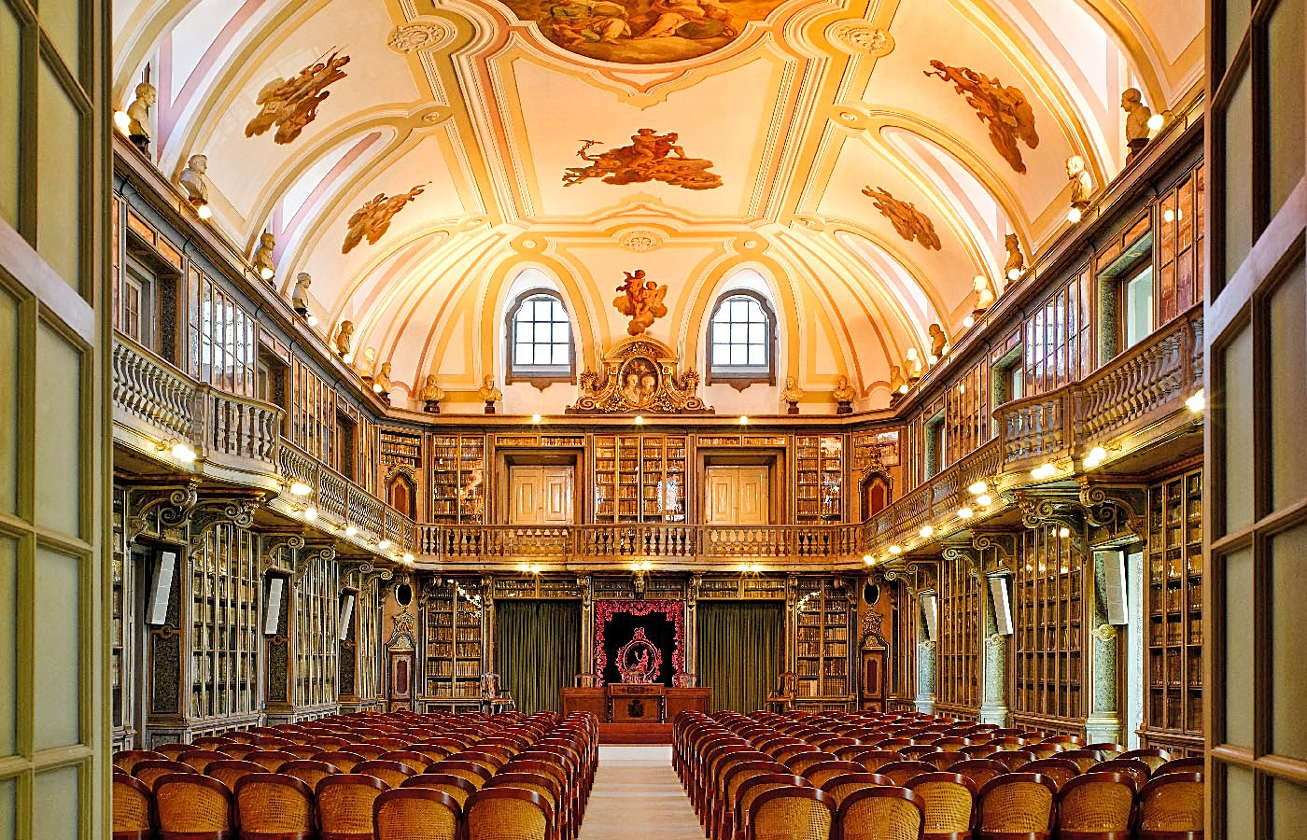
Francisco Giraldes Barba
Francisco Barba (June 5, 1780 - April 15, 1855) was a Portuguese scholar and nobleman, with a military career and a corresponding member of the Portuguese Academy of Sciences.
In 1834, he published an essay, with a lottery plan. The main novelty of the plan was that it was implemented with a deck of cards and could be played as a social recreation.
Probably inspired by Ozanam’s Récréations mathématiques (1770).

Slide 3
The lottery
The main ideas:
- Two decks are used, one for the Bank and another one to be distributed among the Players.
- A lottery ticket is a triplet of cards.
- Each Player must pay an entry for each ticket they hold.
- According to the cards drawn by the Bank, some cards will be null, some will have a small prize (equal to the value of the entry), and some will have a big prize.
- The prizes are designed to assure a 12% profit to the Bank.

Slide 4
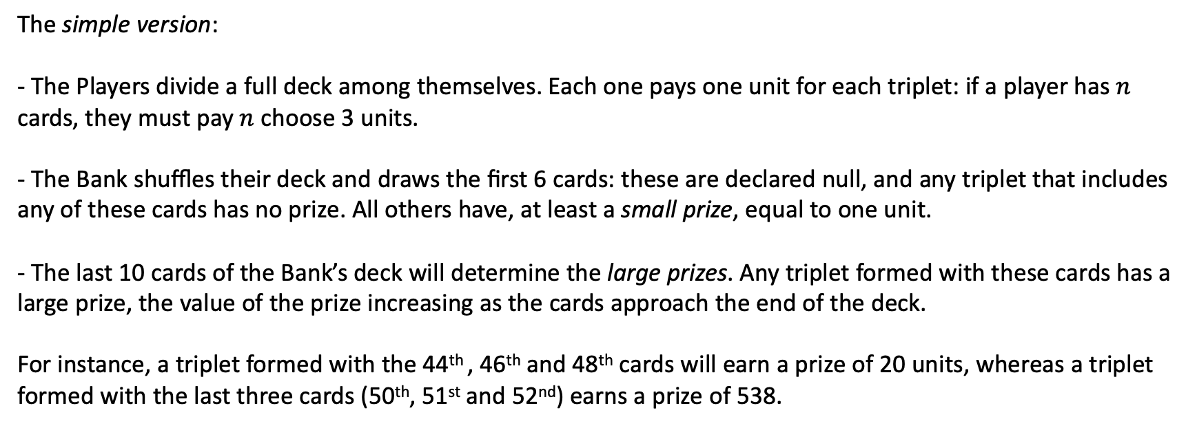
The lottery plan
The simple version:
- The Players divide a full deck among themselves. Each one pays one unit for each triplet: if a player has $n$ cards, they must pay $n$ choose 3 units.
- The Bank shuffles their deck and draws the first 6 cards: these are declared null, and any triplet that includes any of these cards has no prize. All others have, at least a small prize, equal to one unit.
- The last 10 cards of the Bank’s deck will determine the large prizes. Any triplet formed with these cards has a large prize, the value of the prize increasing as the cards approach the end of the deck.
For instance, a triplet formed with the 44th , 46th and 48th cards will earn a prize of 20 units, whereas a triplet formed with the last three cards (50th, 51st and 52nd) earns a prize of 538.

Slide 5
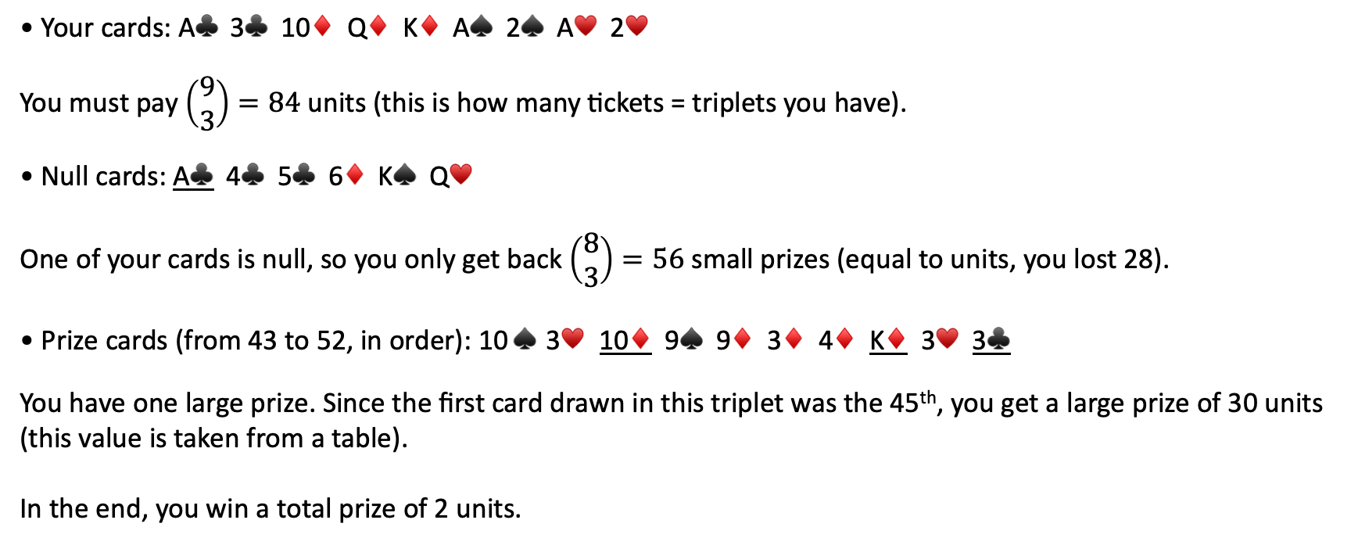
An example
• Your cards: A♣️ 3♣️ 10♦️ Q♦️ K♦️ A♠ 2♠ A♥️ 2♥️
You must pay $\left(\begin{matrix}9 \\ 3\end{matrix}\right)=84$ units (this is how many tickets = triplets you have).
• Null cards: A♣️ 4♣️ 5♣️ 6♦️ K♠ Q♥️
One of your cards is null, so you only get back $\left(\begin{matrix}8 \\ 3\end{matrix}\right)=56$ small prizes (equal to units, you lost 28).
• Prize cards (from 43 to 52, in order): 10 ♠ 3♥️ 10♦️ 9♠ 9♦️ 3♦️ 4♦️ K♦️ 3♥️ 3♣️
You have one large prize. Since the first card drawn in this triplet was the 45th, you get a large prize of 30 units (this value is taken from a table).
In the end, you win a total prize of 2 units.

Slide 6
Documents
In this implementation, not all triplets are in play in a game, and not all prizes are given.
However, the author suggests a way of accomplishing this.
The author establishes an order in the deck and defines the document of a card as the set of all triplets formed by that card and two preceding ones.
The main feature:
Documents are a partition of the set of triplets
In document play, each card held by a Player represents its document.
He suggests that only a half deck can be used, so that the numbers do not get too big.
The author has many tables to help with computations.

Slide 7
An exemple with 26 cards
• Your cards: A♣️ 3♣️ 5♣️ 4♦️ 6♦️ (in order)
• Null cards: 4♣️ 3♦️ 4♦️ Q♦️
The 4♦️ generates blank tickets in the documents 4♦️ (all) and 6♦️ (some). Same for 4♣️ and 3♦️.
Total: 180 blank tickets.
• Prize cards (from 17 to 26, in the order they were drawn): 3♣️ K♣️ J♦️ A♠ 2♣️ 5♦️ 6♣️ 6♦️ 5♣️ A♣️
Document 6♦️ has 21 prizes, document 5♣️ has 3 prizes and document 3♣️ has one prize.
Total: 328 units.
In the end, you win a total prize of 328 – 180 = 148 units

Slide 8
