Slide 1
Ten to the Top
But Nine to the…
…what?
Sam Hartburn

Slide 2



Popmaster
Ten to the Top

Slide 3


Slide 4
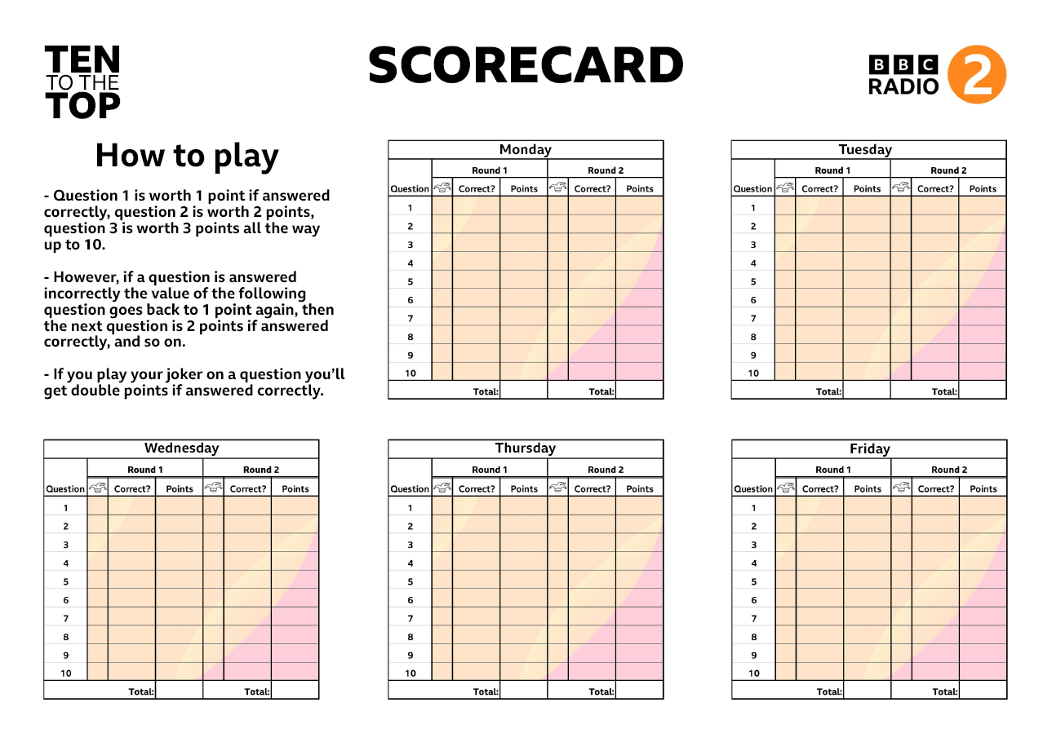

Slide 5
Question | Correct? | Points
1 | ✓ | 1
2
3 | ✓ | 1
4 | ✓ | 2
5 | ✓ | 3
6
7 | ✓ | 1
8 | ✓ | 2
9 | ✓ | 3
10 | ✓ | 4
Total | 8 | 17

Slide 6
9
8 + 1
7 + 2
7 + 1 + 1
6 + 3
6 + 2 + 1
6 + 1 + 1 + 1
5 + 4
5 + 3 + 1
5 + 2 + 2
5 + 2 + 1 + 1
5 + 1 + 1 + 1 + 1
4 + 4 + 1
4 + 3 + 2
4 + 3 + 1 + 1
4 + 2 + 2 + 1
4 + 2 + 1 + 1 + 1
4 + 1 + 1 + 1 + 1 + 1
3 + 3 + 3
3 + 3 + 2 + 1
3 + 3 + 1 + 1 + 1
3 + 2 + 2 + 2
3 + 2 + 2 + 1 + 1
3 + 2 + 1 + 1 + 1 + 1
3 + 1 + 1 + 1 + 1 + 1 + 1
2 + 2 + 2 + 2 + 1
2 + 2 + 2 + 1 + 1 + 1
2 + 2 + 1 + 1 + 1 + 1 + 1
2 + 1 + 1 + 1 + 1 + 1 + 1 + 1
1 + 1 + 1 + 1 + 1 + 1 + 1 + 1 + 1

Slide 7
9
8 + 1
7 + 2
6 + 3
5 + 4
45
37
31
27
25

Slide 8
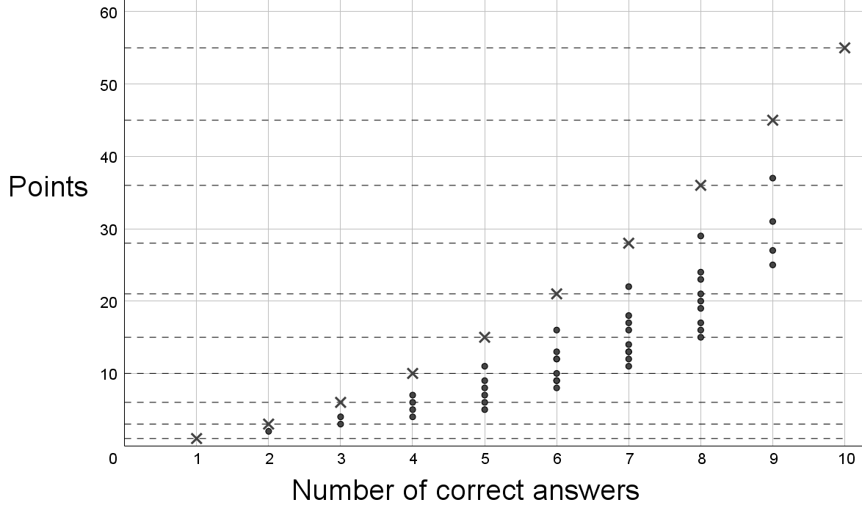

Slide 9
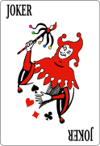


Slide 10
How else could this quiz be made
fairer or more strategic?
What other interesting scoring
systems are there?

