Slide 1
A cool magic square
Tony Mann
A.Mann@gre.ac.uk

Slide 2
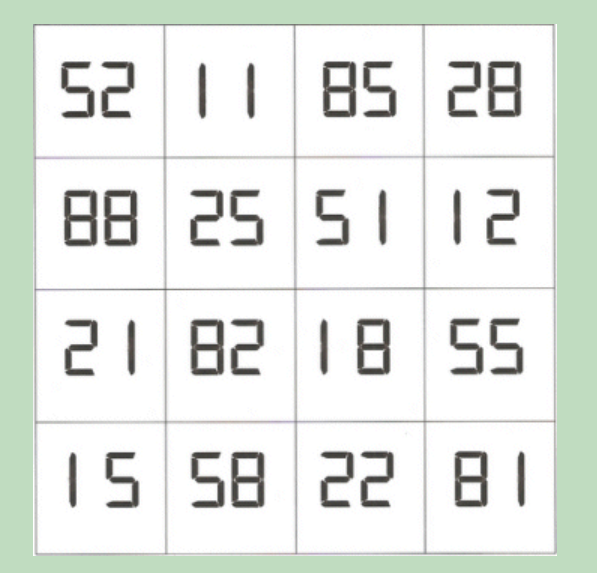
Chris Wardle’s Reflections Magic Square www.markfarrar.co.uk/chris-wardles-reflections-magic-square.htm Thanks also to Grand Illusions grand-illusions.com

Slide 3
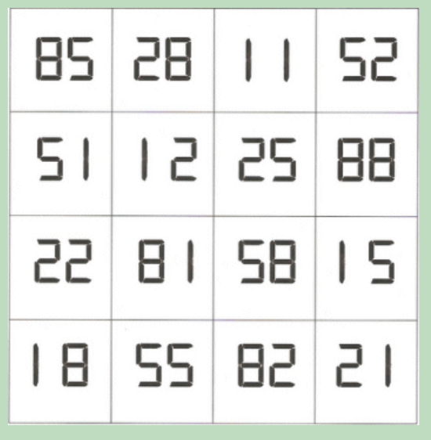
Four magic squares with row sum 176

Slide 4
Thankyou.

